Slide 1
Caring with Compassion for Children and Families
Compassion in Action Webinar Series
July 27, 2018

Slide 2
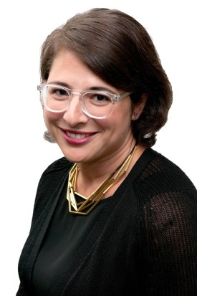
Moderator
Stephanie Adler Yuan
Director, Education & Training
The Schwartz Center for Compassionate Healthcare

Slide 3
Audience Reminders
This webinar is funded in part by a donation in memory of Julian and Eunice Cohen.
You may submit a question by typing it into the Question and Answer pane at the right of your screen at any time.
Please respond to audience polls by clicking on the answer of your choice.
We value your feedback! Please complete our electronic survey following the webinar.

Slide 4
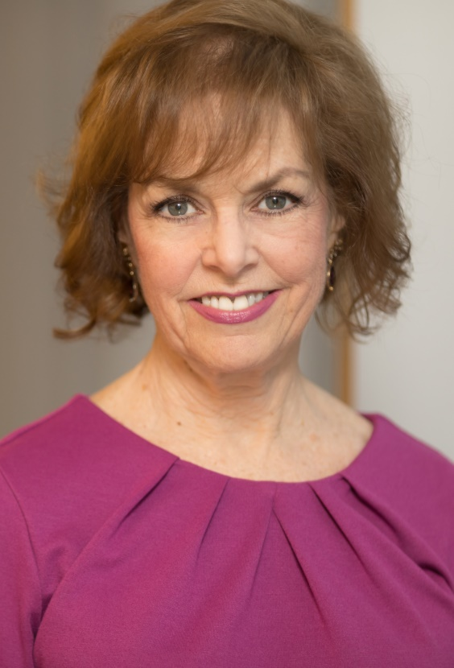
Host
Beth Lown, MD
Medical Director
The Schwartz Center for Compassionate Healthcare

Slide 5
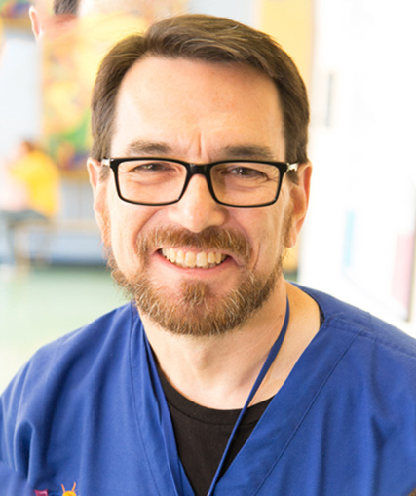
Today’s Speaker
W. Richard Boyte, MD, MA
Palliative and Supportive Care
Forrest General Hospital
Notes:
Rick UNMUTE - (Move mouse and Left Click in PowerPoint to take control - then use arrow keys to move the slides) Presentation

Slide 6
My best teachers have been my patients…
Narrative competence: the ability to acknowledge, absorb, interpret, and act on the stories and plights of others.
“Like narrative, medical practice requires the engagement of one person with another and realizes that authentic engagement is transformative for all participants.”
Rita Charon
JAMA. 2001;286:1897-1902
Notes:
With my introductory slides I hope to identify the objective of the presentation: we can learn to express compassion through absorbing and reflecting the narratives of patients, families and colleagues. Rita Charon has pioneered, and others have further developed, the concept of medicine practiced with narrative competence, called narrative medicine. This is proposed as a model for humane and effective medical practice. Though I do not claim to be an expert in narrative medicine, I have realized over the course of 35 years that the narratives, or stories, of my patients and of their families have molded how I practice, not just how I practice effectively but how I practice compassionately. I will admit that much of this evolution has been subconscious. First, I had to learn to listen. Listening led to understanding.

Slide 7
My best teachers have been my patients…
“Narrative humility acknowledges that our patients' stories are not objects that we can comprehend or master, but rather dynamic entities that we can approach and engage with, while simultaneously remaining open to their ambiguity and contradiction, and engaging in constant self-evaluation and self-critique about issues such as our own role in the story, our expectations of the story, our responsibilities to the story, and our identifications with the story—how the story attracts or repels us because it reminds us of any number of personal stories.”
Sayantani DasGupta
Lancet. 2008: 371: 980-981
Notes:
Dr. DasGupta has proposed the idea that we should not so much strive for “competence” as much as we do “humility” towards the narratives we hear every day in our lives and in our work. I like this idea because it takes into account the possibility that we are prone to making assumptions based on our own experience that may not apply perfectly, or even at all, to the experience of the story teller. We have to be open to new understanding and open to our own development, our own evolution, through our compassionate and empathic reactions to the stories of others.

Slide 8
One of my biggest influences…
“Wounding and healing are not opposites. They're part of the same thing. It is our wounds that enable us to be compassionate with the wounds of others. It is our limitations that make us kind to the limitations of other people. It is our loneliness that helps us to to find other people or to even know they're alone with an illness. I think I have served people perfectly with parts of myself I used to be ashamed of. ”
Rachel Naomi Remen
Notes:
I have enjoyed the writings of Rachel Remen and have had the great honor of hearing her speak in person on several occasions including, literally, at her feet at workshops and seminars. She deeply honors the stories of her patients and reflects the ideas of Charon and DasGupta. I’ve learned from her that everyone has a story to tell and that every story is important on its own. The Deep South where I was (partly) raised and where I have practiced medicine has a deep tradition of story telling. We tell stories every day. Story telling in many ways comes naturally to me. Listening to stories is something I have had to learn through mindful practice.

Slide 9

“You’ve taken a different path.”
Notes:
Over the next 3 slides I will tell of my own experiences during the first years of my career that helped me get in touch with the emotions that arise in the care of children. The first is my emotional break down while watching a TV news story describing a toddler who died from a self inflicted gunshot wound. He discovered the gun while playing in his neighbor’s home. This occurred at the end of my first year of fellowship in pediatric critical care. I became terrified that I didn’t have the “right stuff” for the career path I had chosen. I was worried that I was too emotional. I felt distressed enough to approach my program director. Instead of telling me to pack my bags, as I anticipated, he told me that I had simply taken a different path. He encouraged me to stay in touch with my emotions instead of pushing them down, Note: this is a stock photo but I plan to replace it with a personal one from a bike trail I enjoy.

Slide 10
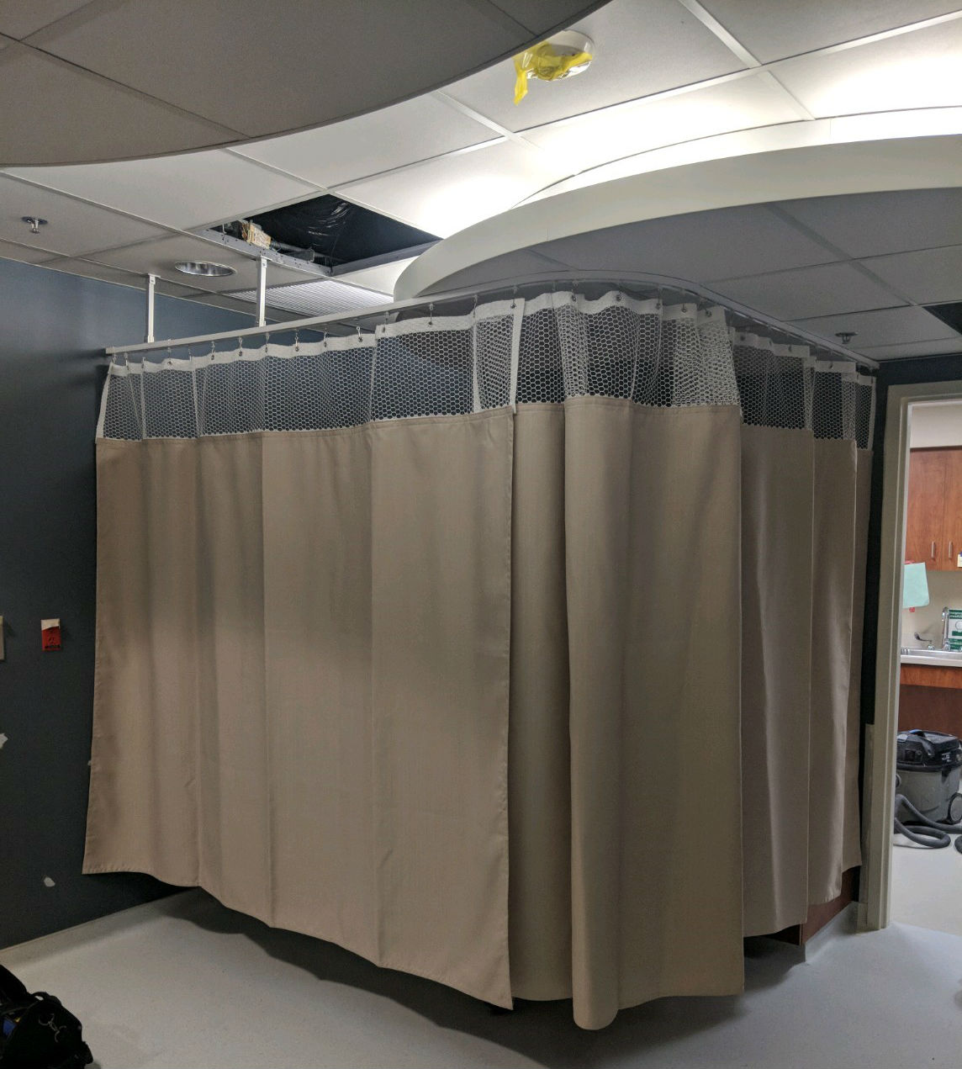
“No, I’m thanking you for your tears.”
Notes:
This is an experience that was described in my NCCY acceptance speech. As a young critical care doctor I was moved to tears when a baby died from meningitis. I was so hopeful that I could make a difference and contribute to his recovery. I waited to cry until I left his room where I had just given my condolences to his parents. Outside the door I ran (almost literally) into his grandmother. She thanked me. Embarrassed and feeling undeserving of gratitude, I told her that I wished I could have done more. She then corrected me by saying, “No, I’m thanking you for your tears”. She taught me that family members can welcome and appreciate your emotional response to their loss. I used a hospital curtain in an essay I wrote (“The Curtain”) to illustrate how we close ourselves off from emotional responses. I observed years ago how hospital staff place these flimsy barriers to assure privacy knowing well that they do not. Staff act one way on our side of the curtain and a very different way on the patent’s side.

Slide 11
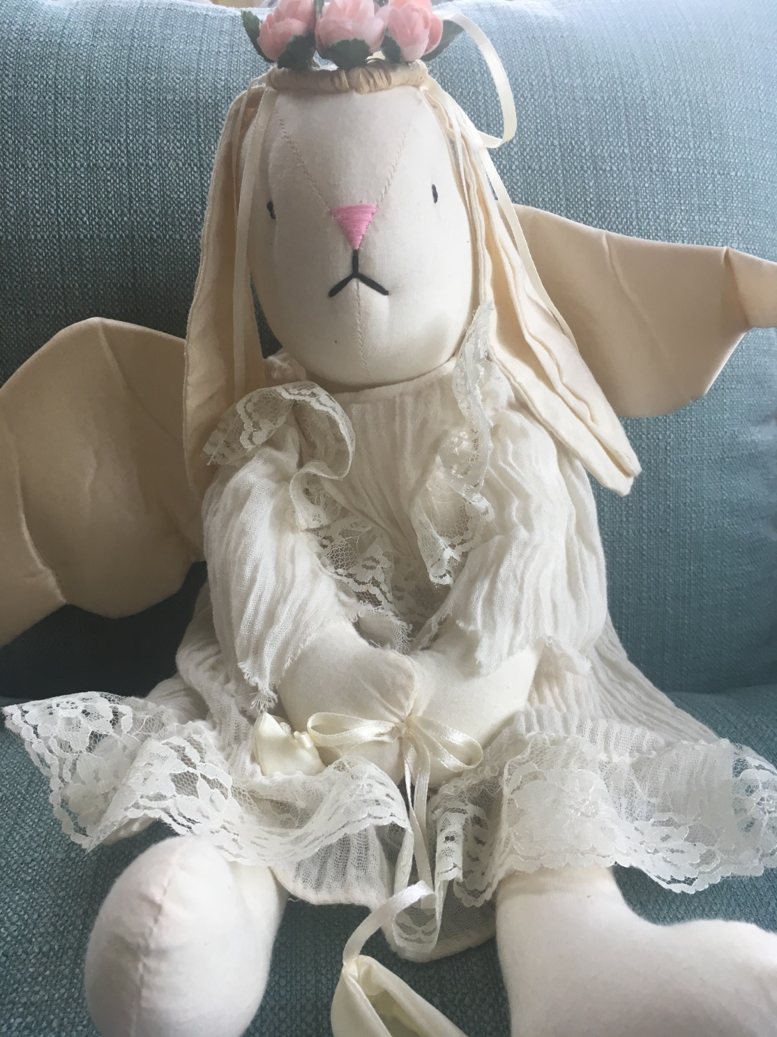
“But, when will I wake up?”
Notes:
I became close to a young girl with sickle cell disease who had a long hospitalization following an illness with severe lung disease. I also became close to her mother and grandparents. At one point, I told her family that she would not likely survive. Miraculously, she did. I wrote about this in an essay for Health Affairs / Narrative Matters entitled “The Curtain” in which I call her Sherry. After Sherry was discharged, I made a point to see her whenever I could at her follow up visits. If I didn't’t go to the clinic, her grandparents would bring her to my office. I had knick knacks on my desk or shelves and she would always leave with one. Later, she returned to our PICU critically ill again. I had to tell her that I was putting her back on the ventilator but that I would be sedating her first. I told her to not be afraid because she would be asleep. She then asked me, “But, when will I wake up?”. She died without ever being conscious again. Hers was the first funeral I attended for a patient. I was very concerned over the reaction of the family, mostly that I would increase their grief. Instead, they were very grateful and I allowed myself to grieve too. Sherry’s grandmother gave me a stuffed animal that was attached to a funeral arrangement. I still have it and will use it as the picture here.

Slide 12
Polling Question 1
Notes:
CLOSE WITH - At this point, I'd like to turn the program over to Stephanie for our first polling question. Mute
Rick UNMUTE - (Thoughts) OK let's move back to the presentation

Slide 13
Battley’s Story
Notes:
Battley was born with the chromosomal anomaly Trisomy 18. Her parents were told to expect death within the first weeks of life and several times she had episodes of brief apnea in which her mother held her and said good bye. She always recovered spontaneously, Her mother insisted on Battley being at home, electing hospice. When Battley lived past a few weeks she was referred to my clinic. Her apnea episodes had stopped and we discussed how a “one day at a time” approach would be best. Battley’s mother, Catherine, had to make decisions regarding the extent of interventions. She did not want her baby to go through anything that did not provide a true benefit but it was hard to know how much to do. She had a large heart defect (VSD) which kept her in heart failure and an inability to eat well which made NG feedings necessary. Catherine could not bring herself to consent to the recommended heart surgery or percutaneous feeding tube placement. We held several discussions during that period. Catherine was told that she shouldn’t delay a decision any longer by her cardiologist. She asked me to attend the meeting she had with the cardiologist. To everyone’s surprise, the studies that day showed that the high blood flow through her heart defect had caused a responsive increase in blood pressure in her lungs leading to a “balanced” situation. In other words, she now had a natural way to prevent heart failure and would not need the surgery. Her mother was thrilled and saw it as a miraculous outcome. Afterwards, she was able to accept that her baby’s life would still be short but it was possible that she could live for several more years. She agreed to a PEG for feedings. I continued to keep up with her. Several months later I was called to the ER. Battley had a seizure at home and was brought to the ER by her parents unconscious and in respiratory distress. She was not expected to survive without life support measures such as mechanical ventilation. Catherine had asked that aggressive measures be avoided. The ER staff accepted this. But, Catherine was also asking to take Battley home. I was not comfortable with this at first. I felt that we could support Battley and her parents more in the hospital. When Catherine practically began to plead with me I could no longer be a part of denying her wish. It was not a popular decision on my part. Much of the ER staff had misgivings, I promised Catherine she could take Battley home. I knew how much she did not want Battley to die in a hospital. To help assure the staff, I made a decision to travel with her parents in the car. Only a few miles from home, Battley took her last breath in her mother’s arms in the backseat of her parent’s car. I was able to spend time with her parents at her home and be present when Catherine placed Battley’s body in the vehicle sent by the funeral home. Battley taught me to be open to the unexpected and to be open to listening and honoring wishes, even when I’m very uncertain of the consequences.
I will have several pictures during the telling of Battley’s story.

Slide 14
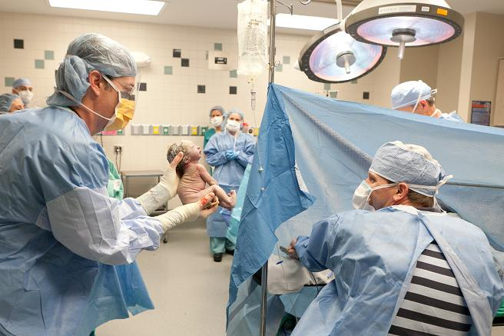
Notes:
Battley’s birth.

Slide 15
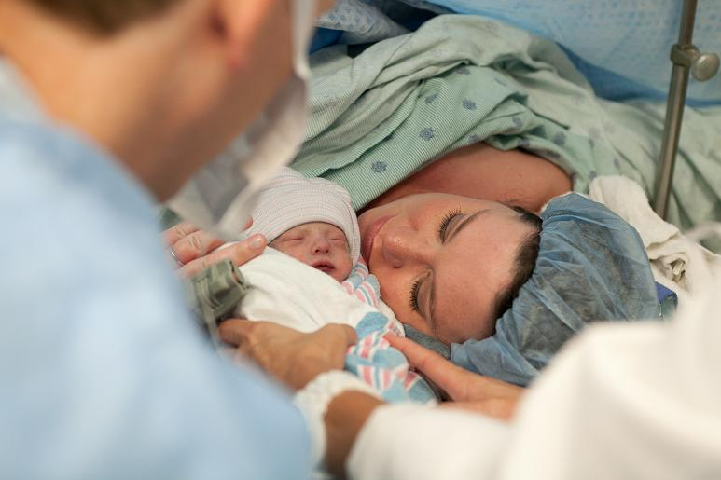
Notes:
Battley’s birth.

Slide 16
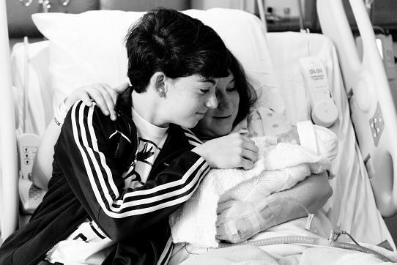
Notes:
Battley meets her older brother.

Slide 17
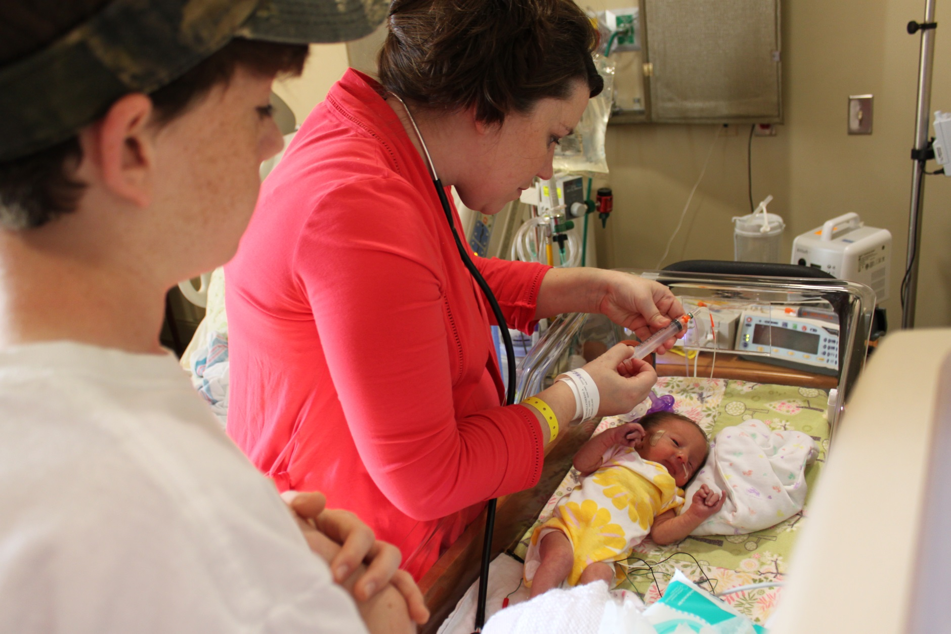
Notes:
Tube feedings are started.

Slide 18
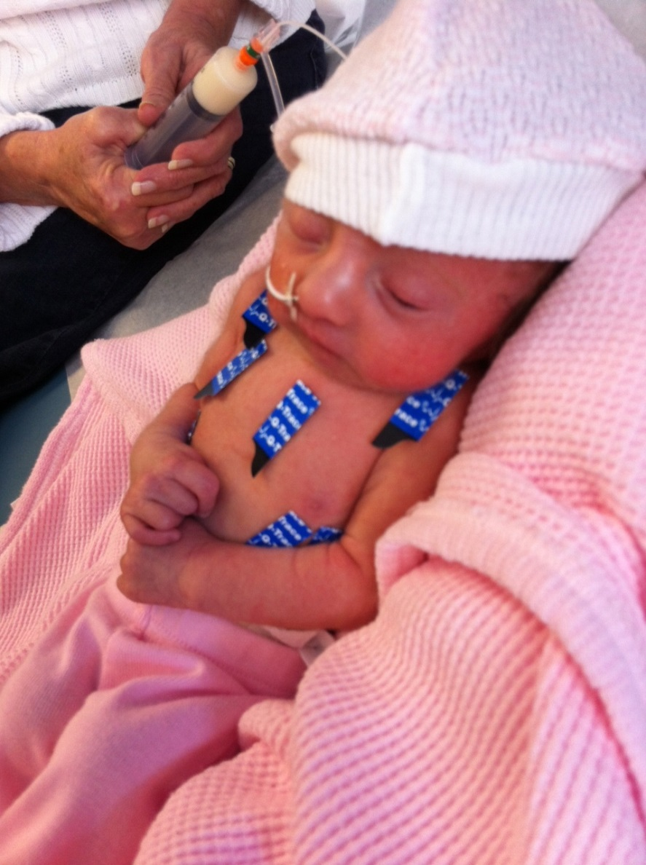
Notes:
6 days of age.

Slide 19
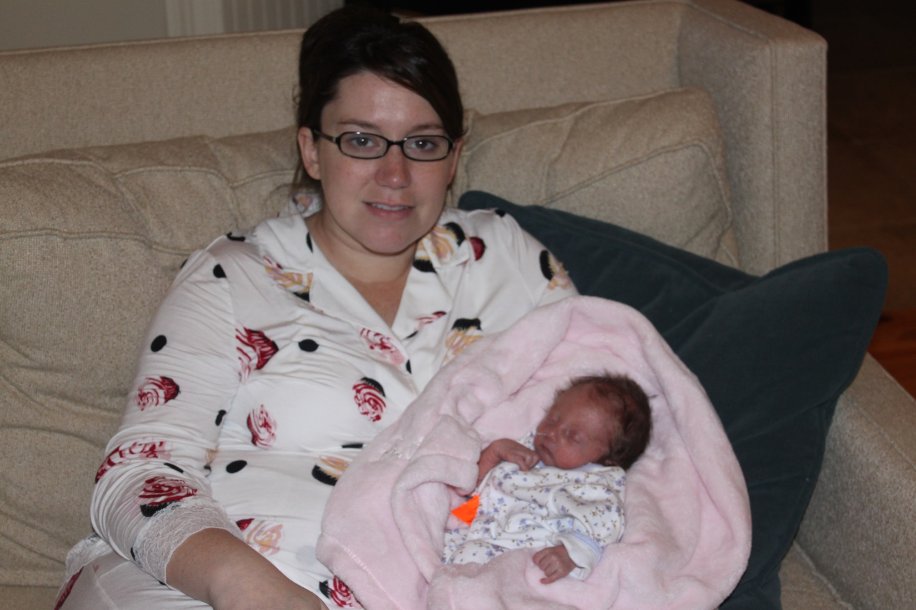
Notes:
9 days of age. During this period of time Battley is having frequent apnea. Battley’s family celebrates a weekly “birthday”.

Slide 20
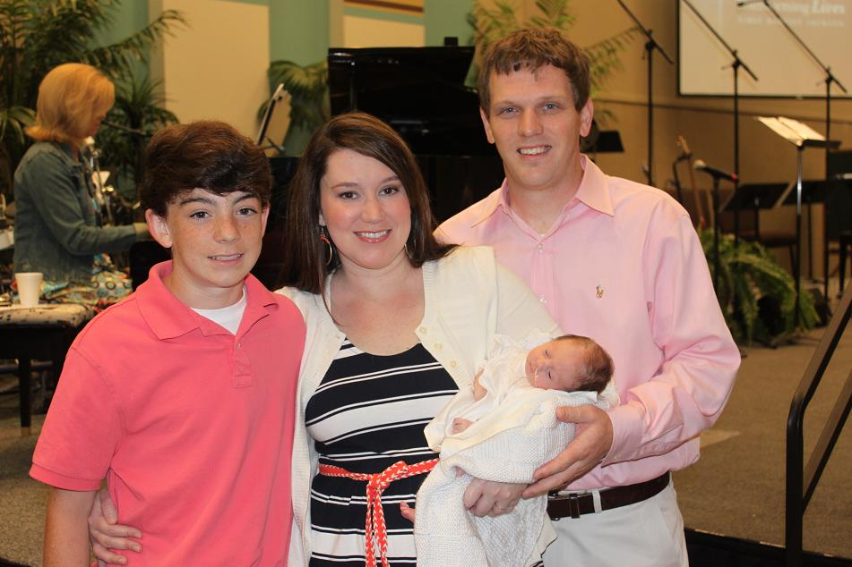
Notes:
Her family attempted to be as “normal” as possible. Here they are seen attending church at one month of age.

Slide 21
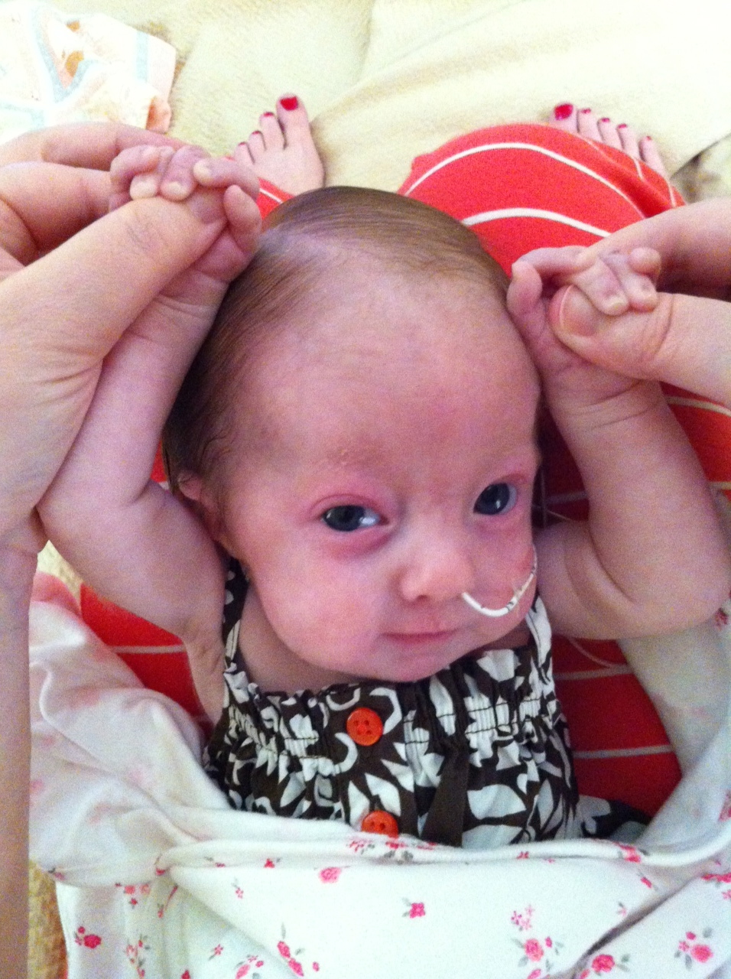
Notes:
The apnea episodes eventually stop and she begins to outlive her prognosis of one month.

Slide 22
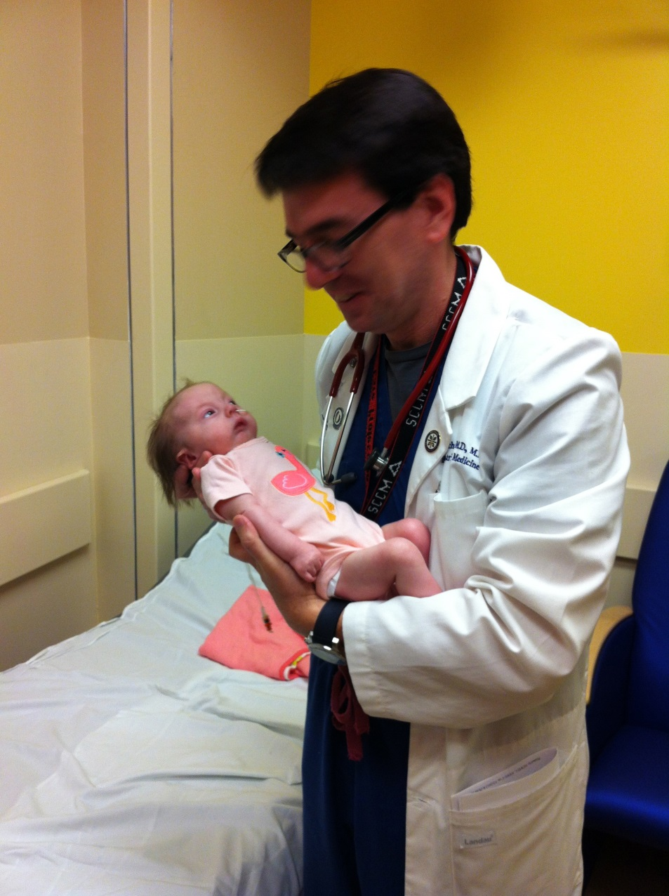
Notes:
I meet Battley in our Palliative Care Clinic. She is 3 months old here.

Slide 23
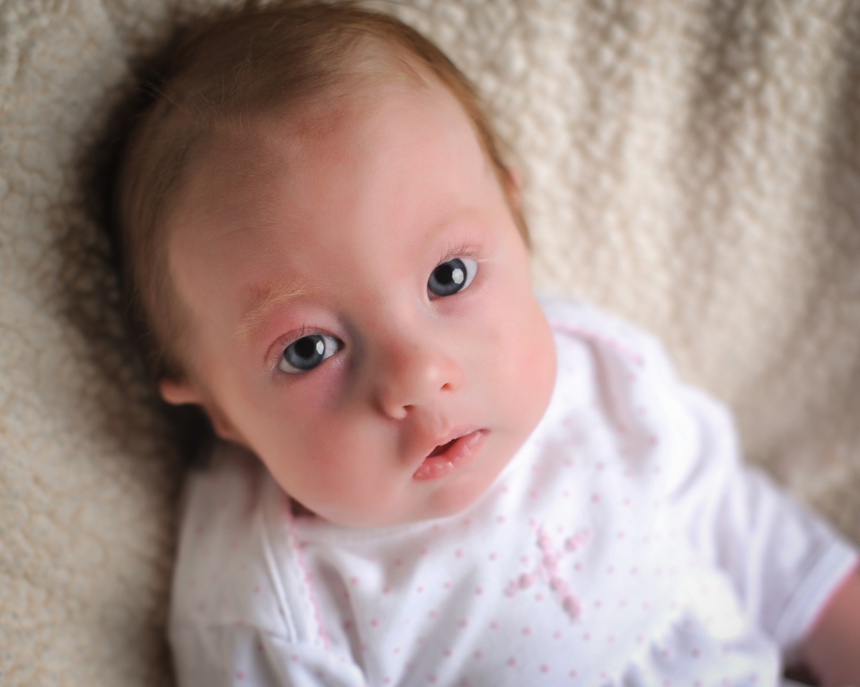
Notes:
5 months of age

Slide 24
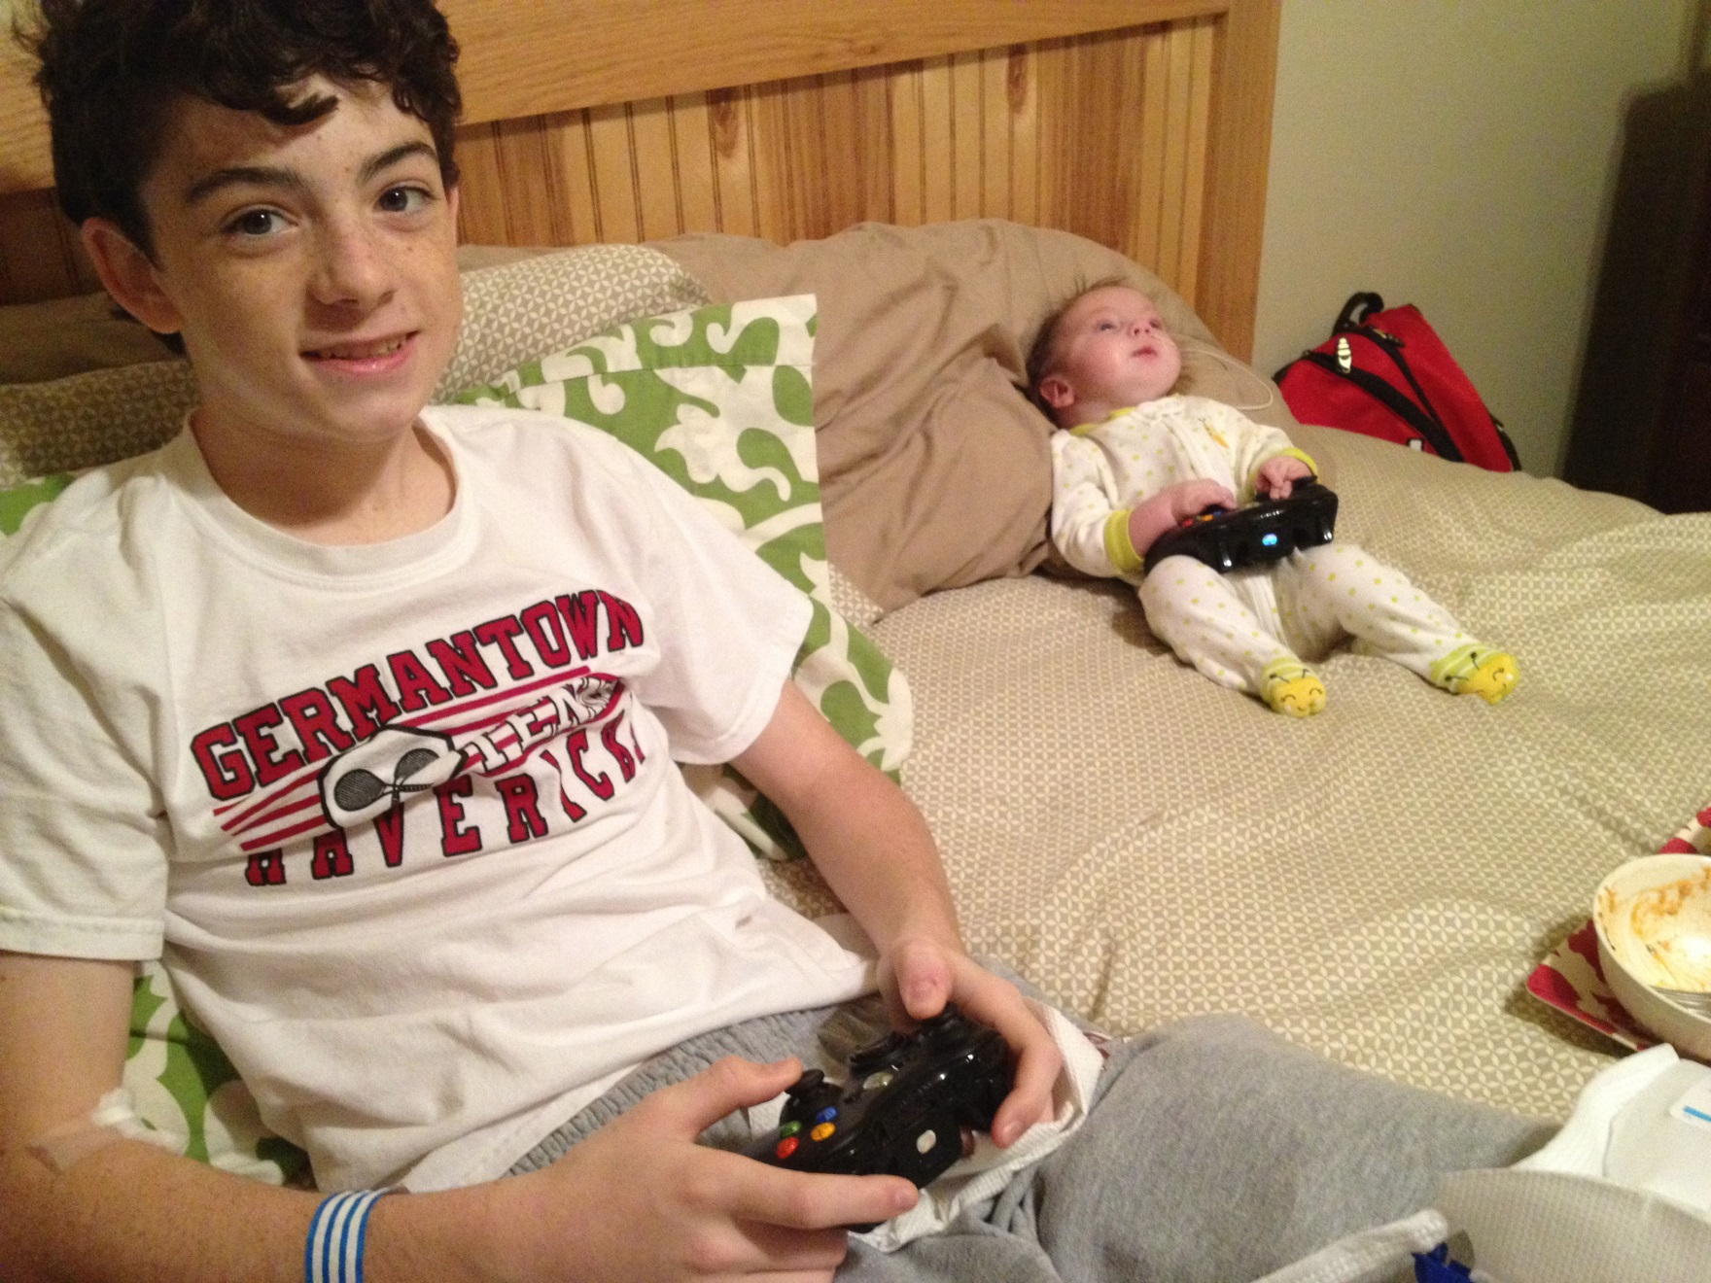
Notes:
Taken around her first Christmas.

Slide 25
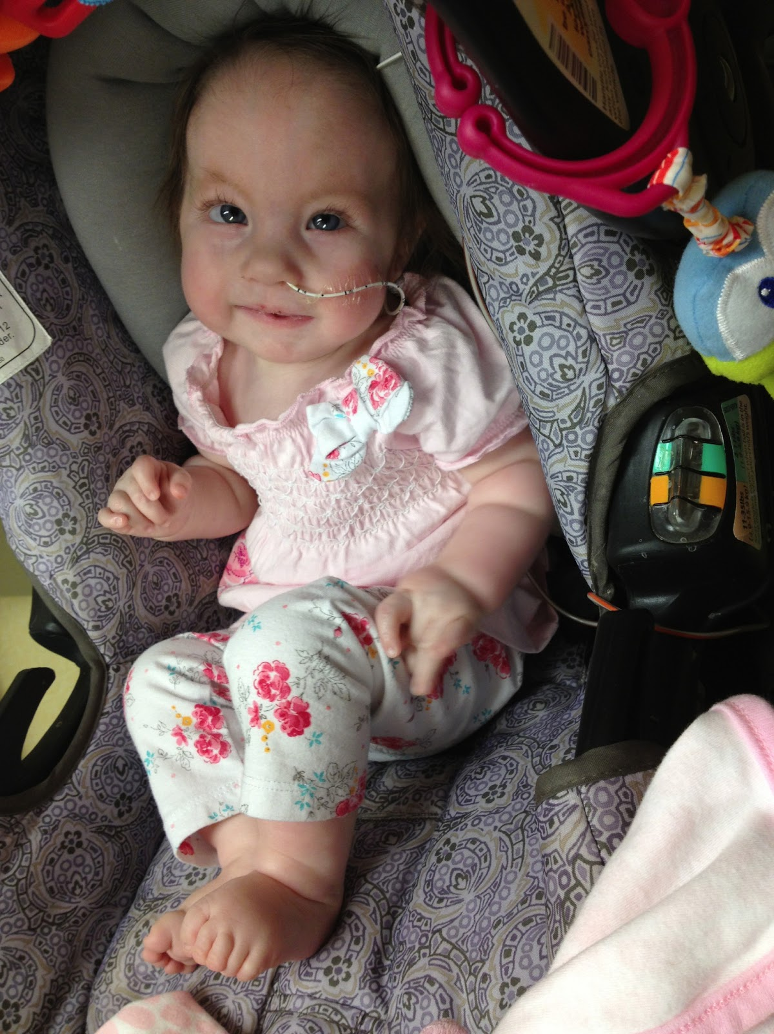
Notes:
NG feedings were continued for a very long time.

Slide 26
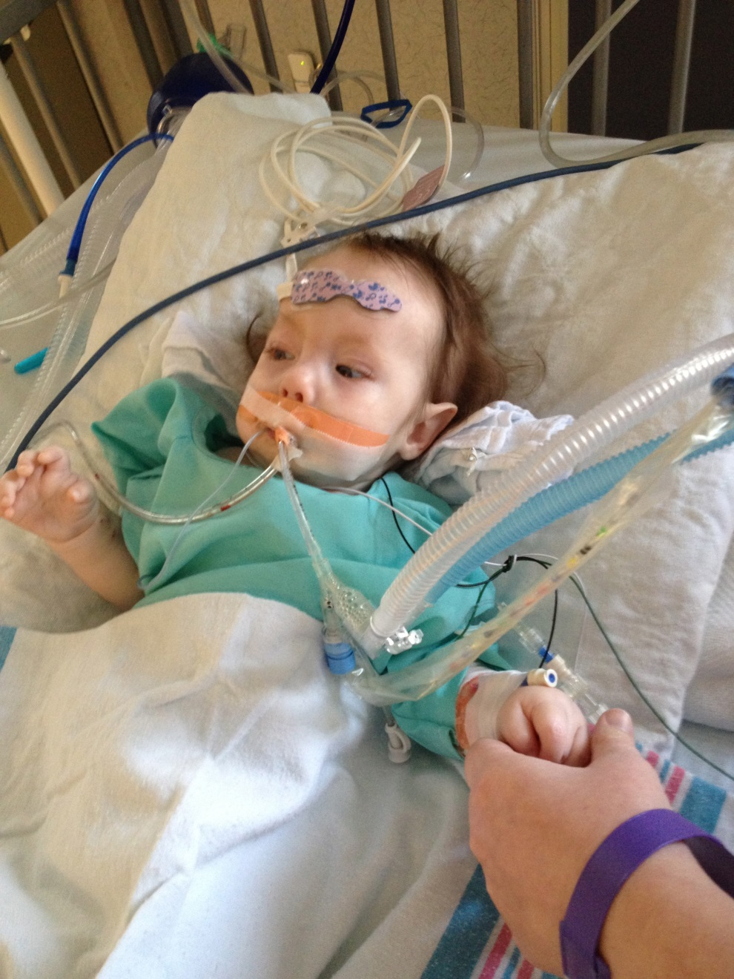
Notes:
Catherine eventually consented to PEG placment.

Slide 27
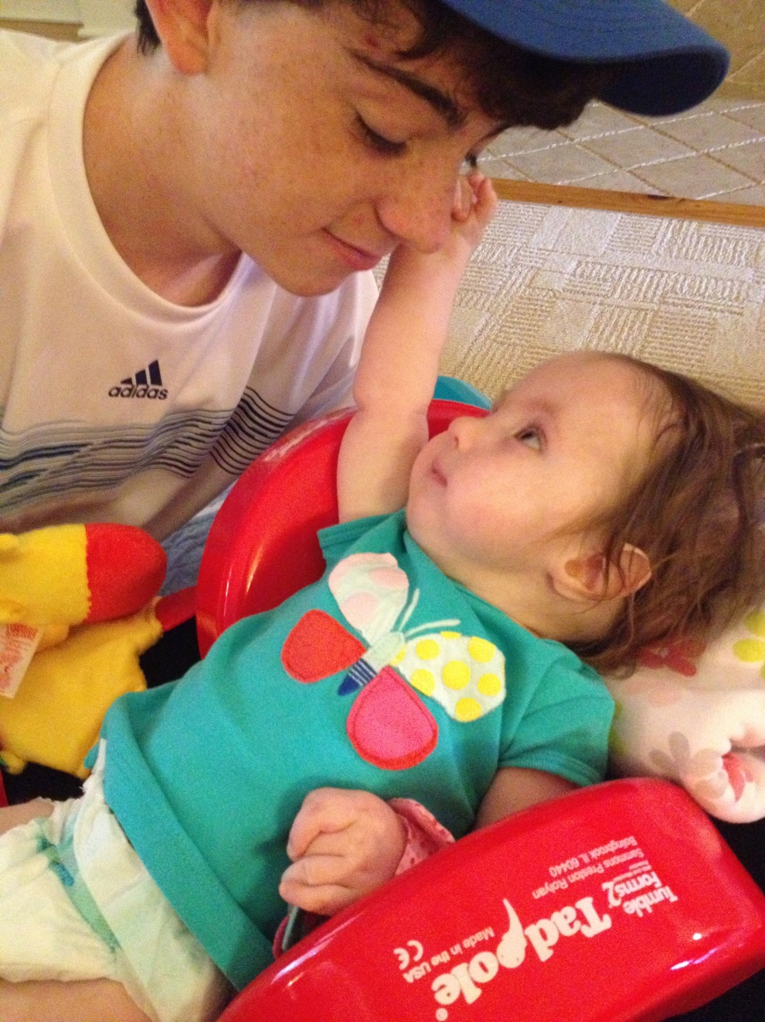
Notes:
Life went on without an expectation of a very brief life.

Slide 28
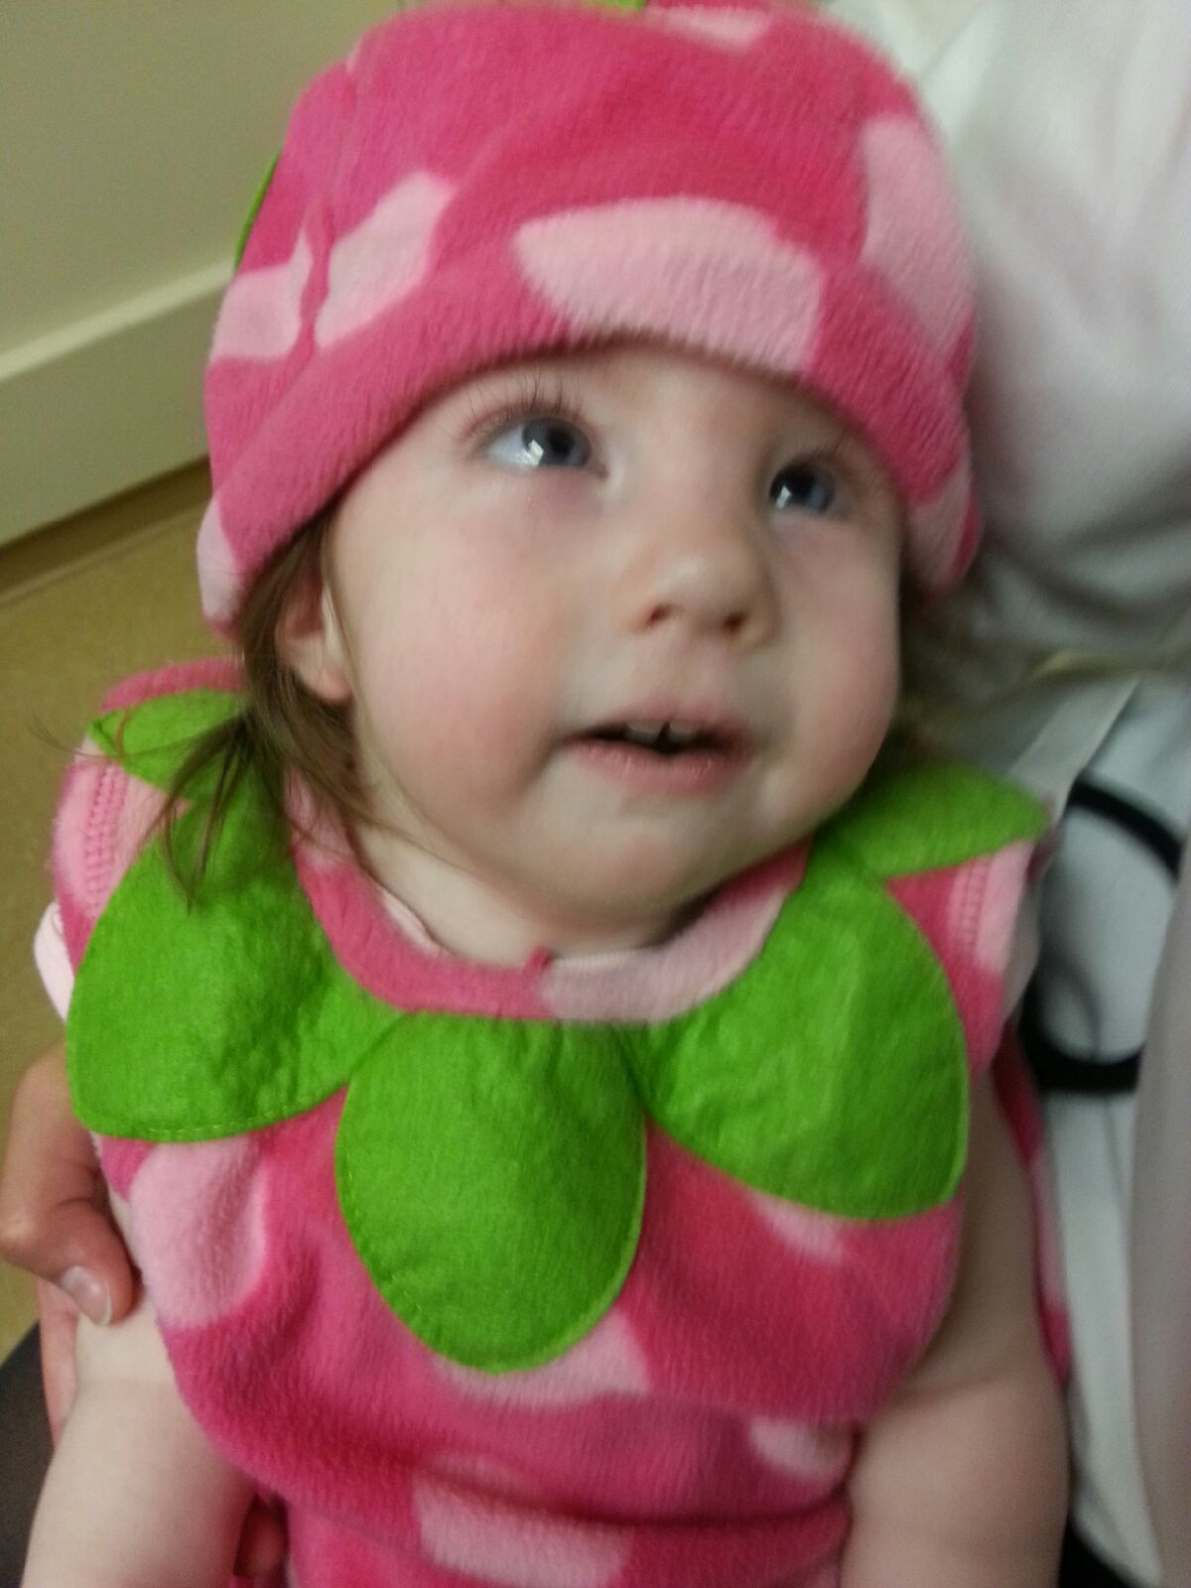
Notes:
Clinic visit at Halloween.

Slide 29
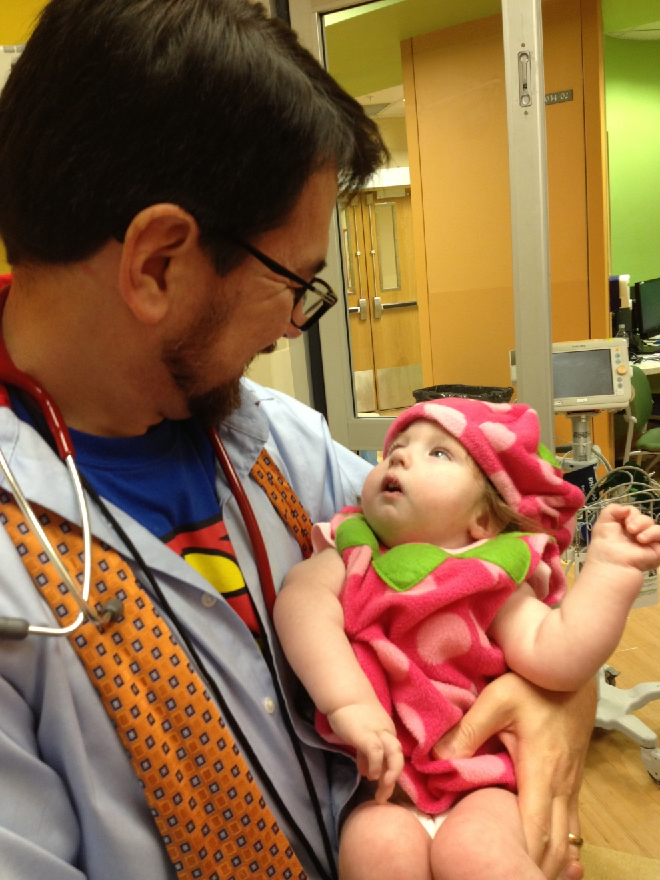

Slide 30
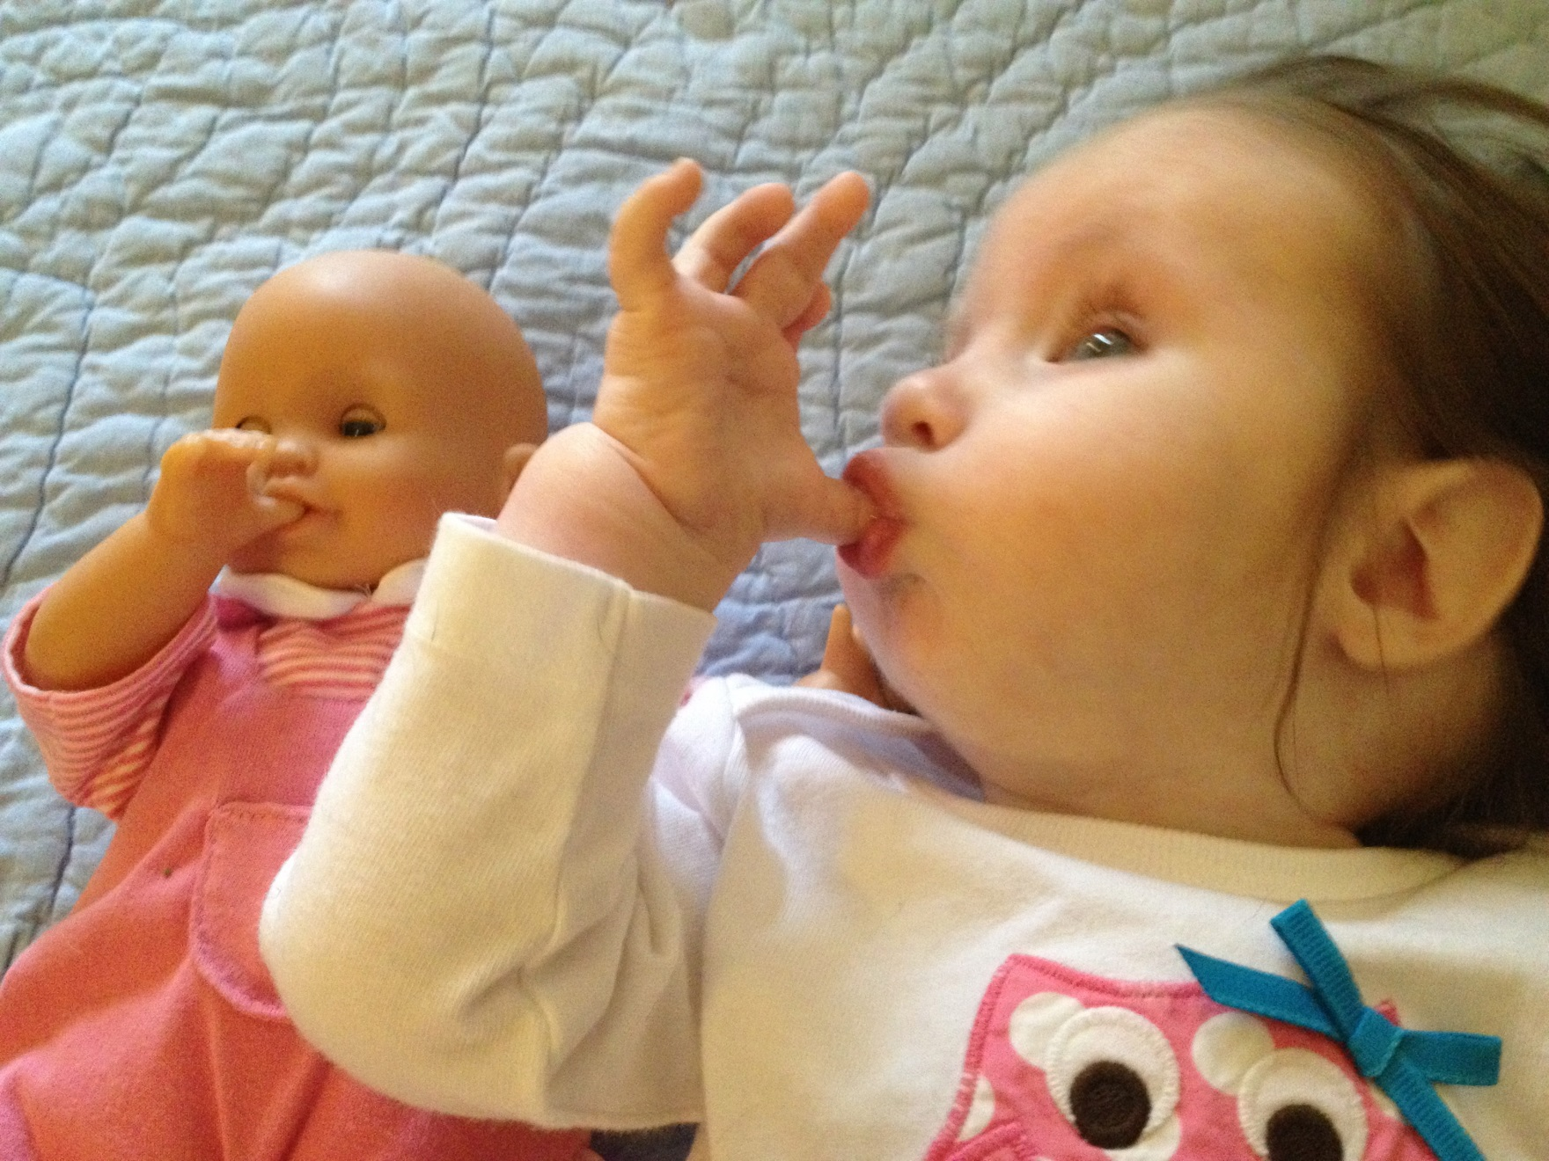
Notes:
Battley grew at a slow pace and always had hypotonia typical for Tri !8.

Slide 31
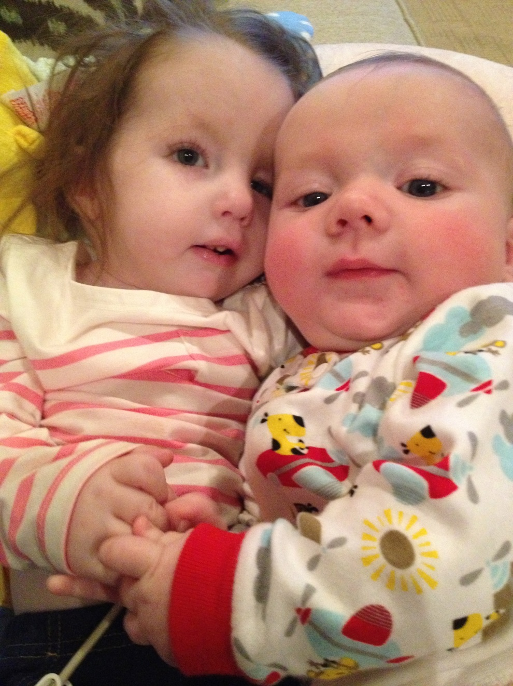
Notes:
Battley became a big sister.

Slide 32
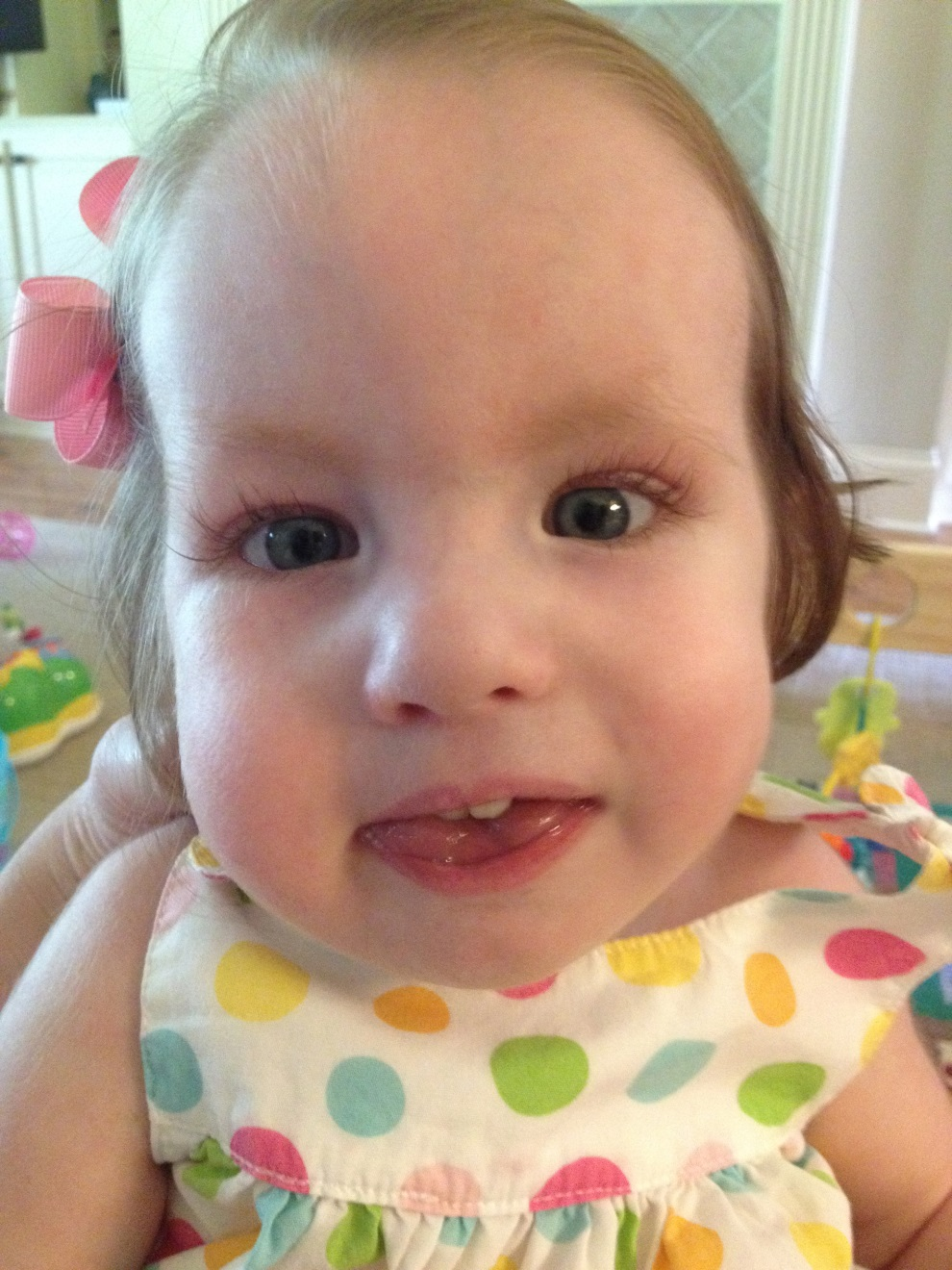
Notes:
Picture taken shortly before her death later that month.

Slide 33
Ryan’s Story
Notes:
Ryan was born with a mitochondrial defect that left him with weakness that caused him to be ventilator dependent. His mother was young and without a social support that would allow her to take on his care at home. There is no long term care facility that provides care for vent dependent children in our state. Ryan spent much of his childhood in the hospital. The staff grew very close to him providing him many substitute “parents” when his mother could not be present. His mother, Raven, finished her education and worked towards establishing a home for her child. She eventually underwent training to care for her child at home on a ventilator. She was able to take Ryan home and was also able to be a mother for one year. During that time, she took Ryan to Memphis for a Justin Bieber concert where he met the singer through Make-A-Wish. The next time Ryan came back to the hospital it was because he had been found pulseless at home. Even with good care, children with complex complex conditions are fragile and vulnerable to sudden death. Ryan survived but with a severe brain injury. We helped Raven accept that withdrawal of life support was in his best interests. Ryan died with his biological family and his hospital family present. Later, Raven had a second child with the same mitochondrial abnormality. Raylon’s condition is not as severe as his brother’s and raven has cared for him at home.
I can also tell of another child who lived in the hospital for years in suspected PVS (many of the nurses disputed this). His young mother and extended family initially insisted on no limitations to support. The staff became very close to this child too. His mother eventually approached me with a request to withdraw life support. An ethics committee affirmed her request and we eventually carried this out. His hospital family was present but no one from his actual family was. These children taught me that compassionate connection can be meaningful but can also be a entry point to deep grief for the caregiver.

Slide 34
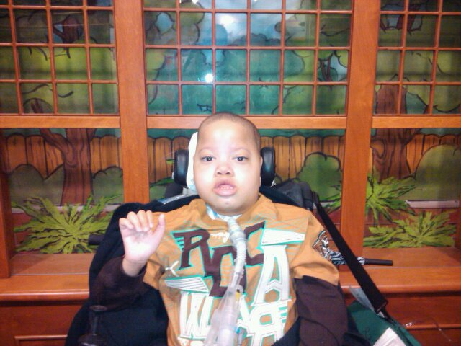

Slide 35
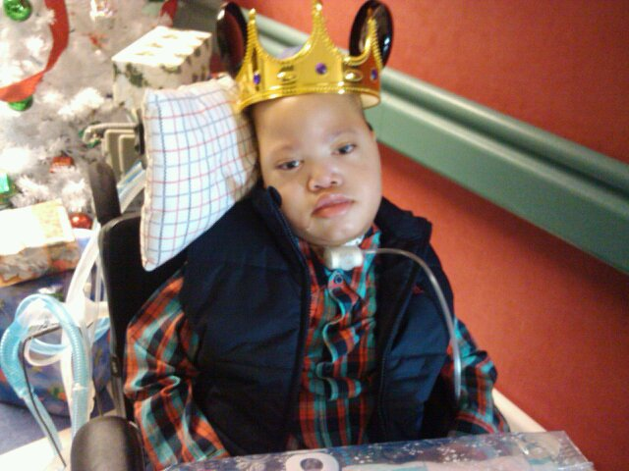

Slide 36
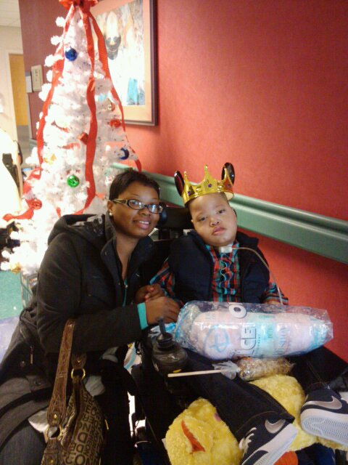

Slide 37
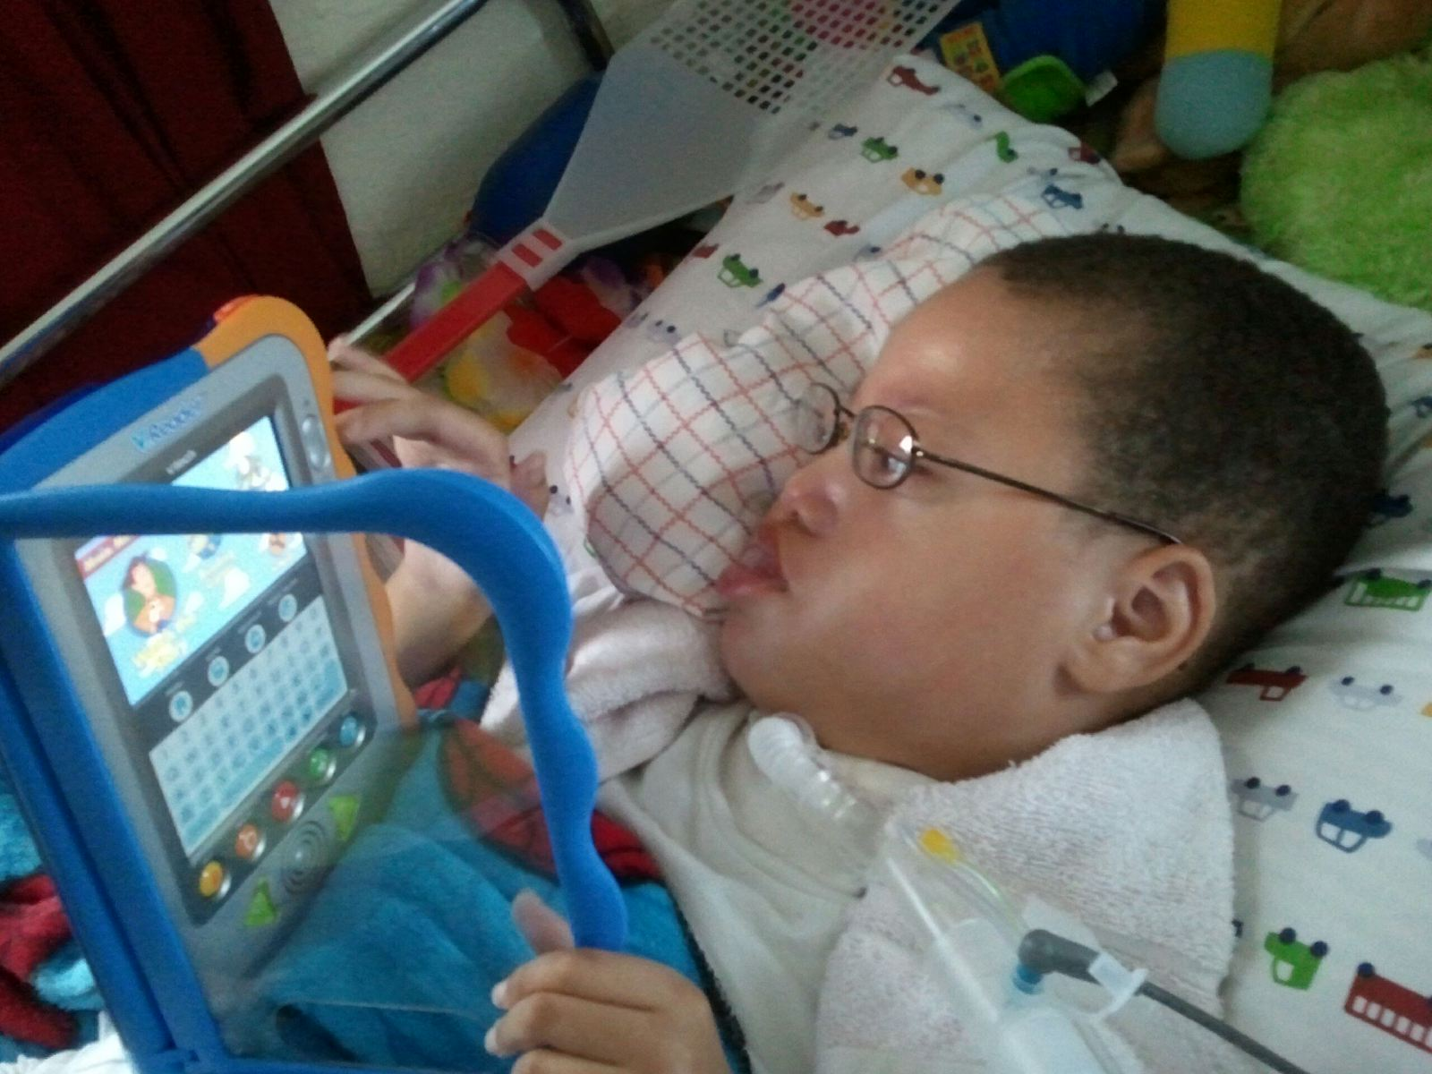

Slide 38
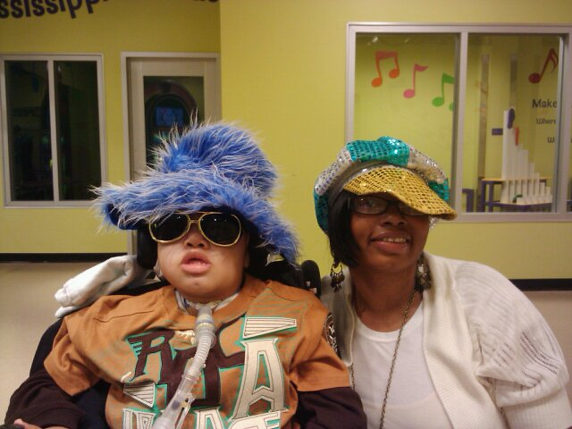

Slide 39
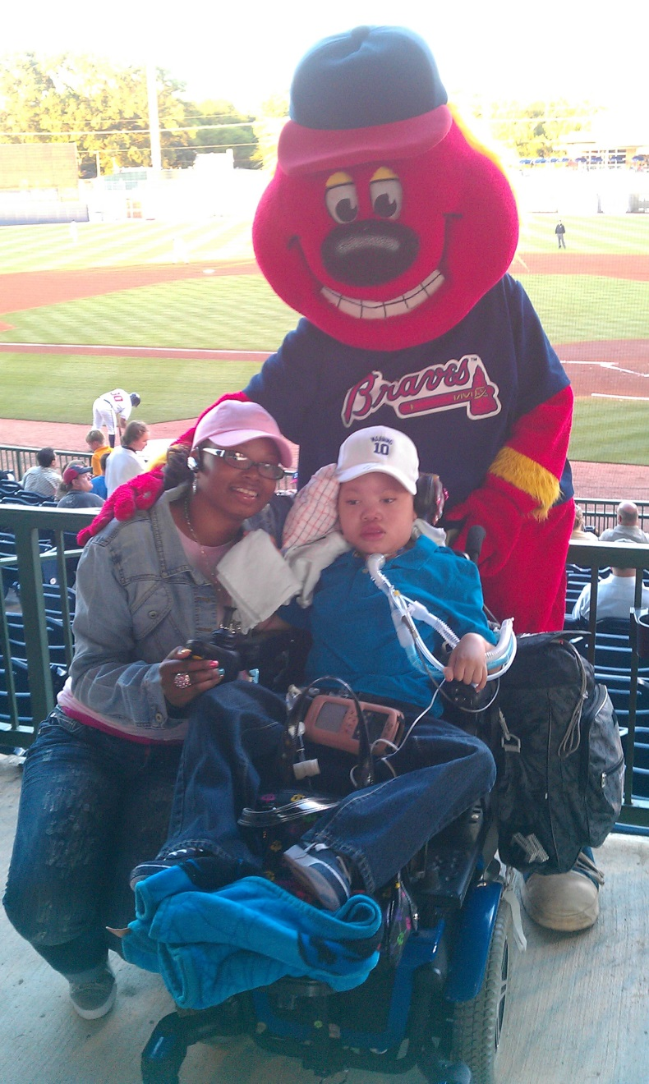

Slide 40
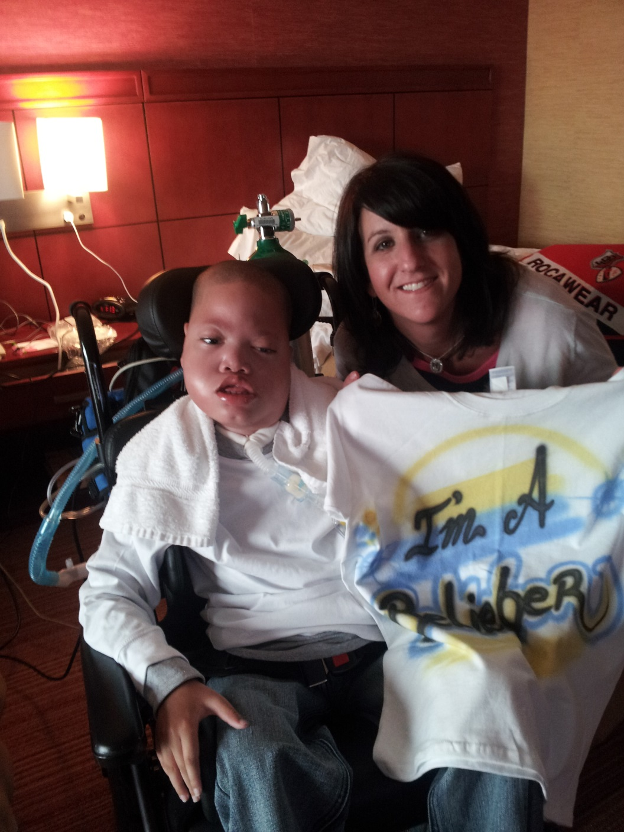

Slide 41
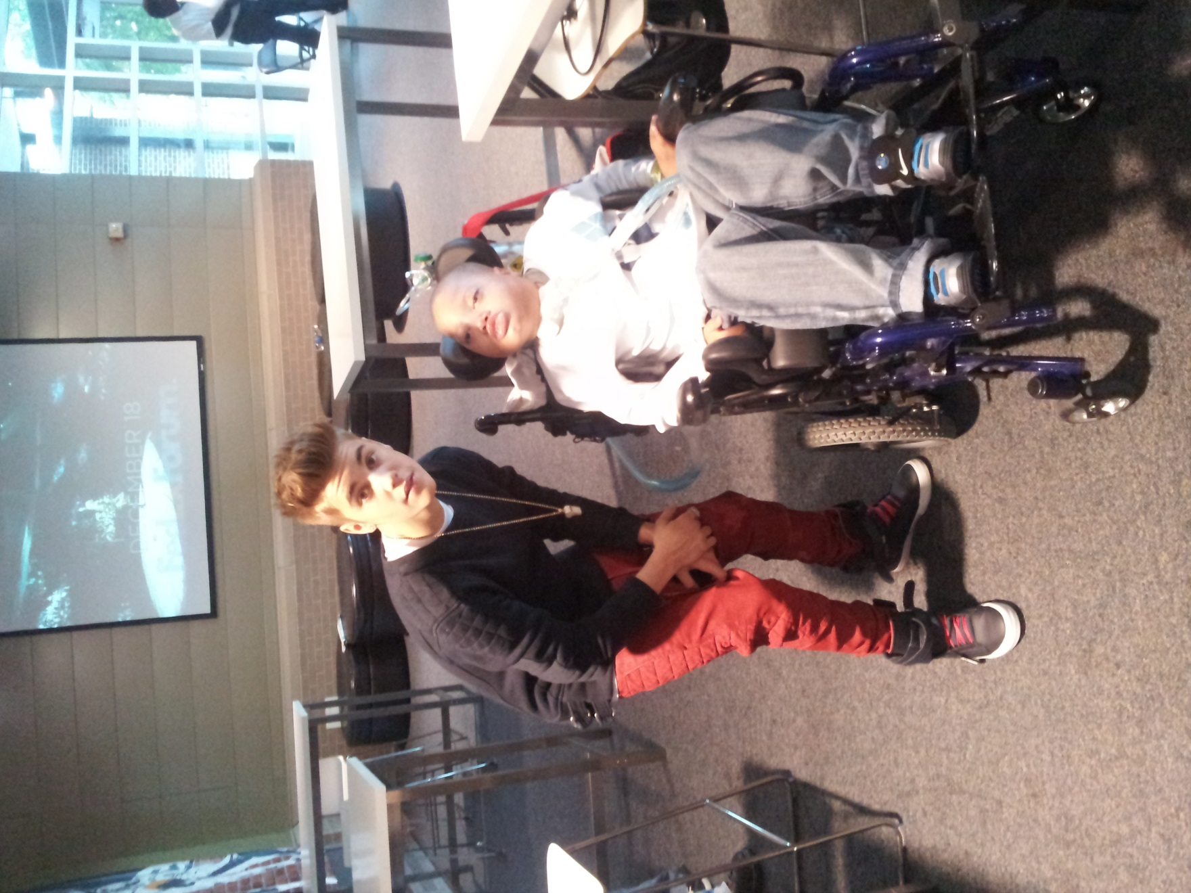

Slide 42
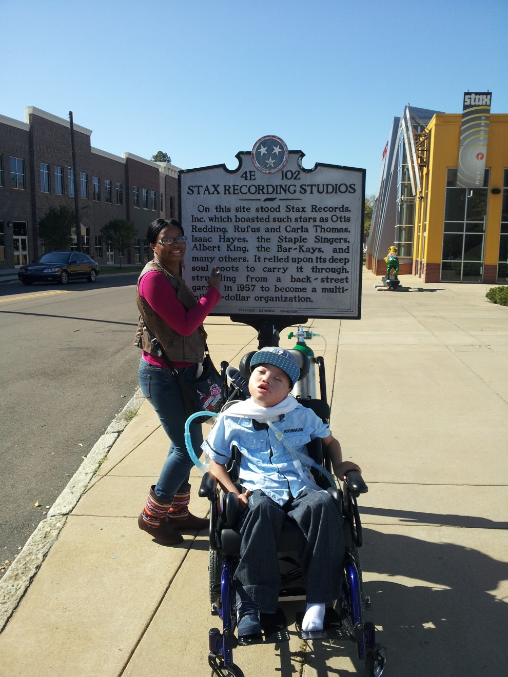

Slide 43
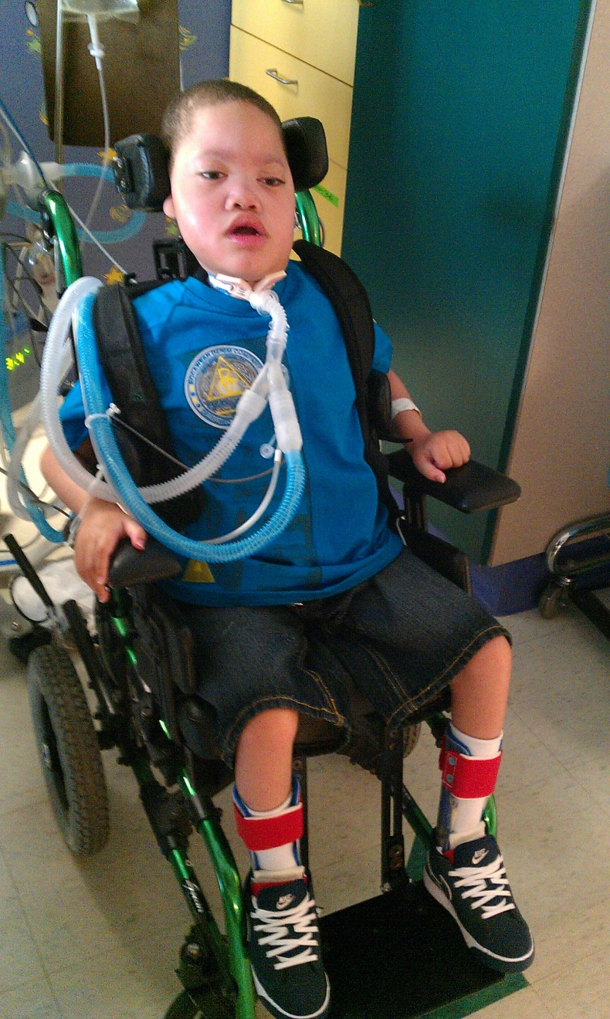

Slide 44
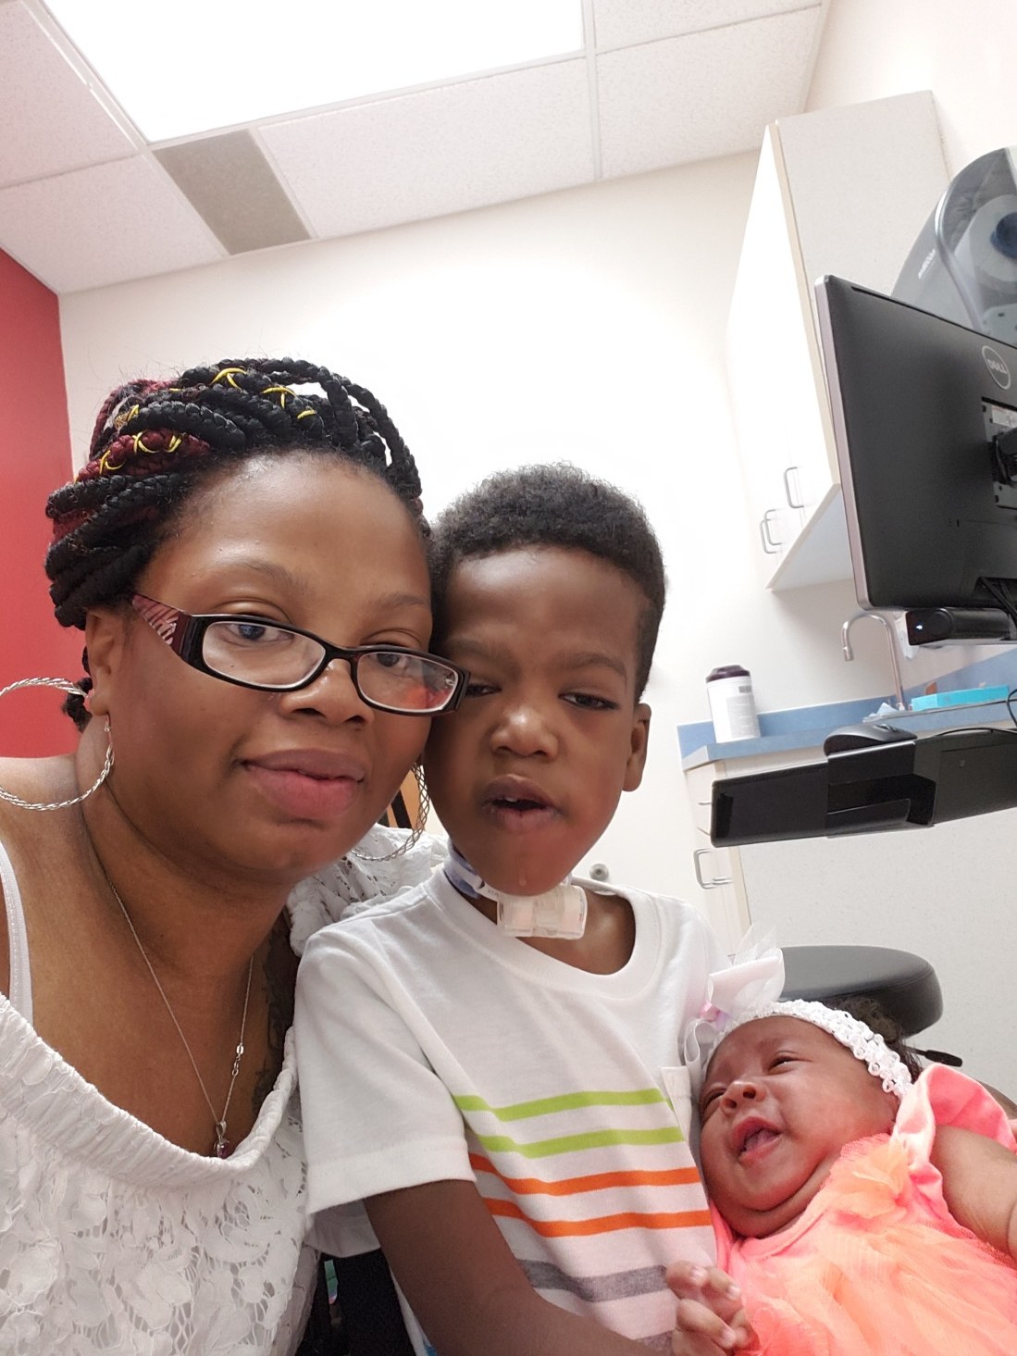

Slide 45
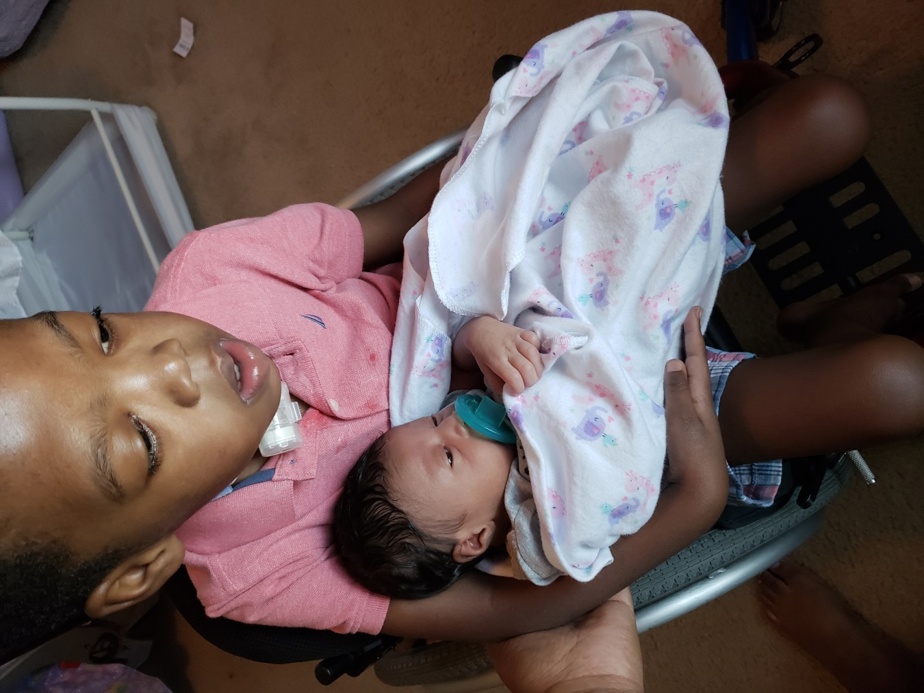

Slide 46
Polling Question 2
Notes:
CLOSE WITH - At this point, I'd like to turn the program over to Stephanie for our second polling question. Mute
Rick UNMUTE - (Thoughts) OK let's move back to the presentation

Slide 47
Grace’s Story
Notes:
Grace’s mother, Karen, was told that her baby would have an encephaloele birth defect by ultrasound during a routine prenatal check up. Karen was a nurse and a colleague on the hospital unit where the majority of my patients were admitted. We began to see her and her husband in our clinic to prepare them for an expected very short life of their daughter. There were predictions that the baby would not survive delivery. Grace’s parents were encouraged to see the time prior to birth as her “life” and to share their favorite activities with their baby. This was something I had learned from hearing Amy Kuebelbeck, the author of Waiting for Gabriel, speak several years ago of her experience carrying a pregnancy to term with a baby, Gabriel, with a lethal heart defect. To increase the chances that the baby would at least survive delivery, Karen elected to have Grace delivered by C-section. After delivery, the large sac could be seen extending from Grace’s head posteriorly. Karen and Chad had to decide whether to allow surgery for Grace. Some advised that this would only be cosmetic and would not change the outcome. Some felt that a hospice approach without interventions would be best for Grace. I learned that this was such a personal decision that I could best be supportive by simply supporting whatever decision they made. Grace’s parents chose surgery to correct the defect. Like with Battley, the prognosis for a very short life would prove to be incorrect. Her father, Chad, had to adjust to this. He explained that we had prepared him for his daughter’s death but not for his daughter’s life. As you will see from the pictures of Grace, she has lived and thrived. She does have disabilities but her parents have been able to celebrate birthdays and milestones like all parents.

Slide 48
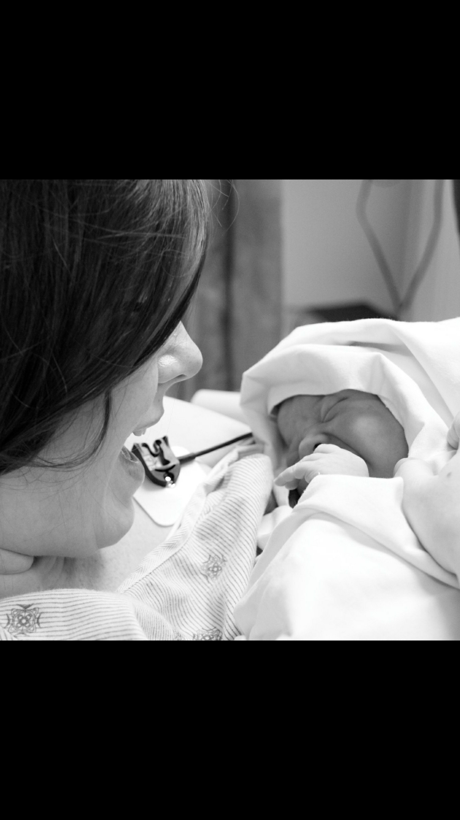

Slide 49
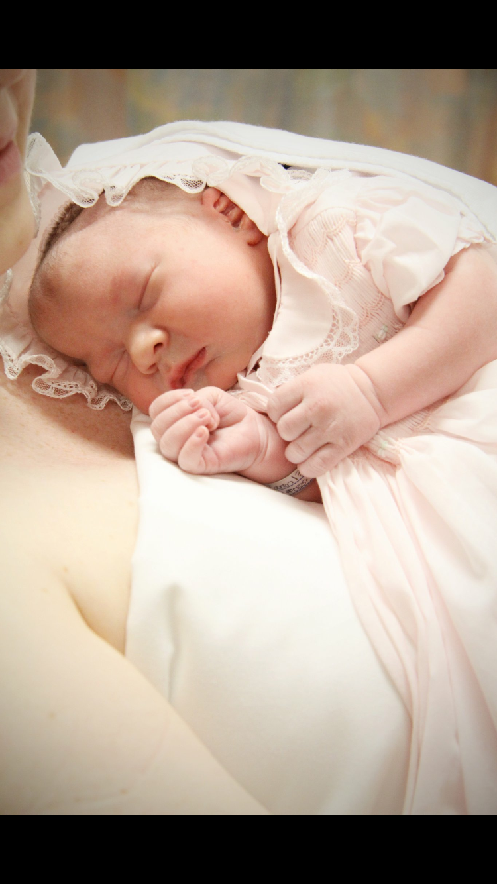

Slide 50
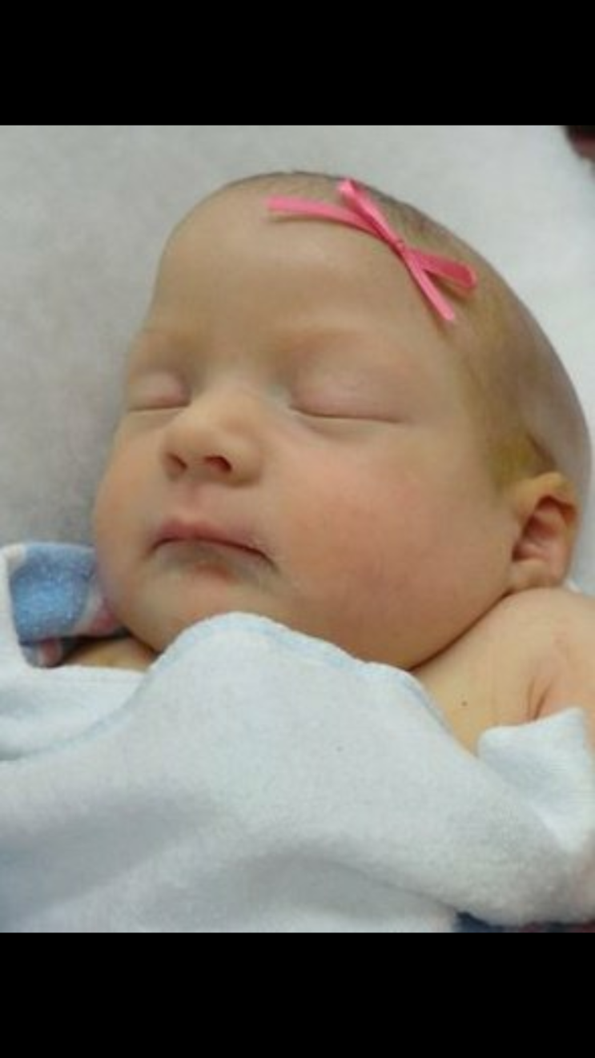

Slide 51
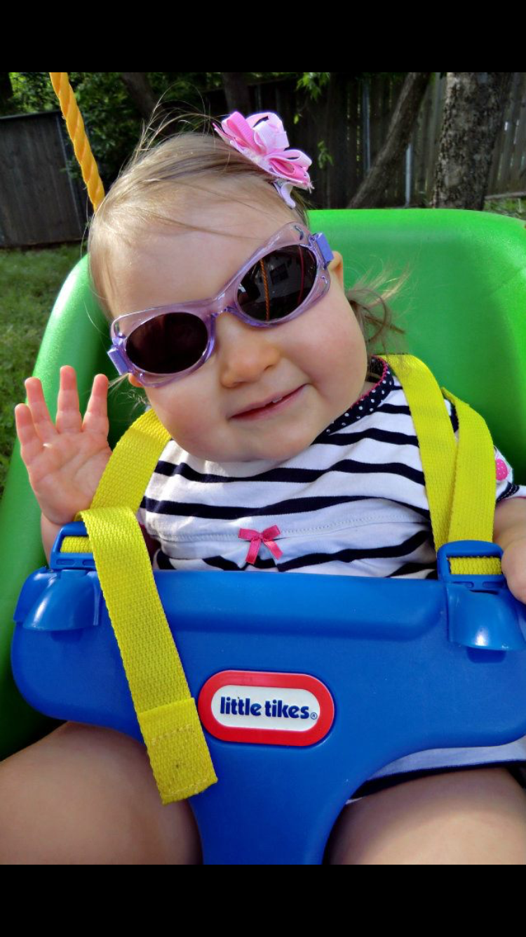

Slide 52
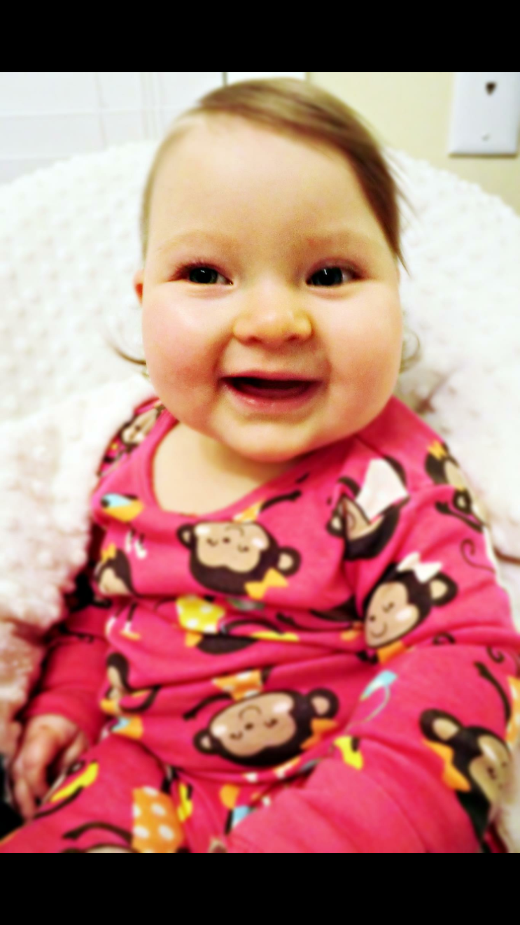

Slide 53
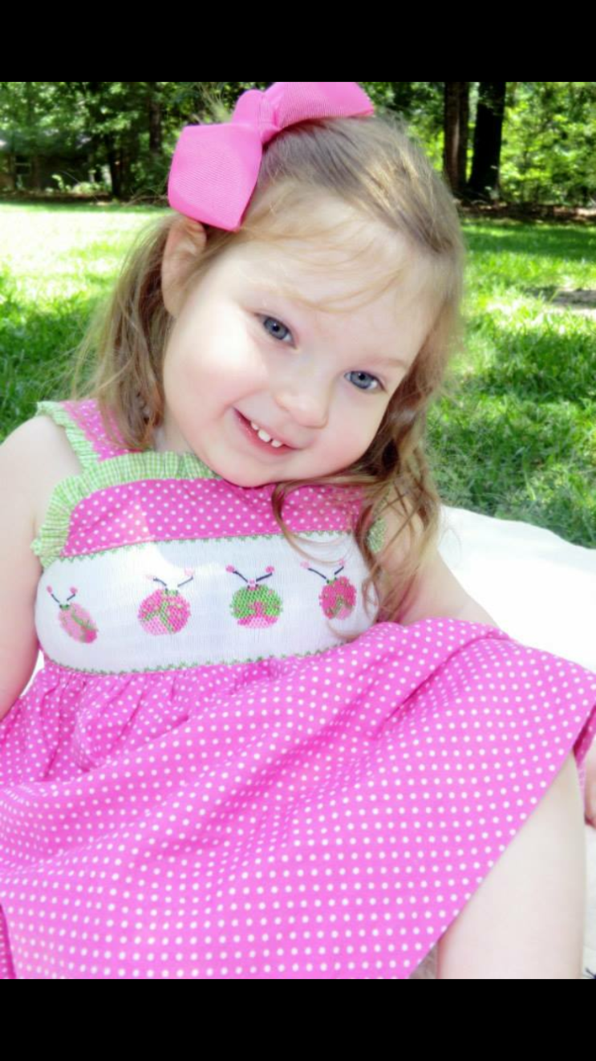

Slide 54
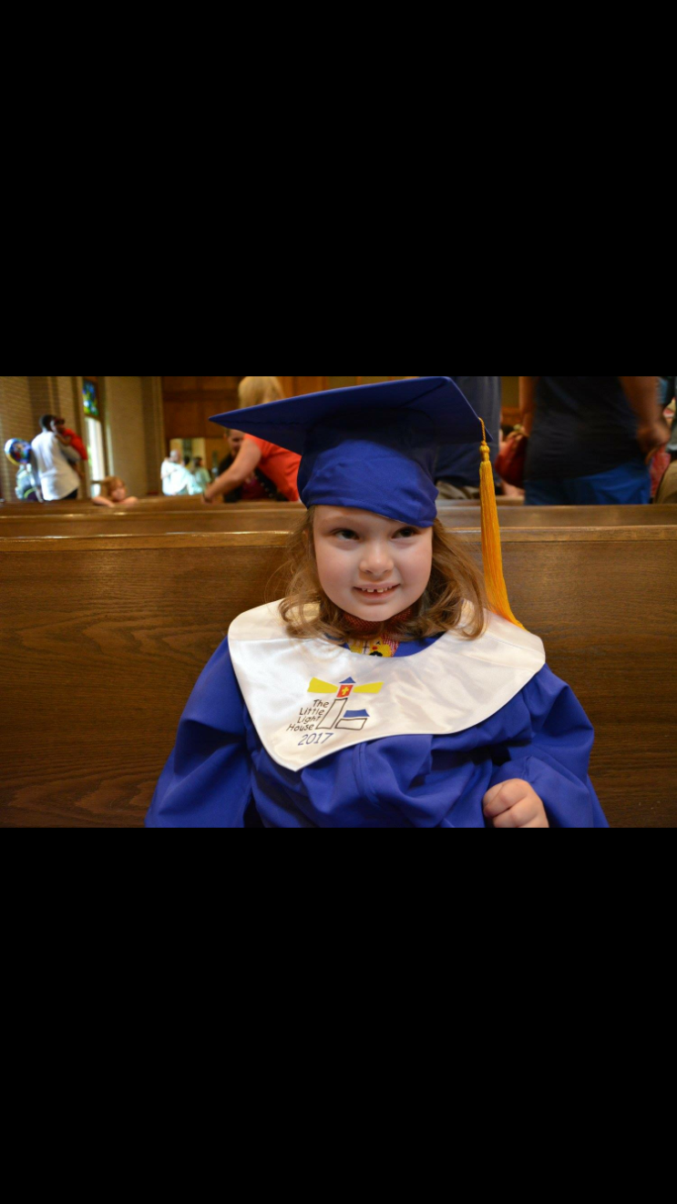

Slide 55
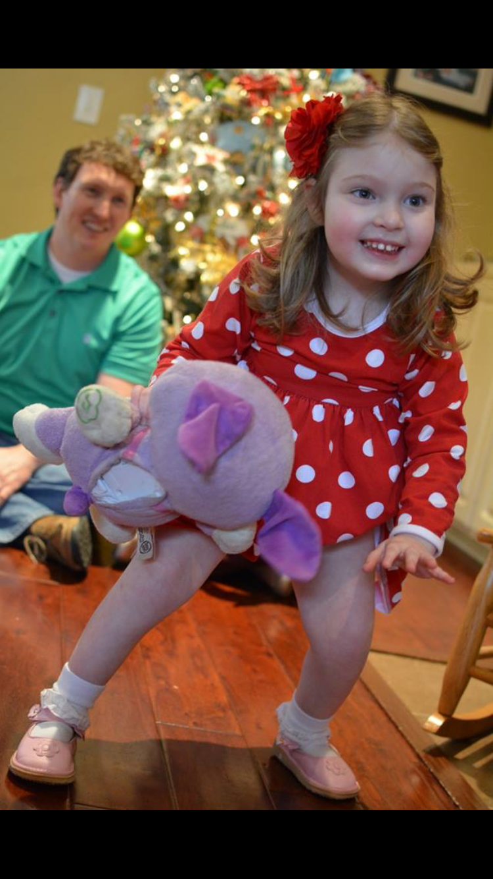

Slide 56
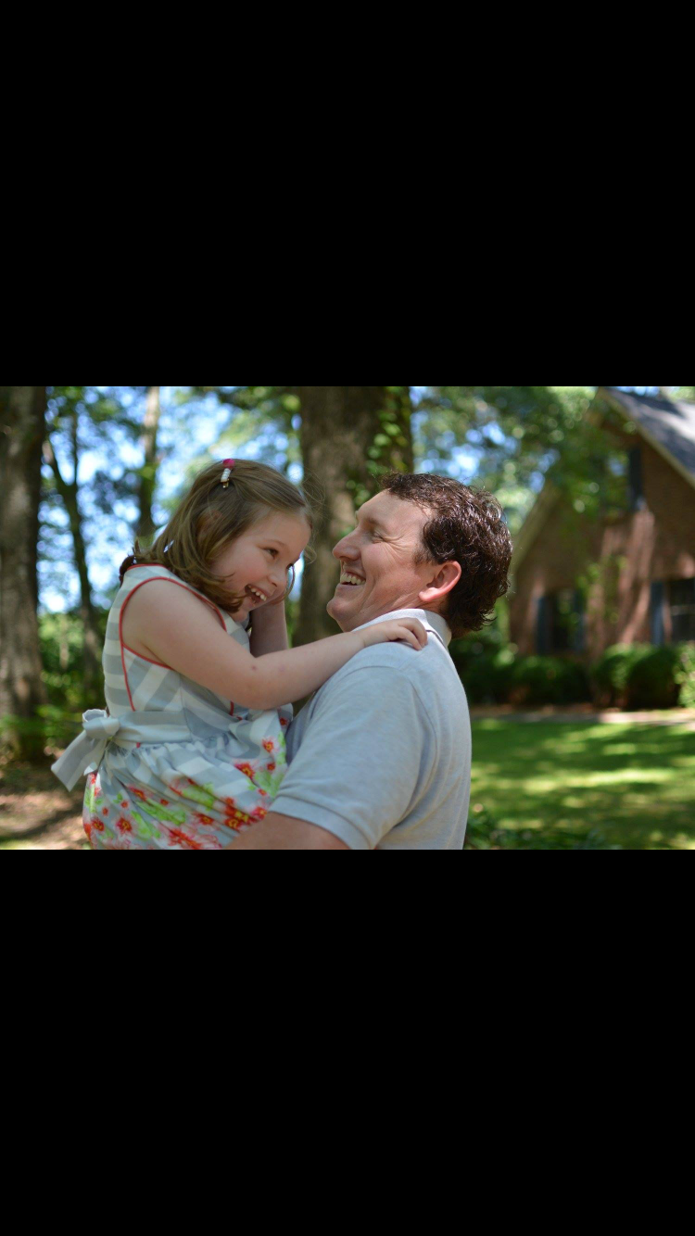

Slide 57
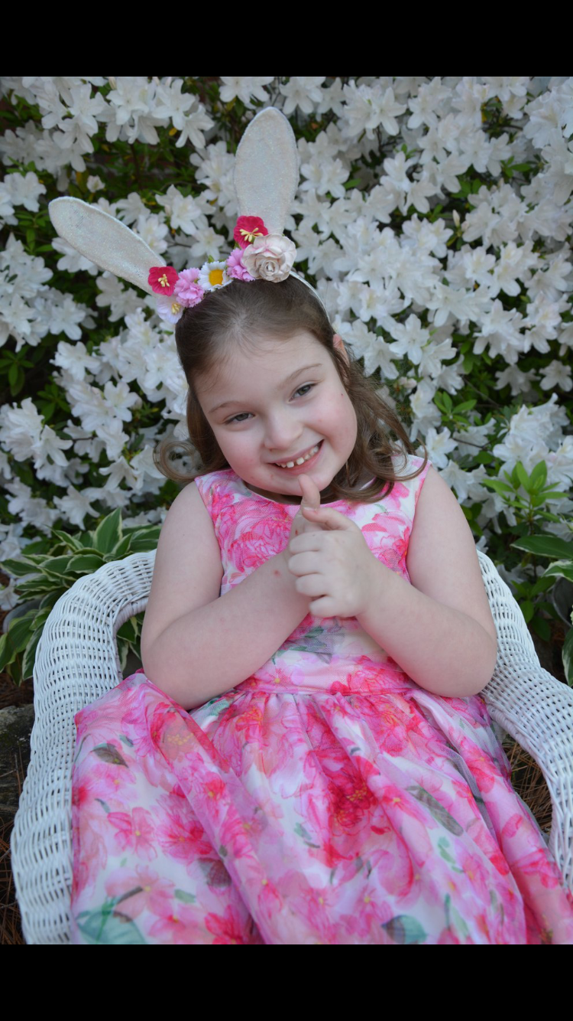

Slide 58
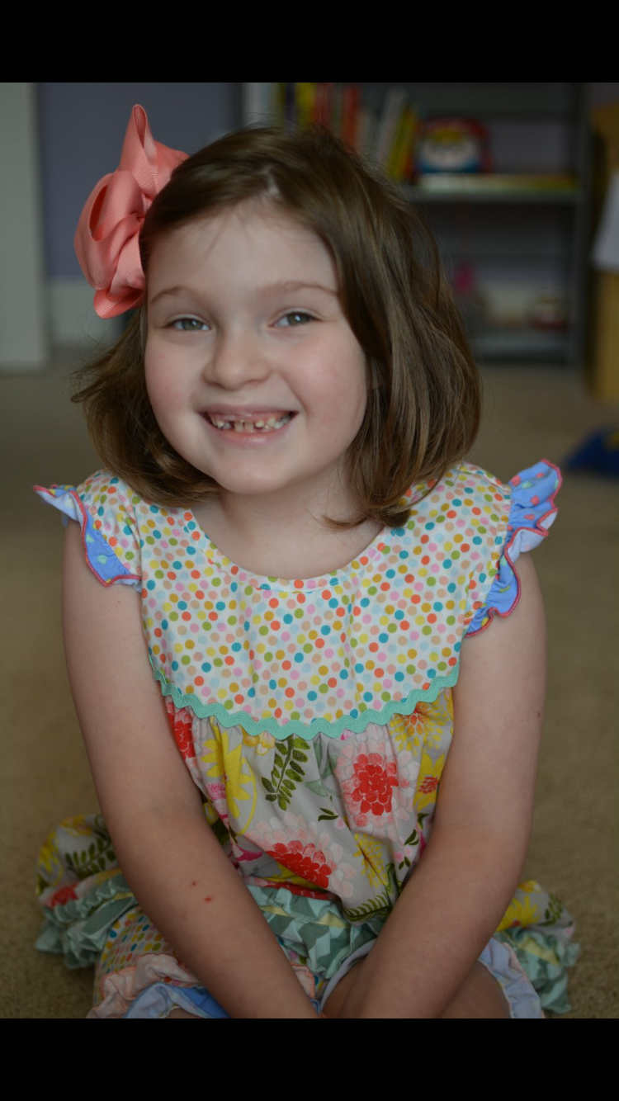

Slide 59
More wisdom from Dr. Remen
Mystery seems to have the power to comfort, to offer hope, and to lend meaning in times of loss and pain. In surprising ways it is the mysterious that strengthens us at such times. I used to try to offer people certainty in times that were not at all certain and could not be made certain. I now just offer my companionship and share my sense of mystery, of the possible, of wonder.
Rachel Naomi Remen
Notes:
I will close with this quote and tie it into my evolution as a young physician with delusions of influence over the uncontrollable to a (hopefully) wiser older physician who embraces mystery.
CLOSE WITH - At this point, I'd like to turn the program over to Beth for our Question and Answer session.

Slide 60

Questions & Answers
W. Richard Boyte, MD, MA
Palliative and Supportive Care
Forrest General Hospital
Beth Lown, MD
Medical Director
The Schwartz Center for Compassionate Healthcare
Type your questions in the Questions Pane on your screen at any time.

Slide 61
Thank you for participating in today’s session.
Please take a moment to complete the
electronic survey upon exiting today’s program.
Visit theschwartzcenter.org for more details or to register for a future session.
Look for our webinar email invitations and share them with your friends!

