Slide 1
Creating a Culture of Caring
Compassion in Action Webinar Series
January 31st, 2018

Slide 2
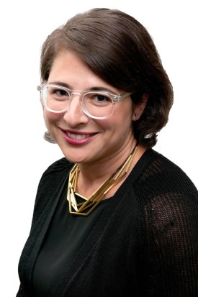
Moderator
Stephanie Adler Yuan
Director, Education & Training
The Schwartz Center for Compassionate Healthcare

Slide 3
Audience Reminders
This webinar is funded in part by a donation in memory of Julian and Eunice Cohen.
You may submit a question by typing it into the Question and Answer pane at the right of your screen at any time.
Please respond to audience polls by clicking on the answer of your choice.
We value your feedback! Please complete our electronic survey following the webinar.

Slide 4
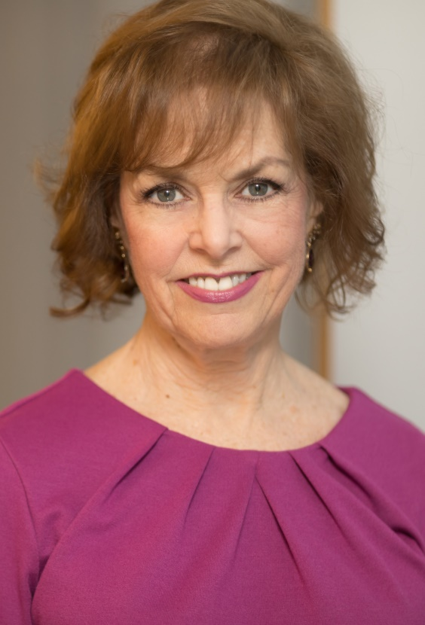
Host
Beth Lown, MD
Medical Director
The Schwartz Center for Compassionate Healthcare

Slide 5
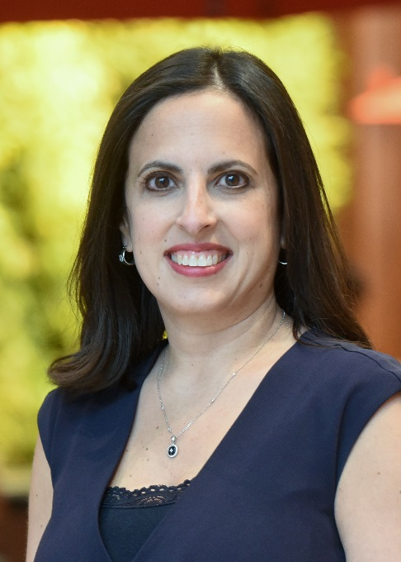
Today’s Speaker
Speaker Photo
Rana Awdish, MD
Medical Director, Care Experience Henry Ford Health System
Director Pulmonary Hypertension Program, Henry Ford Hospital

Slide 6
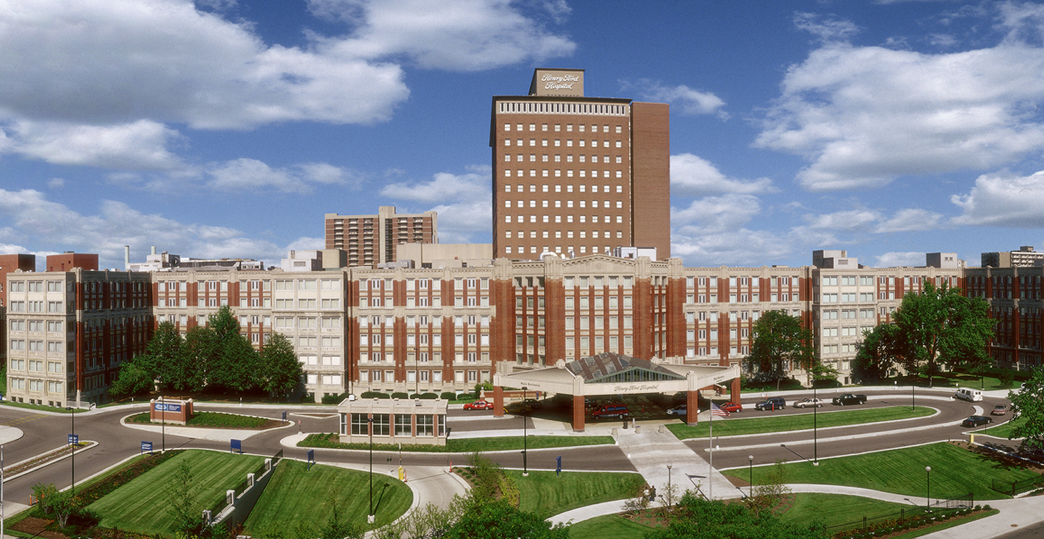
Notes:
I knew I wanted to be a physician from the time I was five years old. I watched my mother on the phone, as she described the way my infant brother was drooling, and leaning forward (tri-poding) in his crib. I listened as the pediatrician put the seemingly vague pieces together into a diagnosis of epiglottitis. I saw medicine as this beautiful melding of science and listening, and from that moment, it was all I ever wanted to be. I spent the next three decades of my life, following a vectored curriculum, believing I would emerge transformed and able to heal.
In medical school I fell in love with the human body, in all forms. The anatomy, the genetic code, the divine elegance of the disease states. And it continued through residency and fellowship. Medicine became my orientation and my identity. Understanding and treating diseases became my purpose.

Slide 7

Notes:
Until the final day of my fellowship when a tumor ruptured in my liver, and in the space of two hours I went into multisystem organ failure. My liver would fail from the compression of the blood volume, my kidneys would shut down from lack of blood flow, I would receive 26 units of packed cells with additional cryo, platelets and FFP. I’d be placed on a ventilator and have a stroke.
As toxins began to accumulate in my bloodstream, in the operating room I heard them say, “We’re losing her.” I thought to myself that they were right, that if I could see myself on the table, that perhaps I was already lost. I felt small, weightless (buoyant even) and yet expansive as if I were part of everything at once. The devastating pain that had brought me into the hospital was gone, and I felt completely at peace.
The baby I was seven months pregnant with would not survive, but I would, thanks to the incredible grace and skill of my medical team.

Slide 8
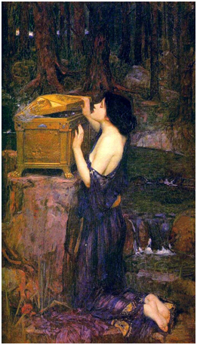
Notes:
That immediate transposition, from critical care physician to dying patient made visible to me the things I hadn’t been able to see. I saw things about us, physicians and other medical providers that I might not have wanted to see. There were deficits in communication, dis-coordinated care. I saw how flawed my orientation to disease had been. How I had in so many ways viewed the patient, not as a person, but as a position in space where the diseases that I loved would land. How I had disarticulated myself from emotion, the way I had been instructed to, so that I could remain objective and demonstrate sound medical judgement. I saw it too, in the doctors who cared for me. I’ll tell you a story that brings this into clearer focus.

Slide 9
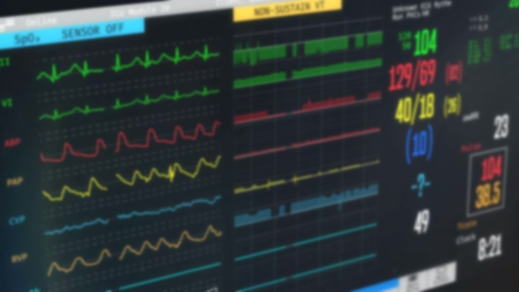
Notes:
Two weeks out from that first catastrophic night, I was in the surgical ICU. I’d come off the ventilator, but my respiratory status was still precarious. My kidneys had failed, a result of the hemorrhagic shock and hastened by a drug-administration error, and fluid was rapidly accumulating in my lungs. I was alone in my ICU room, the nurse had laid me flat and left to get something she’d forgotten.
My heart rate accelerated and my oxygen saturation plummeted. My alarms sounded, but they were always sounding, and had lost meaning. At that point, we all had alarm fatigue.
My vision tunneled and I gasped useless breaths. My arms flailed and I knocked the call button onto the floor, effectively eliminating that option. But as I began to lose consciousness, I saw above me, like a beacon, the code blue button. I pressed it.
The room filled quickly with confused but very engaged providers, who whilst wondering aloud who had called the code, simultaneously inserted drainage catheters into the space around my lungs, my stomach, provided high flow oxygen and made me breathe again. Amazingly well-choreographed interventions which were lifesaving, and yet when they went to leave, I tried to stop them.
“Wait,” I asked them, “Can we talk about what just happened?”

Slide 10
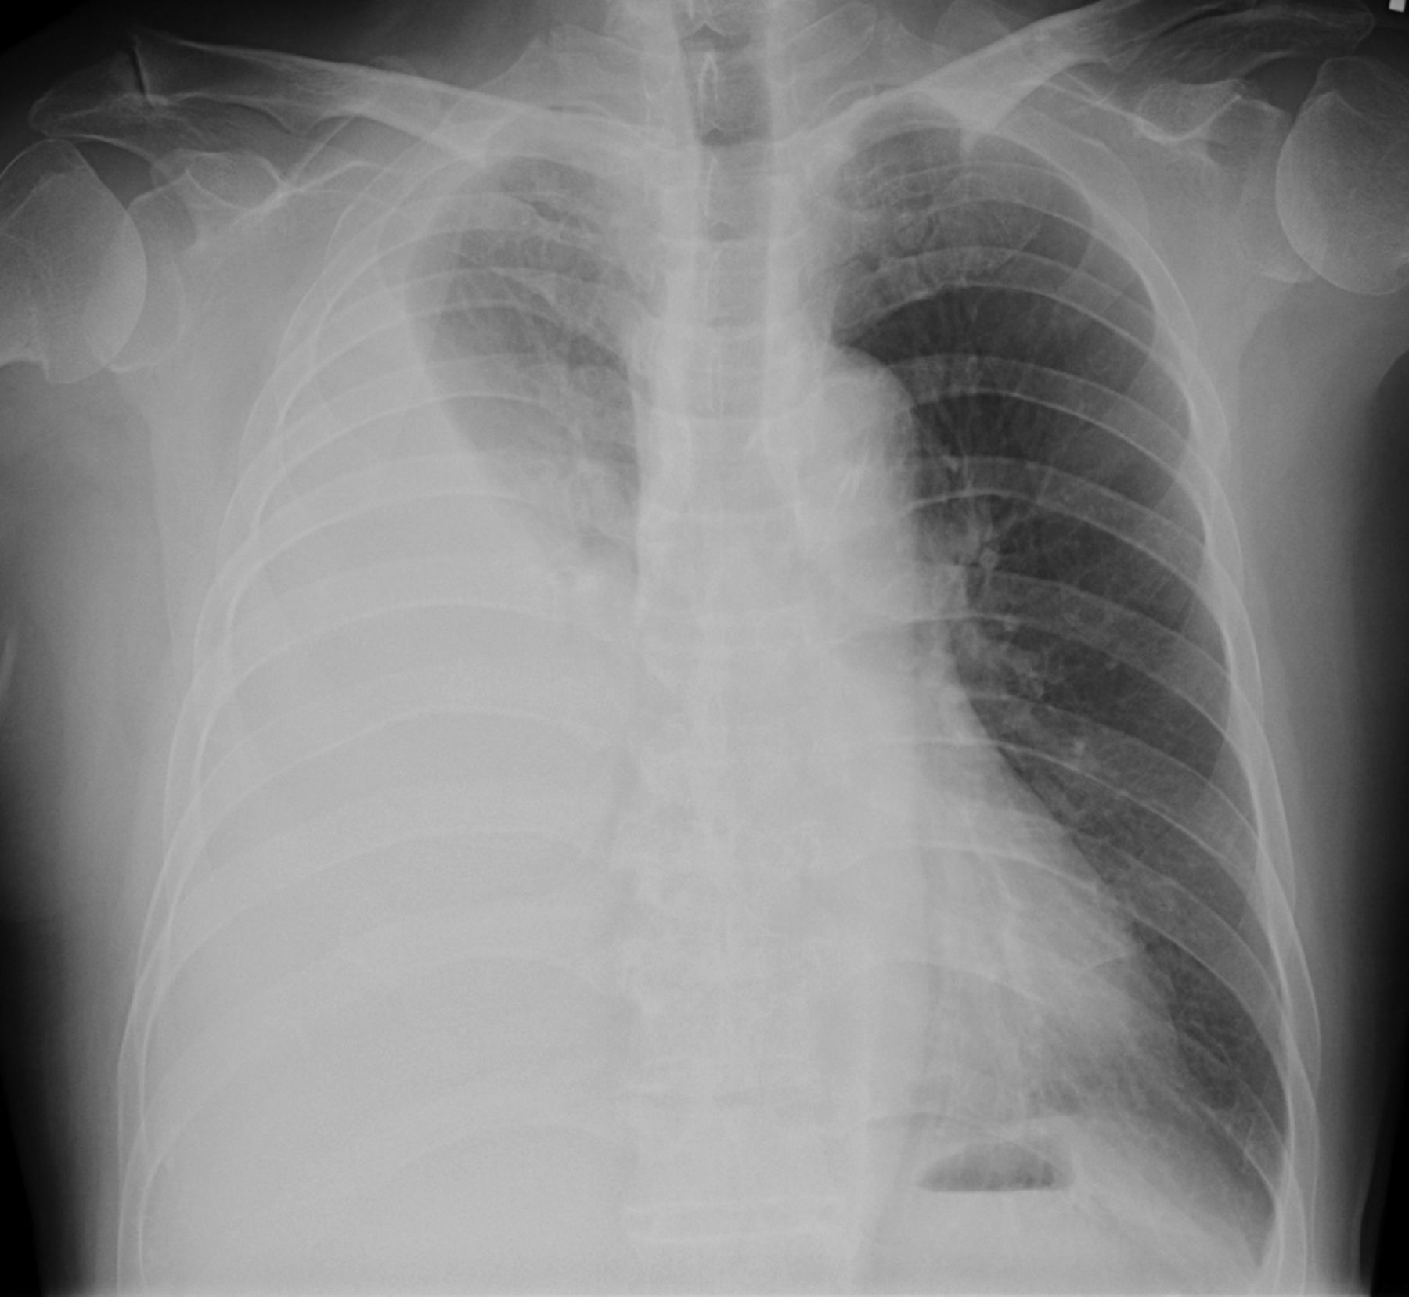
Notes:
One of them turned around and explained the pleural effusion, the accumulation of liters of fluid they had drained that were effectively drowning me.
But, that wasn’t what I meant. I wanted to talk about how I had nearly died. Twice now, for those of us who were keeping track.
It felt as if we should be talking about it. At that point, having completed my critical care fellowship at an active tertiary care center, I had probably participated in or run hundreds of codes. I had never once, not ever, considered talking to the patient about their near-death, mortality or emotions about it.

Slide 11
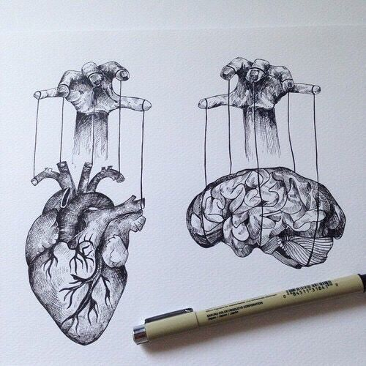
Notes:
Doctors have this tendency to believe that all questions are a request for data. My question was not a request for data. Doctors have this tendency to believe that all questions are a request for data. It’s how we were trained. It’s a far harder task to decode the emotion encoded in the question. To see the fear and know how to respond.

Slide 12
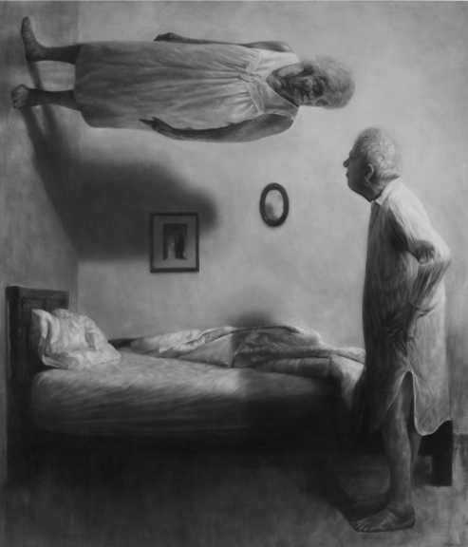
Notes:
That poor doctor had no idea what I was asking of him. I am not sure I knew what I was asking him at the time. I knew why my kidneys had failed, I knew why I was in respiratory failure, but I didn’t understand WHY.
We must be sure we truly understand the questions being asked.
We must be sure we understand each other’s perspective.

Slide 13
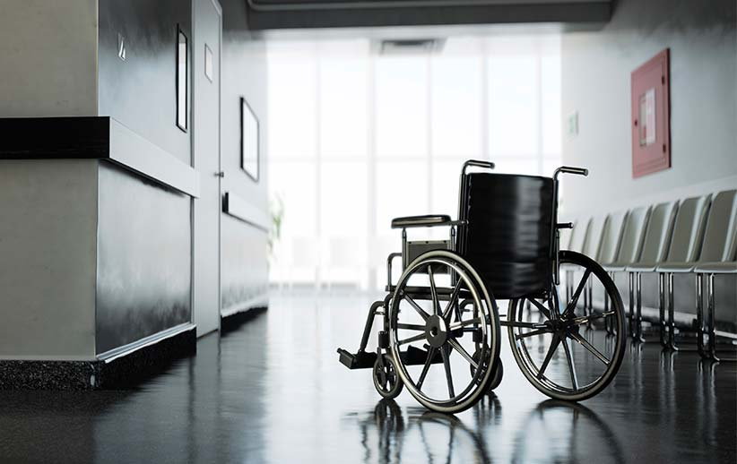
Notes:
I entered the hospital a physician. I left, weeks and weeks later, in a wheelchair, having had a stroke from lack of blood flow to my brain, I was missing words (important words, some of my favorite words, like shoes). I was unable to put my socks on unassisted, unable to walk more than a few steps. I had to completely reimagine my identity.
That was a gift. The wound is the gift.
In that empty space where I no longer existed, I had the opportunity to truly examine what medicine had given me, and what it didn’t have to give.
We all want to be seen. To have our lives reflected back to us in a way that helps us to make sense of what can feel like chaos. This need is more acute in times of critical illness, but it is part of what makes us human. It is what unites us. And yet I saw that my disease-oriented training, even the model medicine had adopted of impartial intellectual curiosity wasn’t aligned with my needs.

Slide 14

Notes:
I had to reimagine what kind of physician I would be when I returned to medicine. I had to light my escape fire. To Un-learn. I had to reexamine how I could be an instrument of healing in the way my patients needed me to be. I found a humility there, in being present for my patients, honoring their strength, asking generous questions, learning their fears. I found inhabiting the role of humble Sherpa felt much more authentic and right to me than any sort of perceived authority. I knew the path, through sickness, and I could map it, warn them of pitfalls and the traps. The thing is, I knew all of those things before too. I just didn’t know how much our patients needed us to light their way, and in turn how much we needed them.

Slide 15
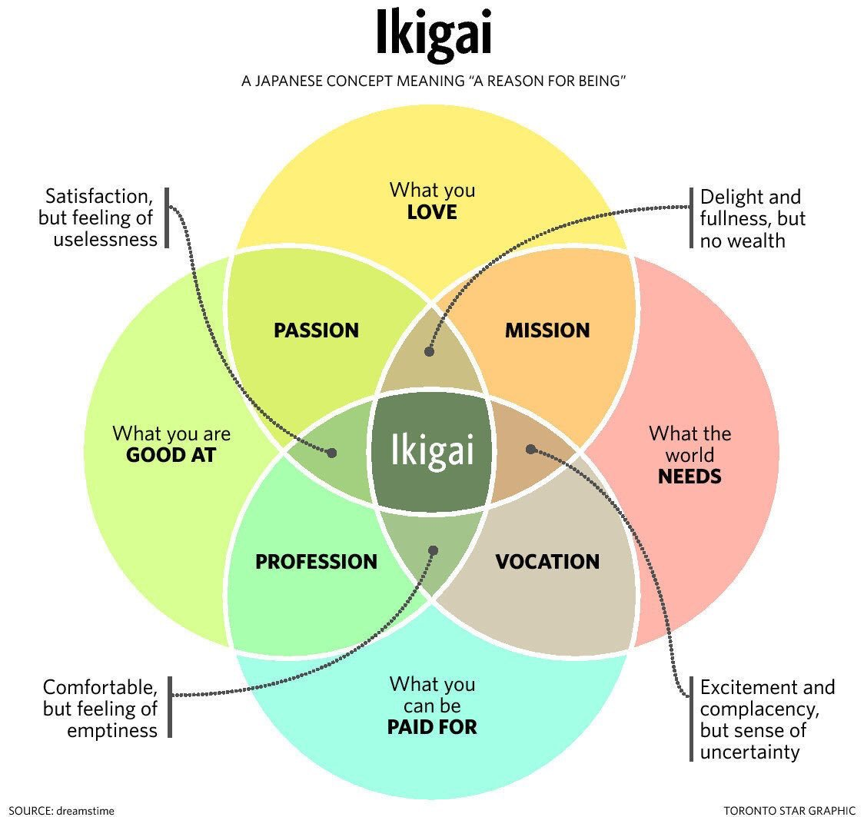

Slide 16
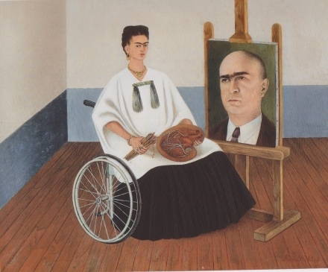

Slide 17
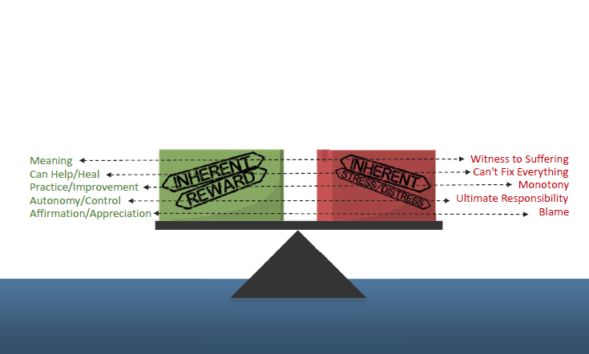
Always ‘On Call’
Workload/Productivity
EMR Requirements
Scheduling & Patient Flow
Other Departs’ Performance
Poor Leadership
Lack of aligned values
Dysfunctional Relationships
Lack of Recognition

Slide 18
Polling Question 1

Slide 19


CLEAR Conversations
Connect
C
Our vision is to build a culture of empathic, person-centered communication with our patients and their families
Utilizes skilled improvisational actors for simulated practice and protocols to reinforce skills at the bedside
Listen
L
Empathize
E
Align
A
Respect
R

Slide 20
What is Empathy?
Feeling With Other People
Four Qualities of Empathy
Taking
another’s perspective
Staying out of Judgement
Recognizing emotion
Responding to
the emotion
Notes:
I like this definition from Theresa Wiseman.

Slide 21
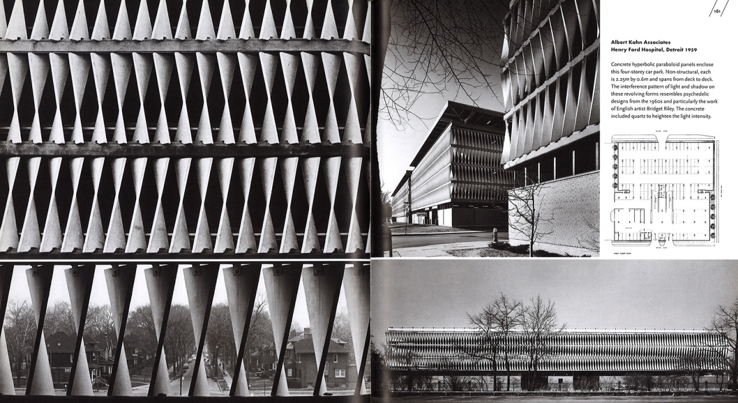
Onboarding

Slide 22

Yoga at work

Slide 23


Slide 24
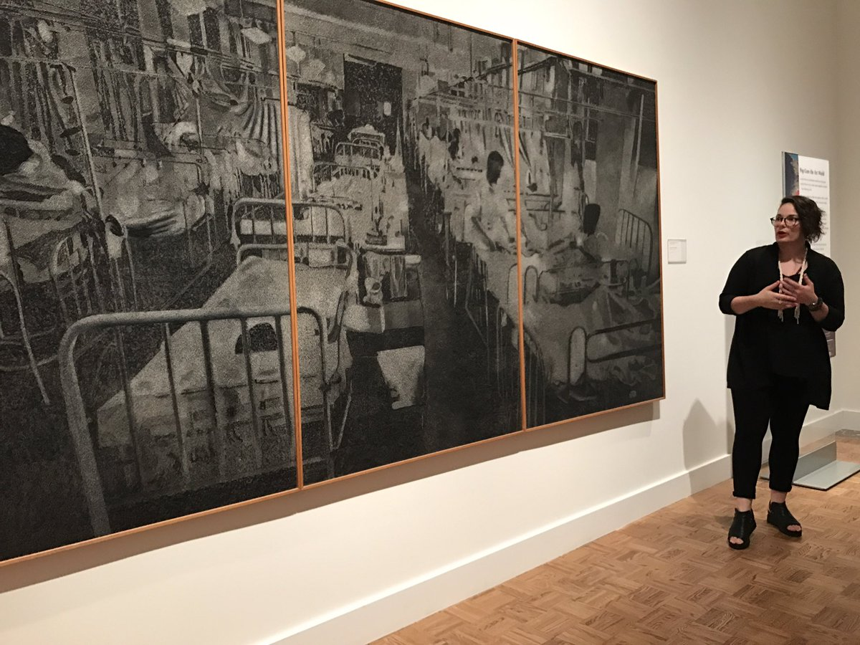

Slide 25
Polling Question 2

Slide 26


Questions & Answers
Rana Awdish, MD
Medical Director, Care Experience
Henry Ford Health System
Beth Lown, MD
Medical Director
The Schwartz Center for Compassionate Healthcare
Type your questions in the Questions Pane on your screen at any time.

Slide 27
Thank you for participating in today’s session.
Please take a moment to complete the
electronic survey upon exiting today’s program.
Visit theschwartzcenter.org for more details or to register for a future session.
Look for our webinar email invitations and share them with your friends!

