Slide 1
Fostering Compassion: One Breath, One Pause, One Community
Compassion in Action Webinar Series
March 21, 2018

Slide 2
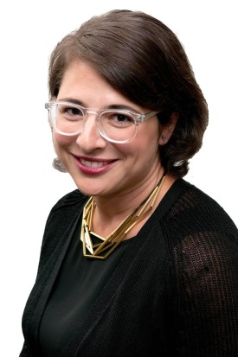
Moderator
Stephanie Adler Yuan, MS
Director, Education & Training
The Schwartz Center for Compassionate Healthcare

Slide 3
Audience Reminders
This webinar is funded in part by a donation in memory of Julian and Eunice Cohen.
You may submit a question by typing it into the Question and Answer pane at the right of your screen at any time.
We value your feedback! Please complete our electronic survey following the webinar.

Slide 4
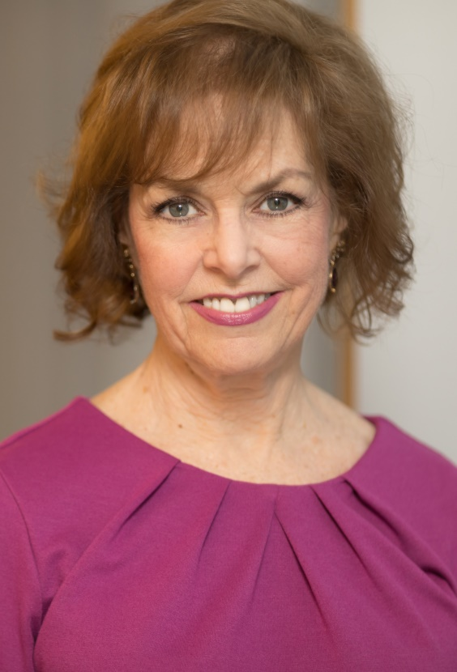
Host
Beth Lown, MD
Chief Medical Officer
The Schwartz Center for Compassionate Healthcare

Slide 5




COMPASSION is
great healthcare.
Know a healthcare professional or team
that demonstrates extraordinary compassion for patients and families?
Nominate them for the 2018 National
Compassionate Caregiver of the Year Award.
See details and nominate at: theschwartzcenter.org/award
Nomination deadline: March 30, 2018

Slide 6
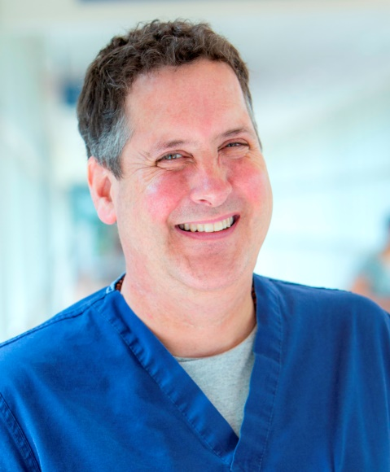
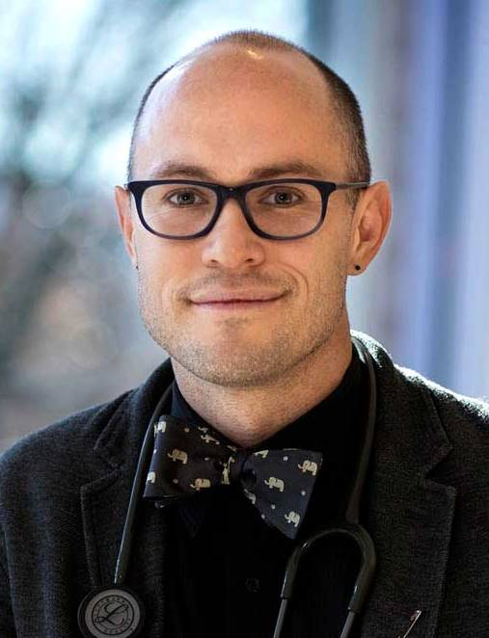
Today’s Speakers
Jonathan Bartels, RN, BSN, CHPN
University of Virginia Health System
Tim Cunningham, DrPH, RN
University of Virginia School of Nursing

Slide 7
Fostering Compassion:
One breath, one pause, one community

Slide 8
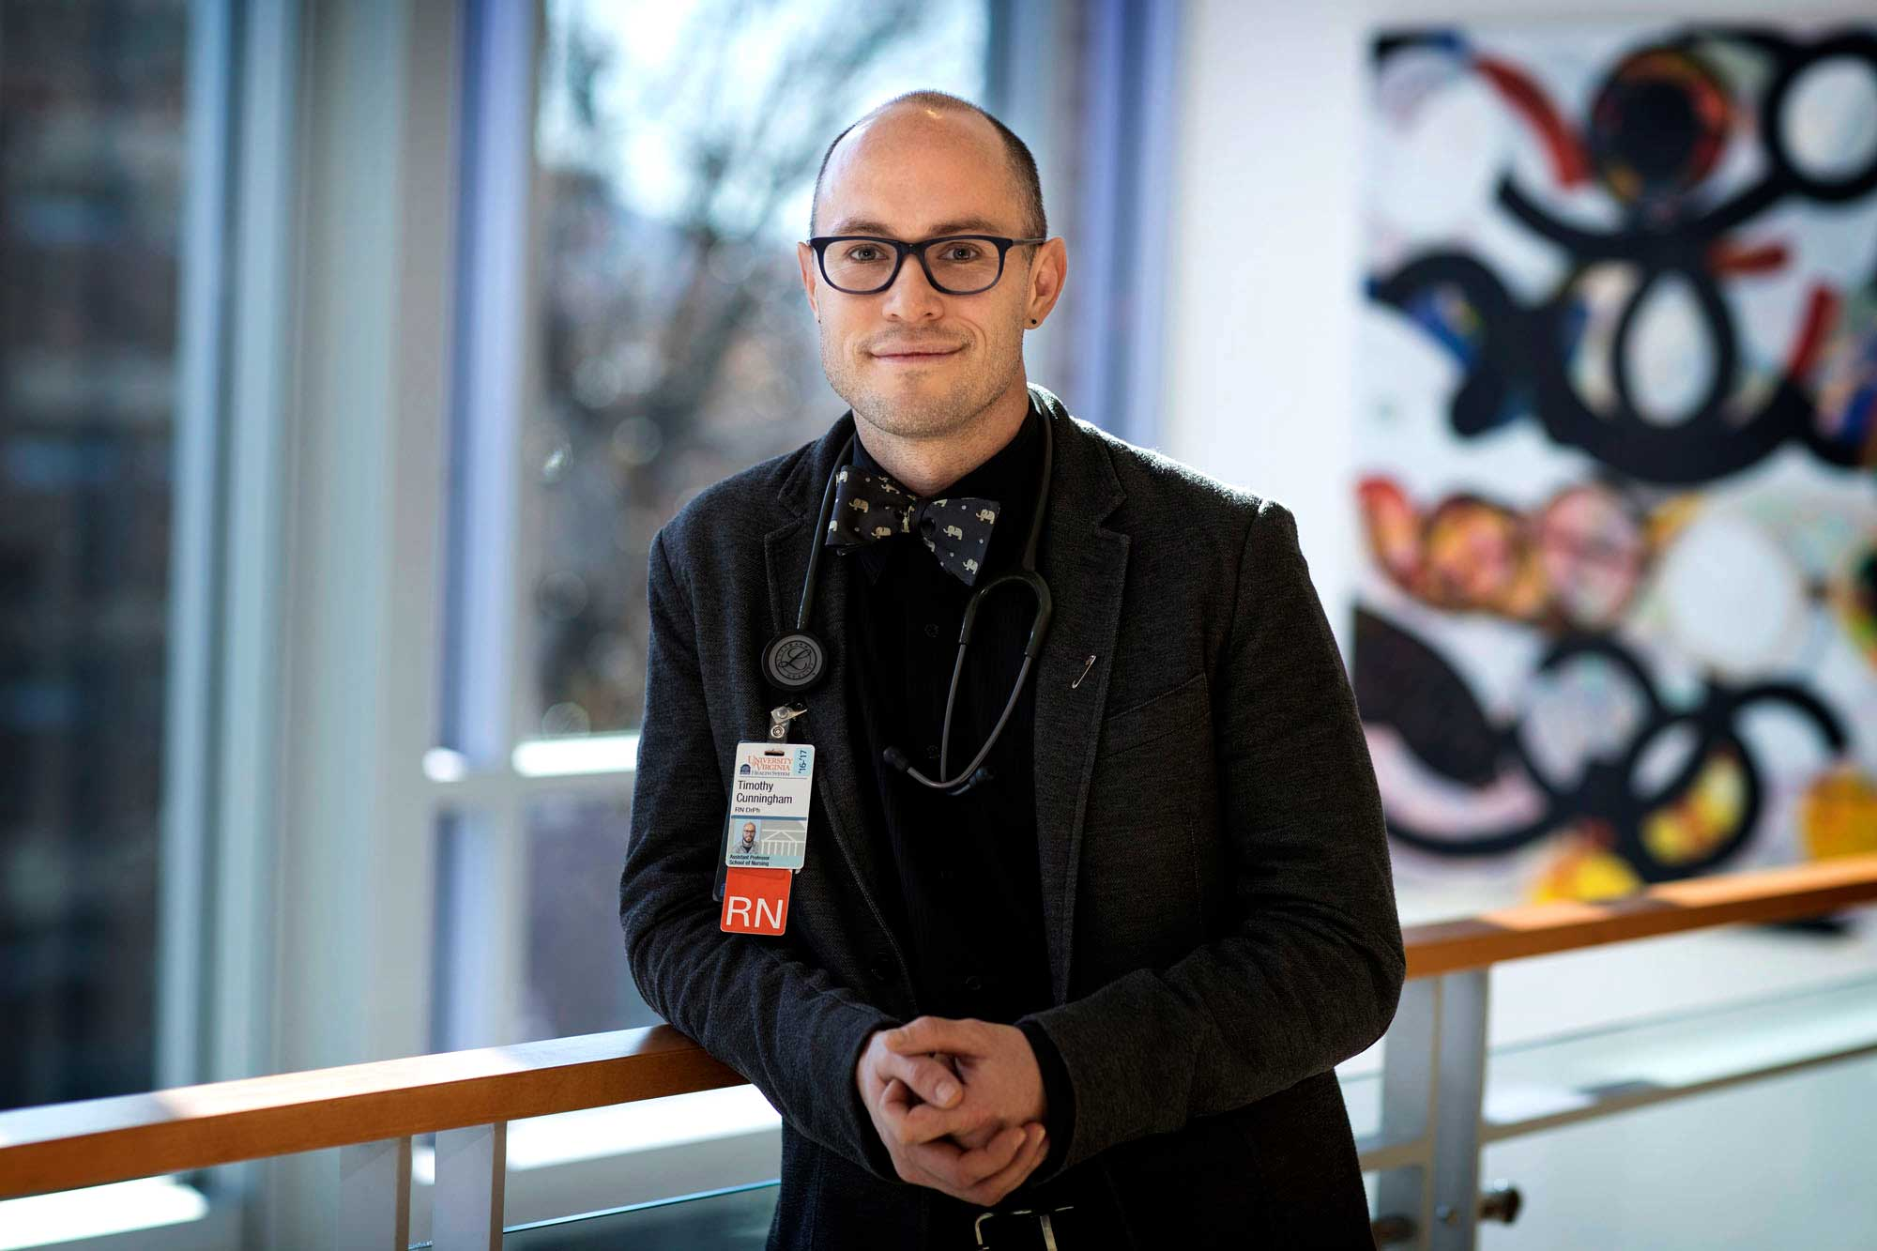
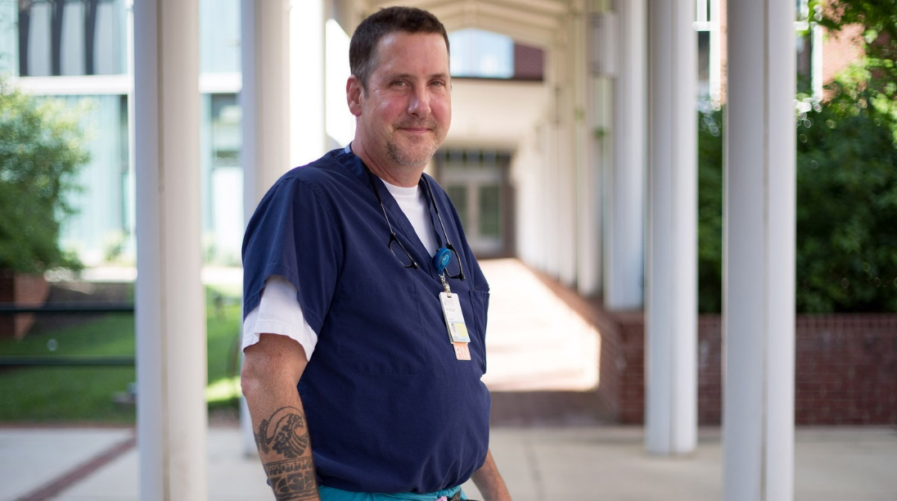
Introductions
Tim Cunningham, DrPH, RN
Jonathan Bartels, RN, BSN, CHPN

Slide 9


Slide 11
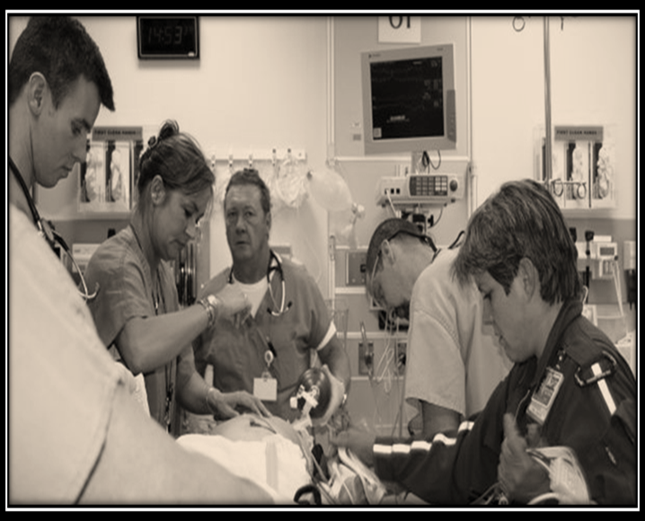

Slide 12


Slide 13

Notes:
Three-fourths of RNs report that stress and overwork are our top concerns.
34 percent of nurses and half of all doctors say they’re already burned out.
Recognize that burnout is more closely associate with added workload, other job duties that take us away from patients.

Slide 14

Notes:
I hear from my students all the time that – once they’ve launched into work beyond nursing school – that the world of nursing is filled with working wounded. They feel overwhelmed my work, by systems, and by people who have compassion fatigue, whose hearts have been broken, and who trudge through their days in a fog of burden, moral distress and yes, trauma.
More than a third of us are ready to leave nursing after a single year. Of the 13 percent of RNs who DO change principal jobs after a year, 14 percent of nurses leave the field altogether.

Slide 15
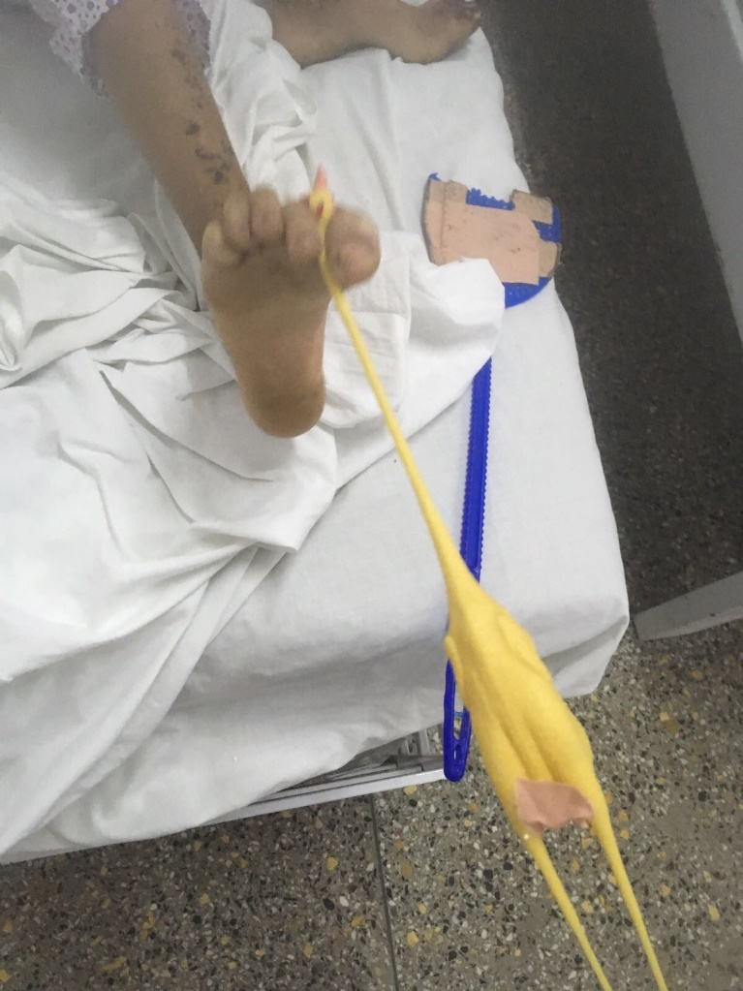

Slide 16

Thank you
Jonathan Bartels
JBB4X@hscmail.mcc.virginia.edu
Tim Cunningham
tdc8h@virginia.edu

Slide 17



Questions & Answers
Jonathan Bartels, RN, CHPN
University of Virginia Health System
Tim Cunningham, RN, DrPH
University of Virginia School of Nursing
Beth Lown, MD
Chief Medical Officer
The Schwartz Center for
Compassionate Healthcare
Type your questions in the Questions Pane on your screen at any time.

Slide 18
Thank you for participating in today’s session.
Please take a moment to complete the
electronic survey upon exiting today’s program.
Visit theschwartzcenter.org for more details or to register for a future session.
Look for our webinar email invitations and share them with your friends!

