Slide 1
Schwartz Rounds Facilitation
Nuts & Bolts
A Schwartz Center Office Hours Webinar
August 13, 2018

Slide 2
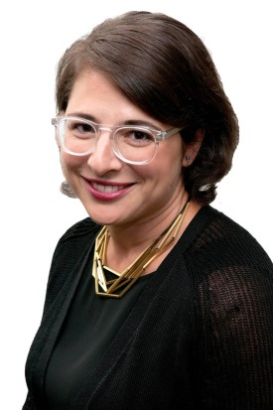
Your Moderator & Host
Stephanie Adler Yuan
Director, Education & Training

Slide 3
Audience Reminders
You may submit a question by typing it into the “Questions” pane at the right of your screen at any time.
Please respond to audience polls by clicking on the answer of your choice.
We value your feedback! Please complete our survey following the webinar.

Slide 4
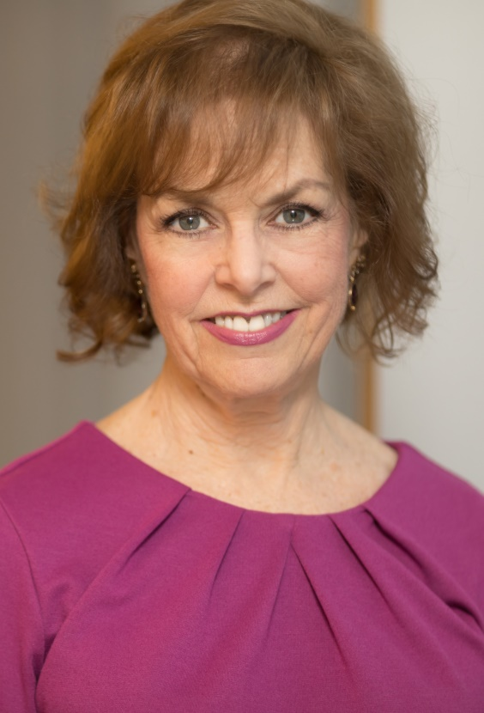
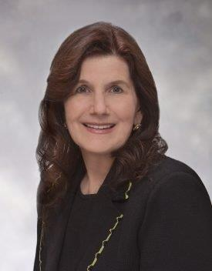
Your Co-Hosts
Beth Lown, MD
Chief Medical Officer
Kathy Scopin, RN
Member Experience Advisor

Slide 5
Today’s Webinar
The Role of the Schwartz Rounds Facilitator
  Phases of Schwartz Rounds Facilitation: Before, During, After
Cultivating Your Facilitation Practice: Characteristics & Behaviors
Additional Resources for Schwartz Rounds Facilitators
Q&A

Slide 6
The Many Hats of a
Schwartz Rounds Facilitator...

Slide 7
Teacher
Host
Ringmaster
Conductor
Role Model

Slide 8
What is the role of a
Schwartz Rounds Facilitator?

Slide 9
Breaking It Down: The Role of the Schwartz Rounds Facilitator
Before Schwartz Rounds
  Prepare the panelists = prepare yourself
During Schwartz Rounds
  Introduce the session; set the tone
  Support panelists
  Guide discussion
  Wrap it up
After Schwartz Rounds
  Debrief with panelists and Planning Committee
  Review evaluations to inform planning

Slide 10
Polling Question 1

Slide 11
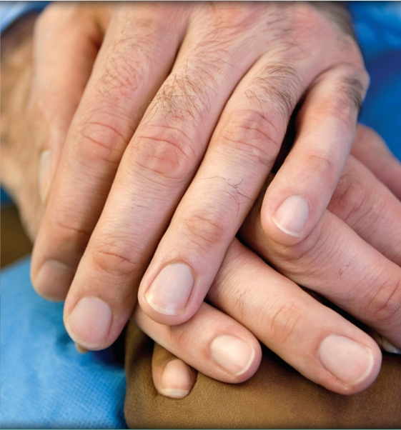
Before: Preparing the Panelists
  What to Cover
  Purpose of Schwartz Rounds
  Role of panelists
    What & how
    Non-verbal cues
    Your support
  Panelist story
  Comfort level with public speaking
  Any questions?

Slide 12
Before: Preparing the Panelists
Three Guiding Principles
  “I know the patient’s story. I want to hear your story.”
  Focus on speaking in first person and using feeling words.
    NO: “That situation was really sad.”
    YES: “I felt sad.”
  Make the panelists feel comfortable and safe: “How can I help you tell your story?”

Slide 13
Before: Preparing Yourself
  Develop a ”game plan.”
    Consider using nonverbal cues with panelists.
    Consider questions, prompts, themes for session.
    Anticipate challenges.
    Define speaker order.

Slide 14
During: Introduction
  Coordination with Physician Leader, co-Facilitator
  Purpose of Schwartz Rounds
    “This is for us.”
  Context
    The Schwartz Center, Ken’s Story
  Ground Rules
    Electronic devices, confidentiality, respectful listening, safe space
  What to Expect
  Introduce Topic and Panelists

Slide 15
Polling Question 2

Slide 16
Some Thoughts on
Co-Facilitation…

Slide 17
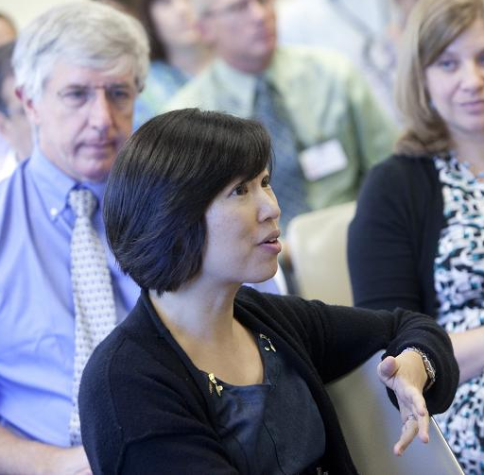
During: Working with Participants
Managing content AND process
Mechanics: Keeping time and calling on people
Modeling behaviors of compassionate caregivers
Schwartz Rounds at Harvard Vanguard Medical Associates, Cambridge, MA

Slide 18
During: Wrapping It Up
  Leave time to “button everyone back up.”
  Remind participants to fill out evaluations.
  Express gratitude to participants, panelists, Planning Committee members.
  Highlight relevant resources for additional information support.
  Offer moment for reflection or reiterate themes of discussion.

Slide 19
During: Closing Thoughts on Compassion
  Compassion can come from anyone, at any time.
  We care for family members as much as we do patients.
  Seeing the patient as a person, not a “case”
  Appreciating the perspectives, experiences, and contributions of colleagues
  Value of teamwork, supporting one another
  Importance of and strategies for self-compassion, self-care
  Feelings happen.

Slide 20
After: Debriefing Schwartz Rounds
Check in with panelists.
Review session and evaluations with Planning Committee.
Designate a Planning Committee member to follow up with any participant who seemed challenged by the session.

Slide 21
Cultivating Your Facilitation Practice

Slide 22
Polling Question 3

Slide 23
Modeling Behaviors
Respect
Appreciation
Curiosity
Nonjudgmental positive regard
Active, reflective listening
Patience, comfort with silence
Tolerance of uncertainty

Slide 24
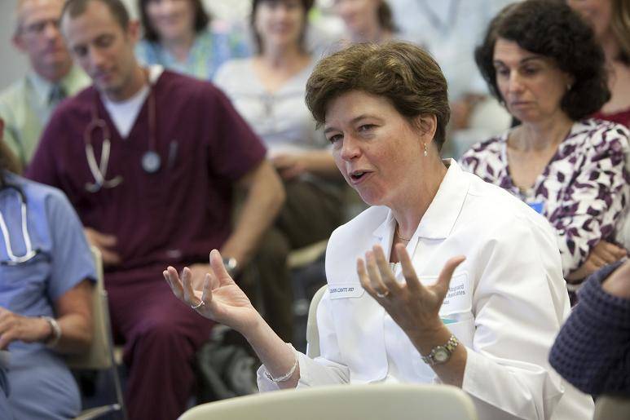
Facilitation Techniques
Ask questions
Name the feeling
Reflect
Connect
Include
Recognize
Use silence
Schwartz Rounds at Harvard Vanguard Medical Associates, Cambridge, MA

Slide 25
Managing the Flow
Manage derailments
  Keep discussions focused on emotions and experiences, away from problem-solving.
Manage time
  Signal the impending end of the session: “We have time for one more comment.”
  Acknowledge at session’s end that not everything will have been said.
Notes:
Managing the discussion
Explain “the parking lot”
During UBSR discussions, facilitators can create a “parking lot” for organizational issues that must be addressed by others later (e.g. quality and safety, HR, others)
The PL and facilitator will note any issues that require follow-up, discuss them with the unit managers/leaders after the Rounds and ascertain who will be responsible for their follow-up.
Post-UBSR evaluation forms will also include a section for comments, issues that require follow-up or policy changes.
Managing derailments
Respectfully transition back to the case, stories, key themes and perspective sharing when participants start to problem-solve or “fix”
Explain to participants and set aside in “the parking lot” issues that arise that may require administrative attention later
Time management
“Sign-post” the impending end of the session: Announce when ~5 minutes are left and ask for additional comments, especially from those who wish to speak but have not yet; e.g. “I’m mindful we have only a few more minutes. We’d love to hear from those of you who haven’t yet spoken;” or, “We have time for 1 or 2 more comments.”
Graciously, “sign post” the actual end of the session; e.g. We know there’s more to say and some may not have had an opportunity to share, but to respect your time we will honor the time limits.

Slide 26

Managing Silence
Center yourself
Tolerate several seconds of silence
Be curious
Gently wonder what the silence may be about
Offer a question
https://outset.org.uk/supported-projects/jane-and-louise-wilson

Slide 27
Building
Deepening
What struck you?
What are you feeling now?
What are your thoughts?
Have you had similar experiences?
What resonates?
Ask for clarification
Reflect back the essence of what you’ve just heard
Listen for deeper, underlying themes
I’m hearing…
Does anyone see this differently?
What if…? Could it be possible that…?

Slide 28

Responding to Emotions
I hear … in your voice
You sound frustrated
Hold the emotions or the silence
Stand near by
fortune.com/2015/06/05/dealing-with-grief/

Slide 29
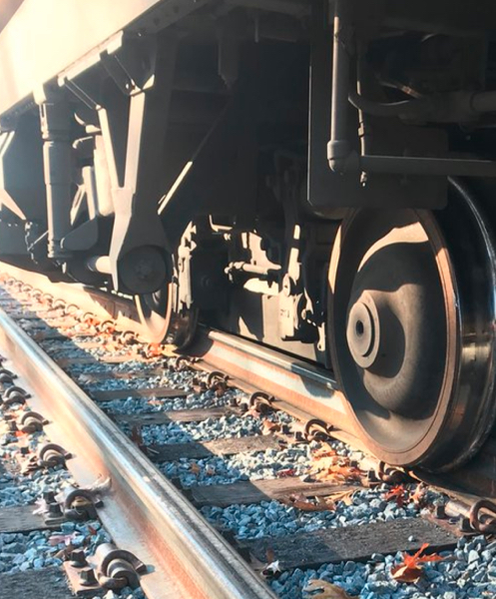
Managing Derailments
Thank you for that comment.
Let’s remember the goals of Schwartz Rounds…
I wonder if we can set that aside for the time being.
www.bostonmagazine.com

Slide 30
Moving Toward Closure
Begin to move from inward-looking reflection to community
Whom do you turn to for support?
How do you support each other?
What have you found to be helpful in these situations?
What strategies have you used?

Slide 31
Fostering a Schwartz Rounds Culture
Open forum
Cultivate respect for and recognition of multiple perspectives
Courage to discuss our human reactions and vulnerabilities
Recognize that there may not always be a 'right' or 'wrong' answer
Appreciate the complexity of clinical relationships
Acknowledge our shared humanity – we are all deserving of compassion

Slide 32
Additional Resources for
Schwartz Rounds Teams

Slide 33
Resources
Member Community Website
  Facilitation Training Videos
  Topic Database
  Past Office Hours Webinars
  FAQ
    To register for access, email Anna Ferrato for your organization code at aferrato@theschwartzcenter.org
Programs & Events
  Compassion in Action & Office Hours Webinars
  Facilitation Workshops
  Compassion in Action Conference: September 8-10, 2019
Your Member Experience Advisor

Slide 34
Q&A
Please type your questions into the “Questions” pane on your screen.

Slide 35
Thank you for participating in today’s session.
We love your feedback.
Please take a moment to complete our survey upon exiting today’s program.

