Slide 1
Stories of Compassion: Caring for People Experiencing Homelessness
Compassion in Action Webinar Series
May 7, 2018

Slide 2
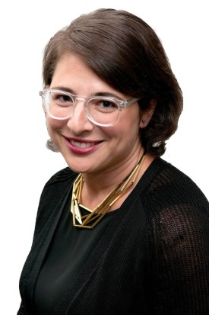
Moderator
Stephanie Adler Yuan
Director, Education & Training
The Schwartz Center for Compassionate Healthcare

Slide 3
Audience Reminders
This webinar is funded in part by a donation in memory of Julian and Eunice Cohen.
You may submit a question by typing it into the Question and Answer pane at the right of your screen at any time.
We value your feedback! Please complete our electronic survey following the webinar.

Slide 4
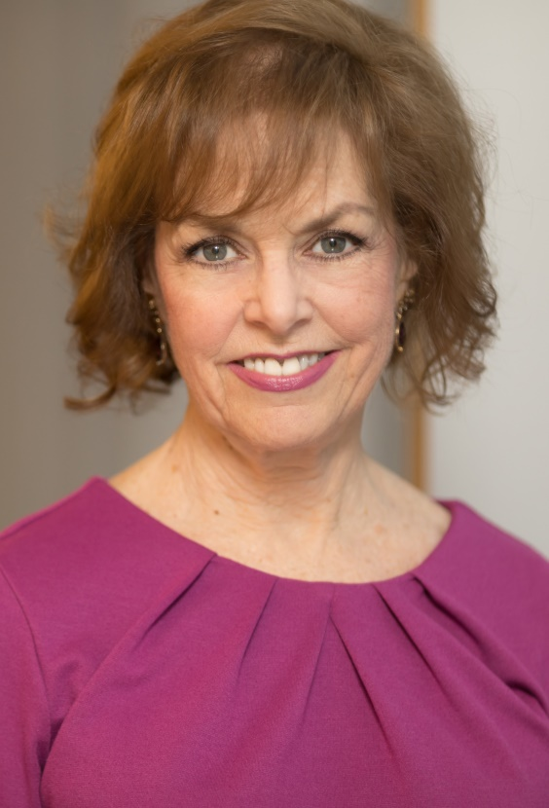
Host
Beth Lown, MD
Medical Director
The Schwartz Center for Compassionate Healthcare

Slide 5
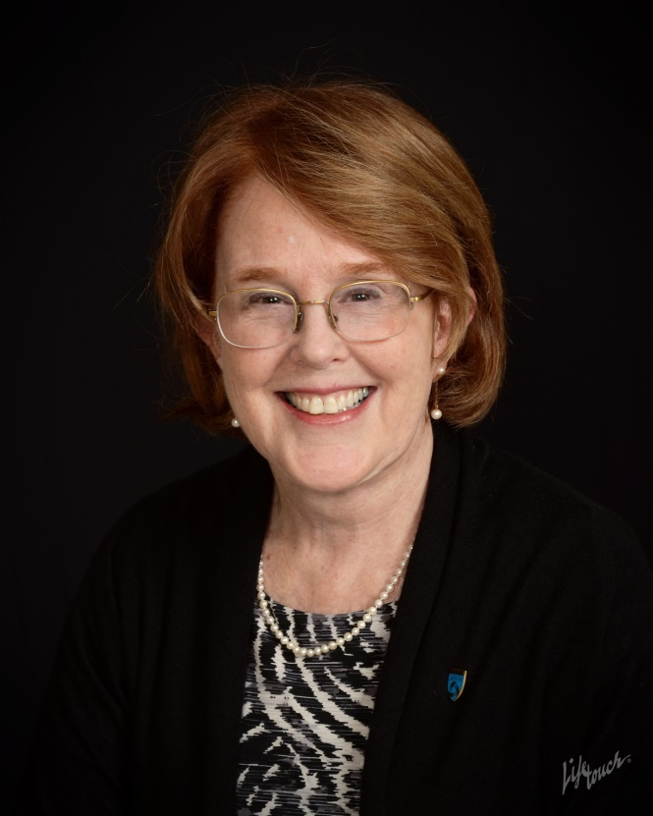
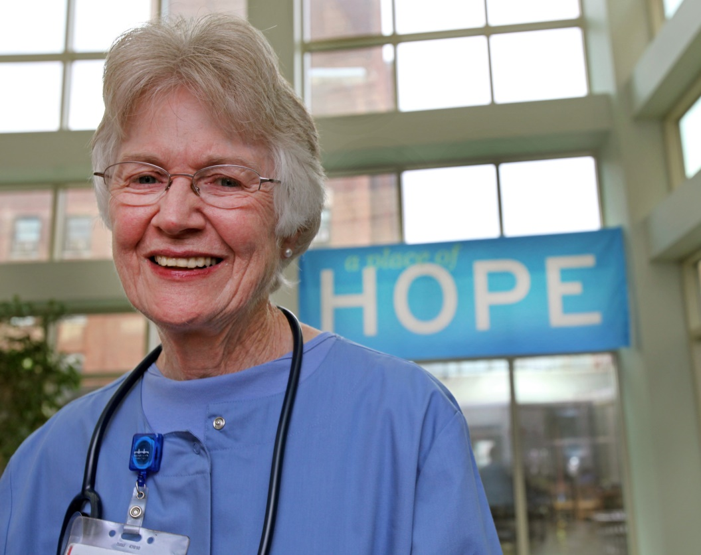
Today’s Speakers
Roseanna Means, MD
Brigham & Women’s Hospital
Founder and President, Health Care Without Walls
Gerry Mullin, RN
Formerly of
Boston Healthcare for the Homeless

Slide 6


Caring for People Experiencing Homelessness
(c) HCWW 2018/all rights reserved

Slide 7
US Health Care Costs
18% of GDP
Chronic disease treatment = 75% of expenses
Aging population
More out of pocket costs
(c) HCWW 2018/all rights reserved

Slide 8
Hunger & Homelessness--USA
(2014 report)
US Poverty rate 14% (43 million)
Increase in requests for emergency food assistance (27% unmet, in many cases food portions were reduced to meet demand)
Homelessness is increasing
  0.5-1.0 million homeless; 63% singles, 37% families (Point-in-time)
  Families, elders worst hit (>50% > 50 yo)
  2.5 million children homeless
  Lack of affordable housing = #1
  22% of requests for emergency shelter unmet
(c) HCWW 2018/all rights reserved

Slide 9
Hunger & Homelessness--Boston
(2017 report)
Nearly 7,000 homeless in Boston
Numbers rising
Increasing # of Older Women and Families
>25% of requests for emergency shelter are unmet
Women under-counted
  Census counts only sheltered, transitional, not doubled up, DV
(c) HCWW 2018/all rights reserved

Slide 10
Homelessness & Health Care Costs
Over-reliance on ER’s
Inability to connect the dots
Having insurance and a PCP isn’t enough
Too many holes in safety net
Despite Boston’s wealth of resources, cost of care for poor and homeless is enormous
Closing the gaps: Bridge care
(c) HCWW 2018/all rights reserved

Slide 11
Social Determinants of Health
What are the realities?
  Housing
  Food sources
  Personal safety
  Transportation
  Support for connecting the dots
(c) HCWW 2018/all rights reserved

Slide 12
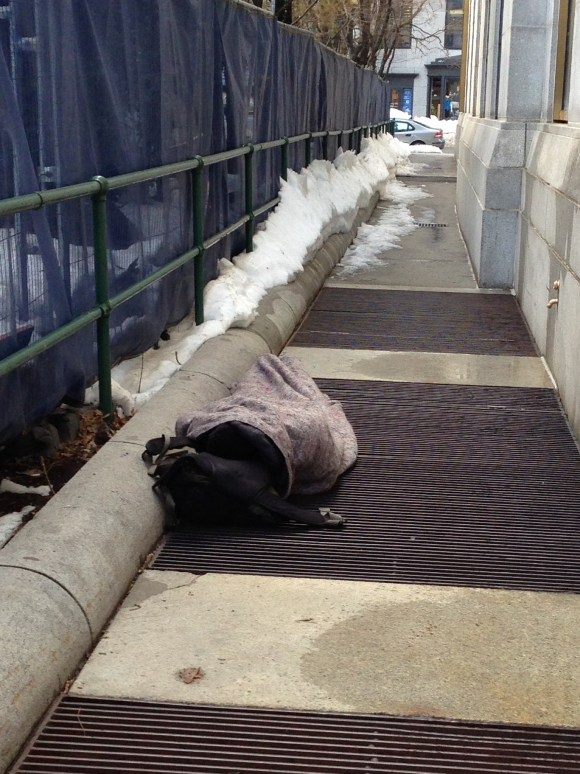

Slide 13
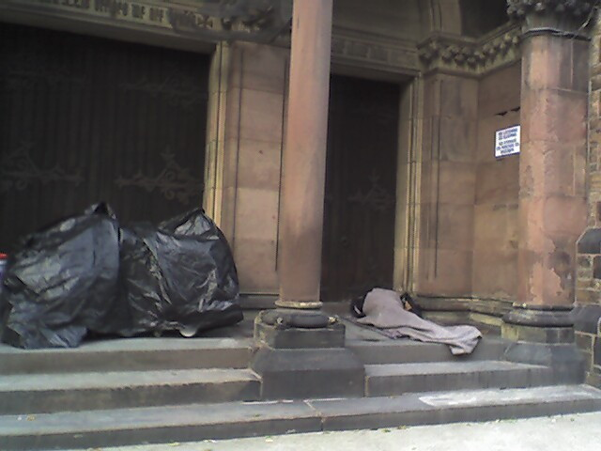

Slide 14
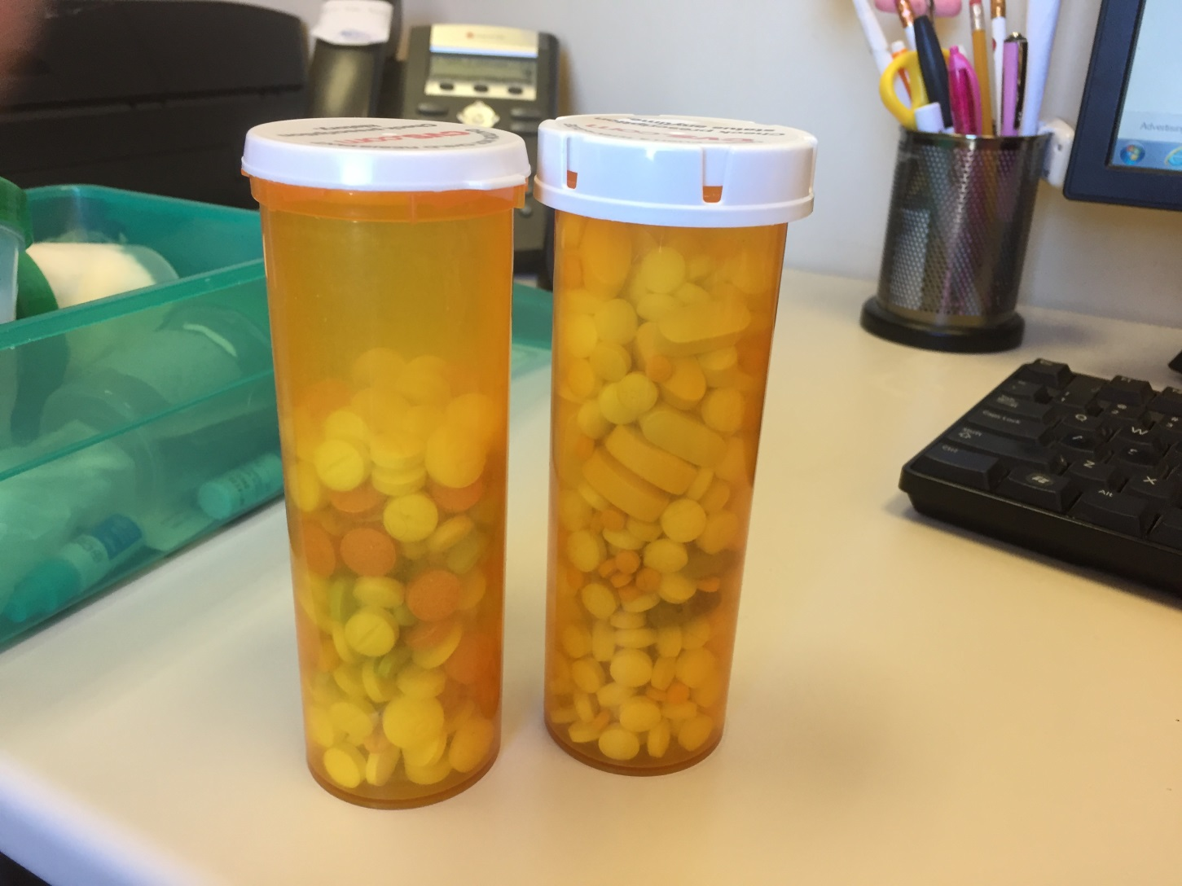

Slide 15
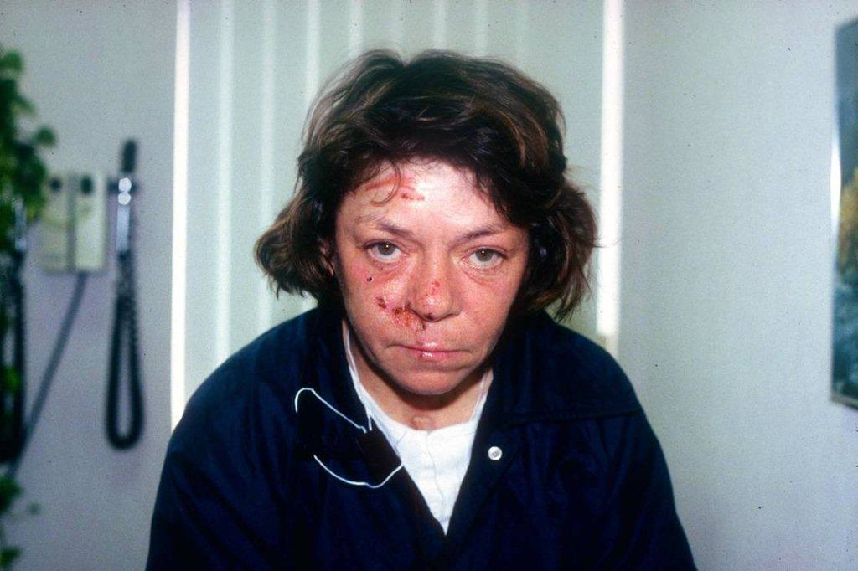

Slide 16
HCWW: A Community-Based Care Team “Bridge care” for Homeless Women
Walk-in clinical services embedded in safe “touch-down” locations for homeless women
  social service intersection points: shelters/streets/soup kitchens/safe houses
Predictable schedules to encourage walk-ins
Elimination of fees, co-pays, bureaucratic hurdles
Connect clients with mainstream caregivers and agencies
Act as a communications hub
Personal, caring, unhurried
(c) HCWW 2018/all rights reserved

Slide 17
HCWW: Community-Based Care Team
Acute/urgent care, chronic disease management
Referrals
On-site testing, asthma treatment, DM care/education, wound care, foot care
Community Health Workers/personal accompaniment
OTC meds and Rxs
Care teams in women’s, families and DV shelters
Unhurried, no time limits
Robust medical education program
(c) HCWW 2018/all rights reserved

Slide 18
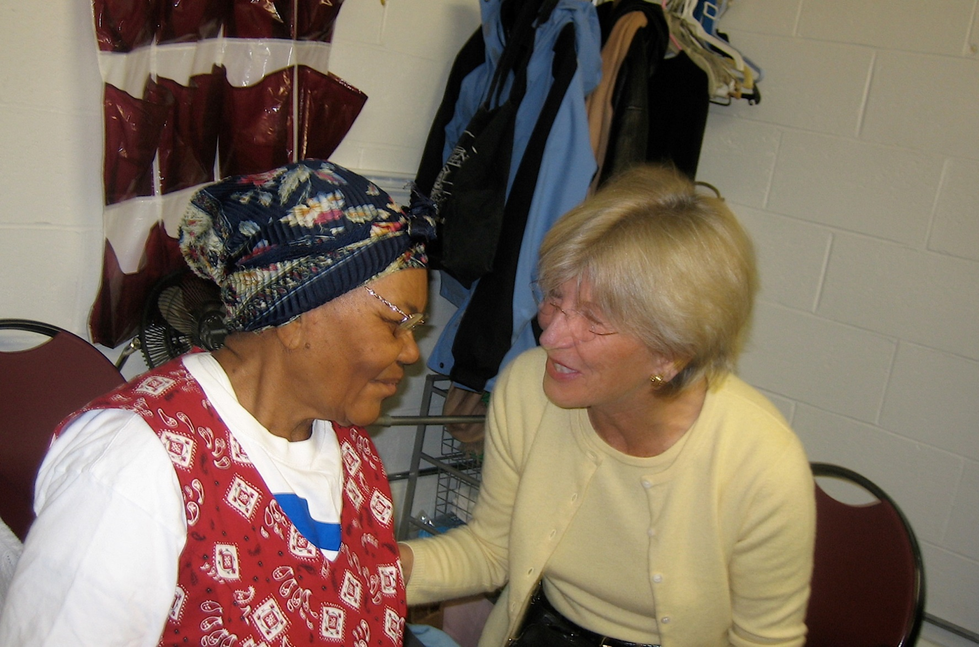

Slide 19
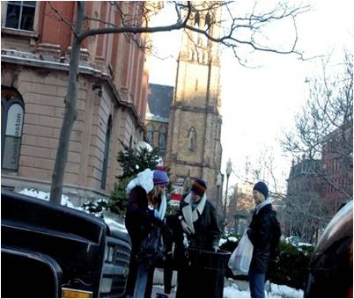

Slide 20
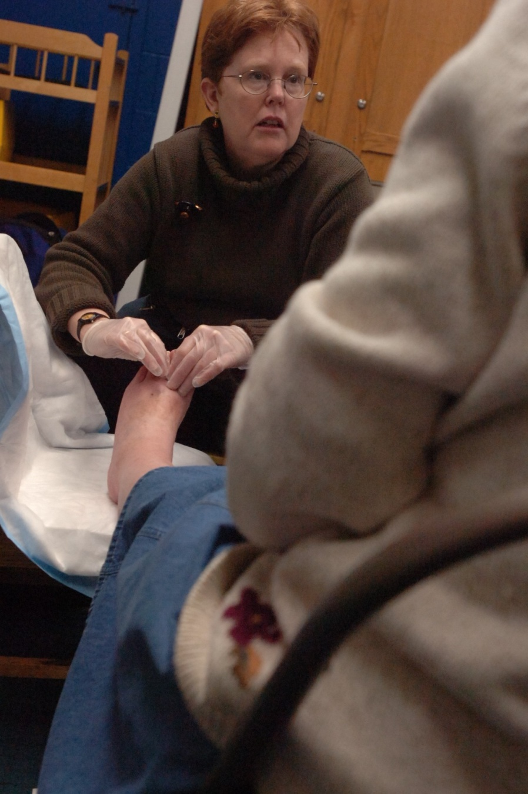

Slide 21
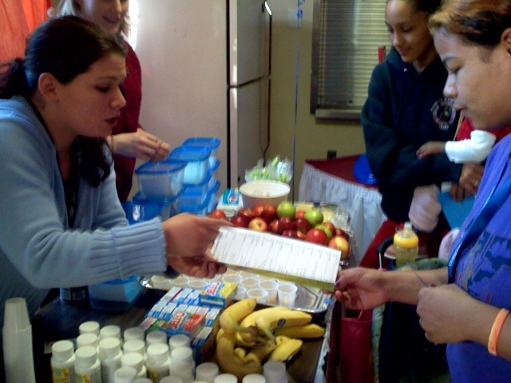

Slide 22
HCWW: Community-Based Field Teams
Community health workers and nurses
  Care coordination, housing, benefits, accompaniment, home visits—addressing SDOH
Bridges to Elders
  Women 60 and older
Bridges to Moms
  Women pregnant and post-partum
(c) HCWW 2018/all rights reserved

Slide 23
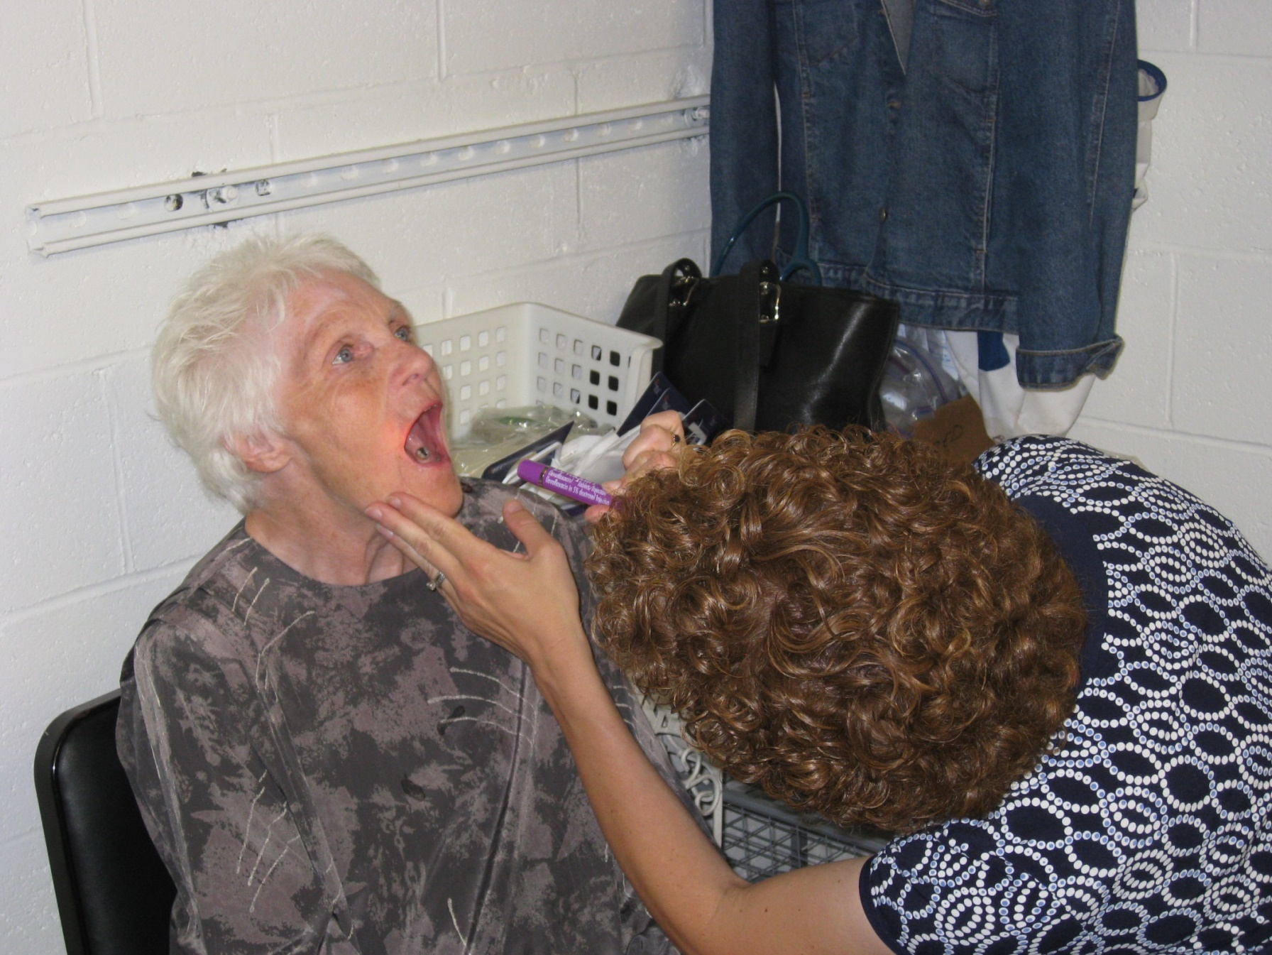

Slide 24
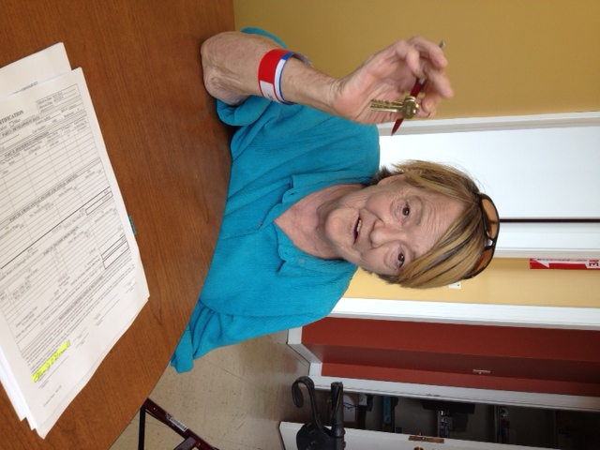

Slide 25
Cost Savings
86 % drop in ED Visits
77 % drop in Inpatient Stays
(c) HCWW 2018/all rights reserved

Slide 26
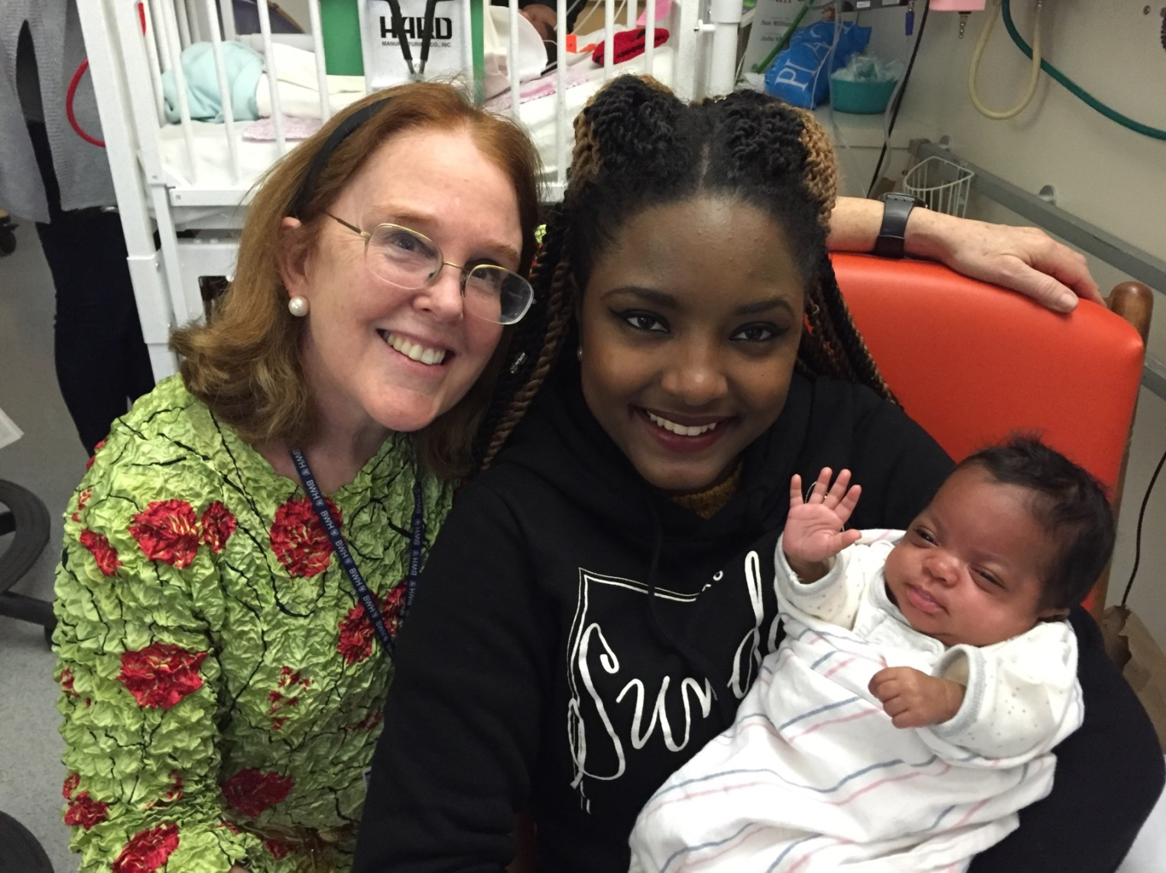

Slide 27
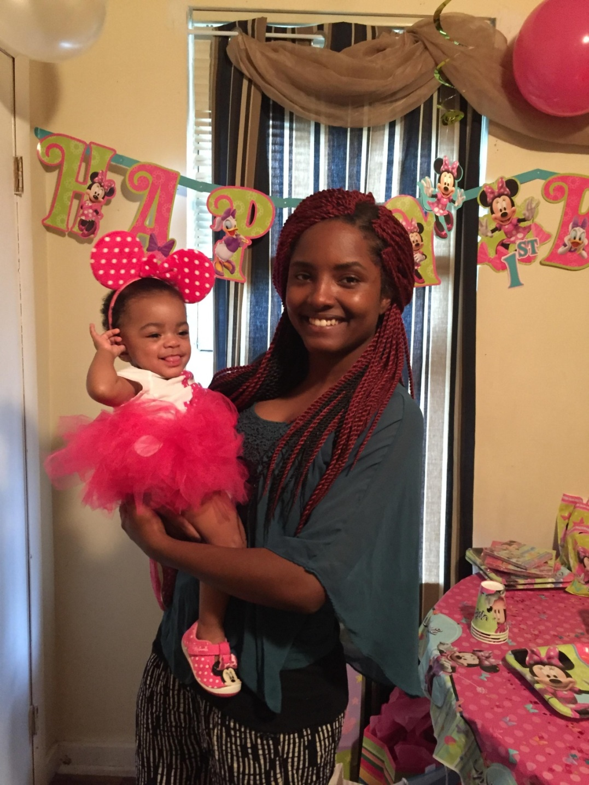

Slide 28
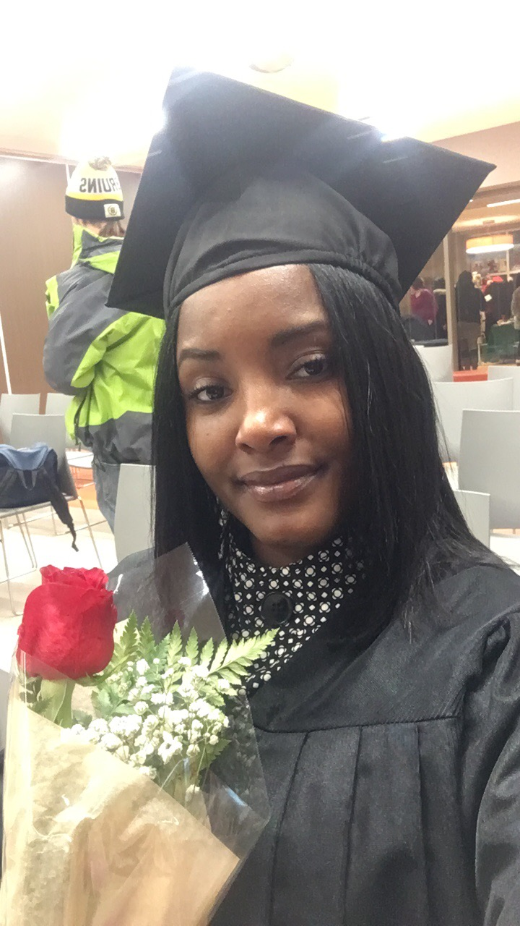

Slide 29
Bridges to Moms
Partnership between HCWW and BWH
80% prenatal clinic attendance
Shorter NICU stays
90% NICU visit/call—maternal bonding, less foster care
Stable housing: 10% to 61%
cab vouchers
meal vouchers
92% birth control
91% connected to PCP
Self actualization
(c) HCWW 2018/all rights reserved

Slide 30
Future of Medical Care for Vulnerable Populations:
Care delivery in multiple patient-centered and patient-selected locations with an embedded Community-Based Care Team as facilitator, communicator, and coordinator between:
  Shelters
  Hospitals
  Community Health Centers, PCPs
Community-Based Field teams address SDOH
  Personal accompaniment
Changing health outcomes for vulnerable women personally and compassionately
(c) HCWW 2018/all rights reserved

Slide 31
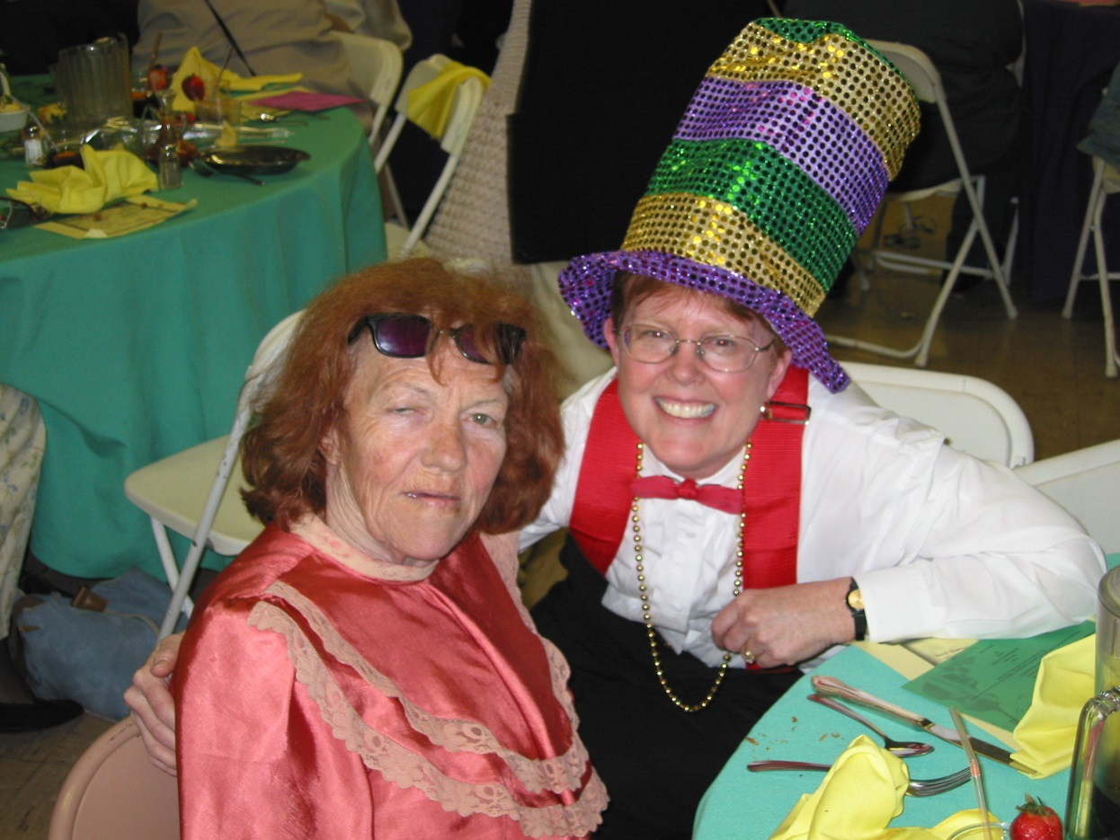
Personal stories

Slide 32

Meet Gerry Mullin, RN

Slide 33

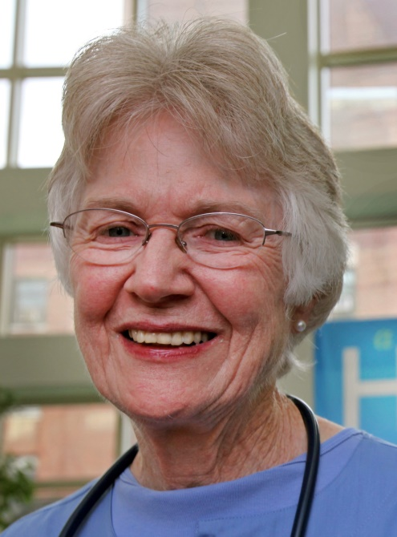

Questions & Answers
Roseanna Means, MD
Brigham & Women’s Hospital
Founder and President, Health Care Without Walls
Gerry Mullin, RN
Formerly of
Boston Healthcare for the Homeless
Beth Lown, MD
Medical Director
The Schwartz Center for Compassionate Healthcare
Type your questions in the Questions Pane on your screen at any time.

Slide 34
Thank you for participating in today’s session.
Please take a moment to complete the
electronic survey upon exiting today’s program.
Visit theschwartzcenter.org for more details or to register for a future session.
Look for our webinar email invitations and share them with your friends!

