Slide 1
Supporting Patients and Families in Pursuit of Compassion
Compassion in Action Webinar Series
November 28, 2018

Slide 2
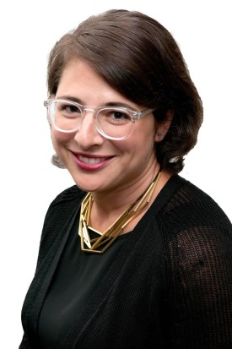
Moderator
Stephanie Adler Yuan
Director, Education & Training
The Schwartz Center for Compassionate Healthcare

Slide 3
Audience Reminders
This webinar is funded in part by a donation in memory of Julian and Eunice Cohen.
You may submit a question by typing it into the Question and Answer pane at the right of your screen at any time.
Please respond to audience polls by clicking on the answer of your choice.
We value your feedback! Please complete our electronic survey following the webinar.

Slide 4
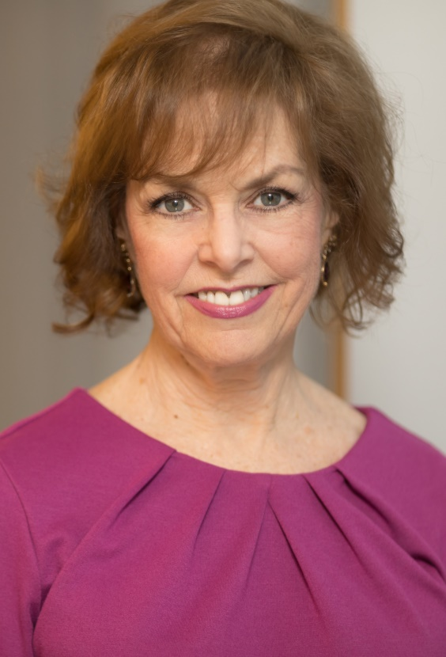
Host
Beth Lown, MD
Medical Director
The Schwartz Center for Compassionate Healthcare

Slide 5
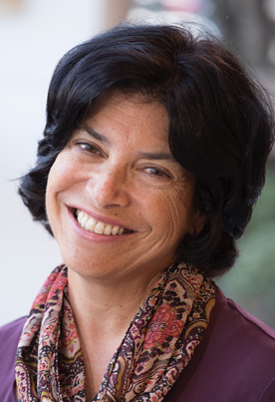
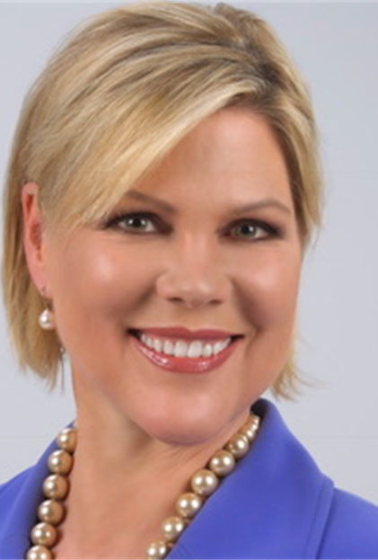
Today’s Speakers
Randi Kaplan, LMSW
Director, Arthur Emil Caregiver Support Center
Montefiore Medical Center
Pat Mastors
Founder
The Patients' View Institute

Slide 6
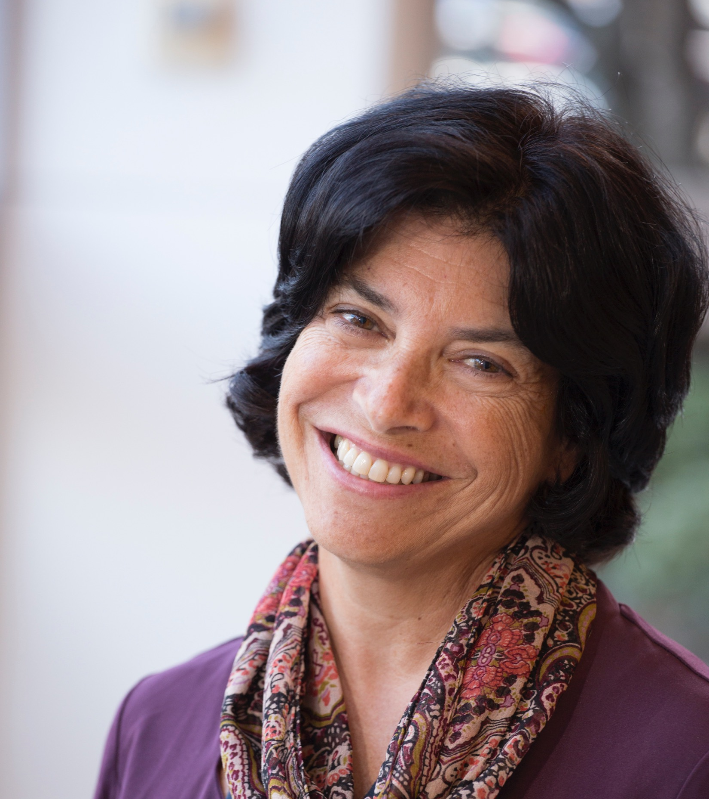
Randi Kaplan, LMSW

Slide 7
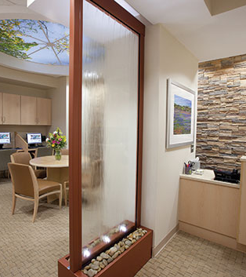
The Caregiver Support Center at Montefiore Medical Center
Bronx, NY
A model for family caregiver support
Services include:
  Tranquil space
  Educational materials and resources
  Emotional support from trained staff and volunteers
  Language assistance
7

Slide 8
Polling Question 1

Slide 9
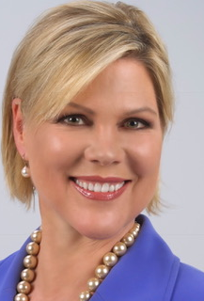
Pat Mastors

Slide 10
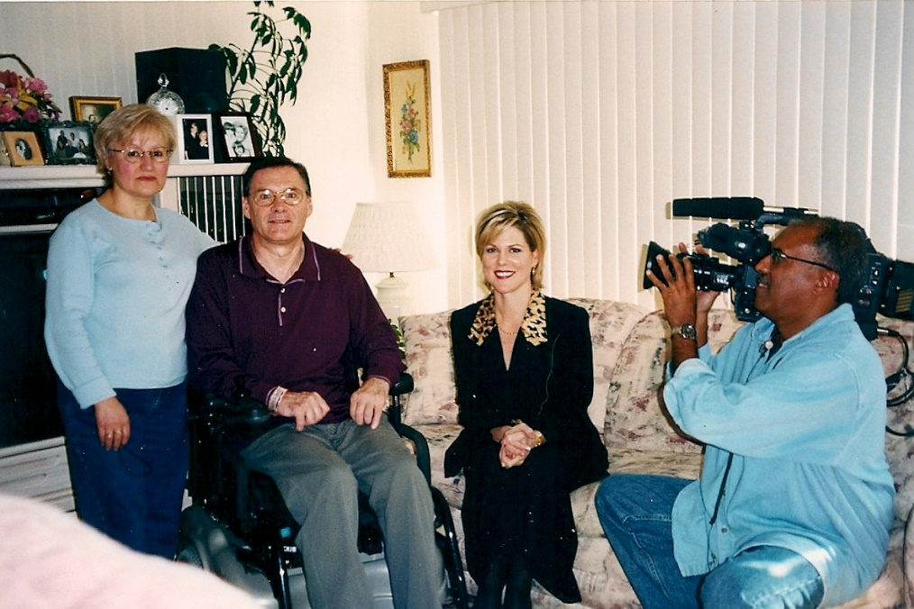
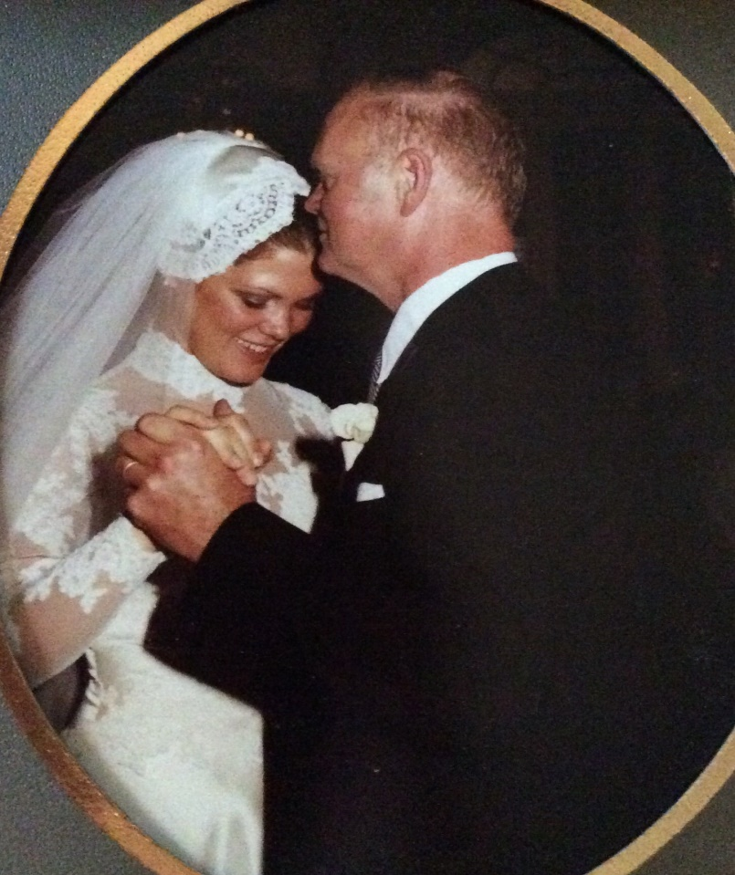
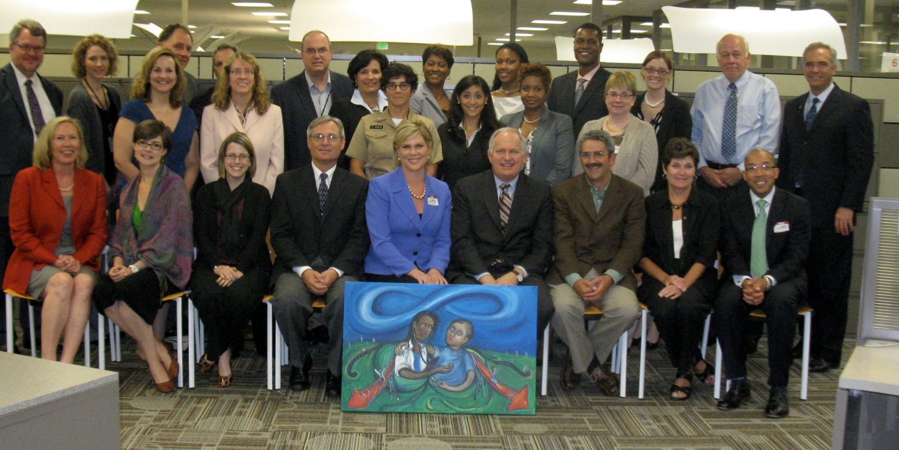
My story…
1
1
4
“I am the 1%.”
Notes:
I am the 1 % (activated patient!)

Slide 11
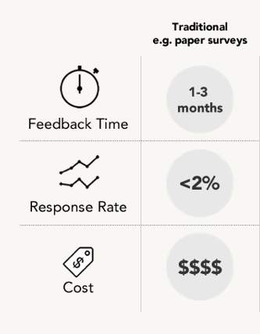
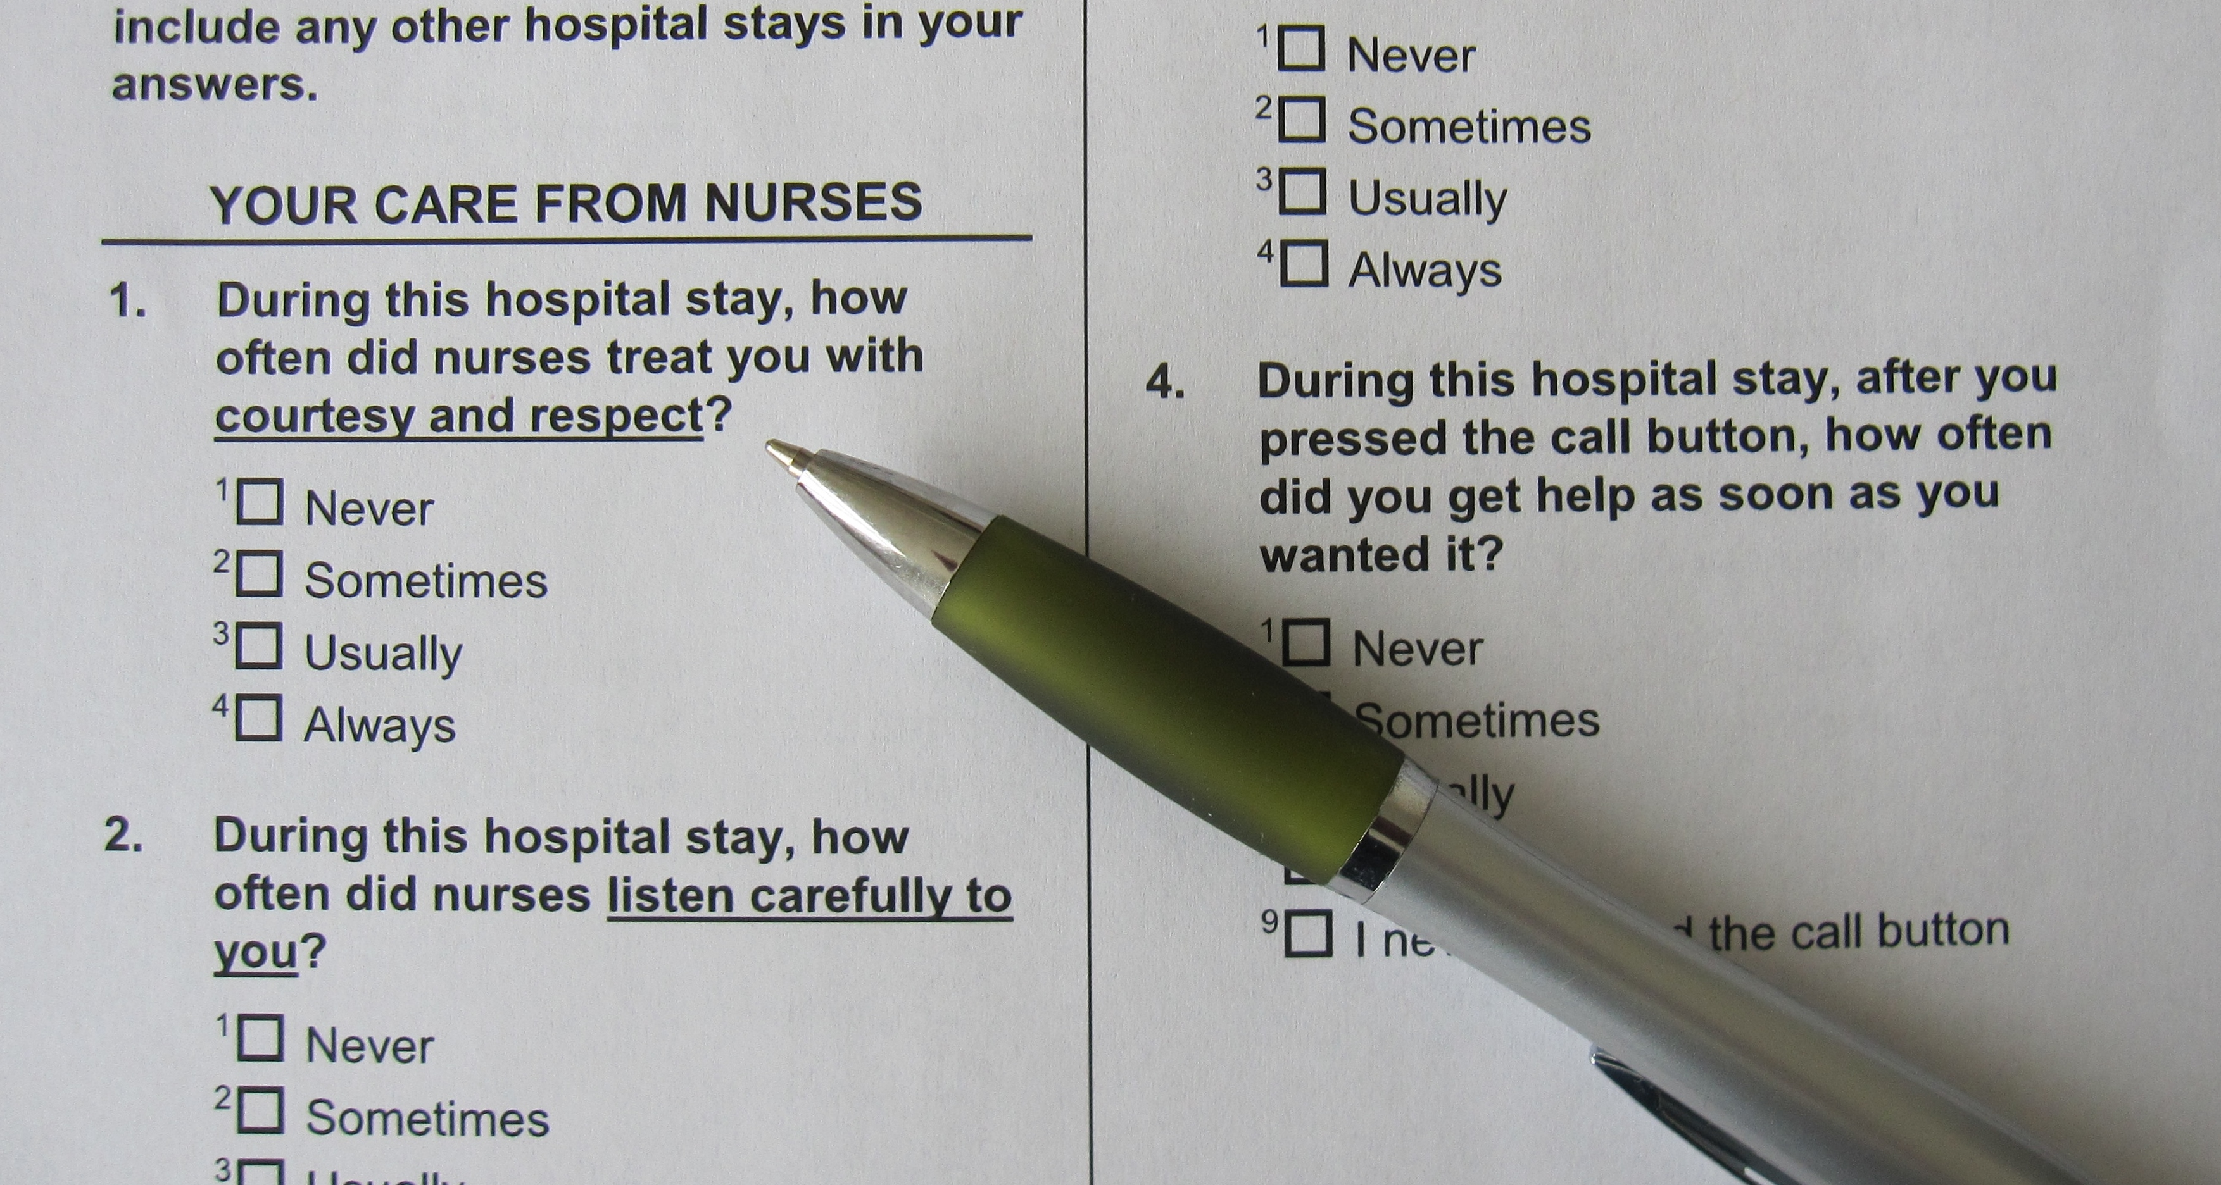
How to make patient experiences drive
improvement beyond currently measured metrics?
Notes:
Diane

Slide 12
Clinical options can be measured. They should rightly guide quality improvement.

Slide 13

But most patients do not think that way.
They hold in their minds a mental picture of how a person should be treated, and that picture becomes the standard by which their experience is judged…not against other hospitals, but against all experiences with other industries, services and products.
Precluding catastrophe, patients judge their experience by the way they are treated as a person.

Slide 14
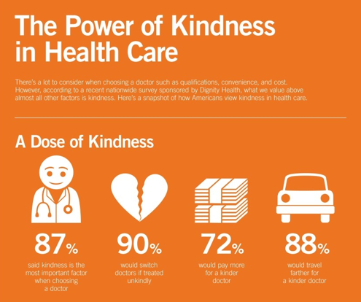

Slide 15

Anthropologists:
70 percent of everything we learn is through stories
15

Slide 16
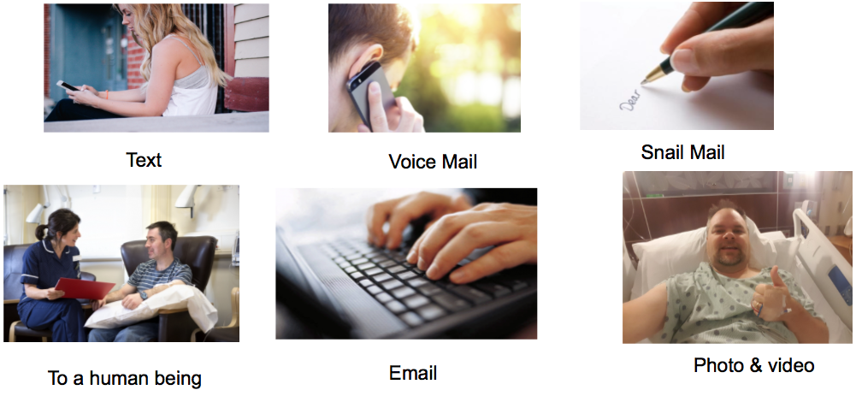
PVI approach:
Get the whole story
16

Slide 17
Insights from 1250 patient stories:
Respect and empowerment are key to the patient experience (4:1)
  Hear me, see me, listen to me
  My time and preferences are valued
  Simplicity (coordinate the coordinators)
  Follow up, responsiveness and accountability
  Getting this right is more critical than ever.

Slide 18
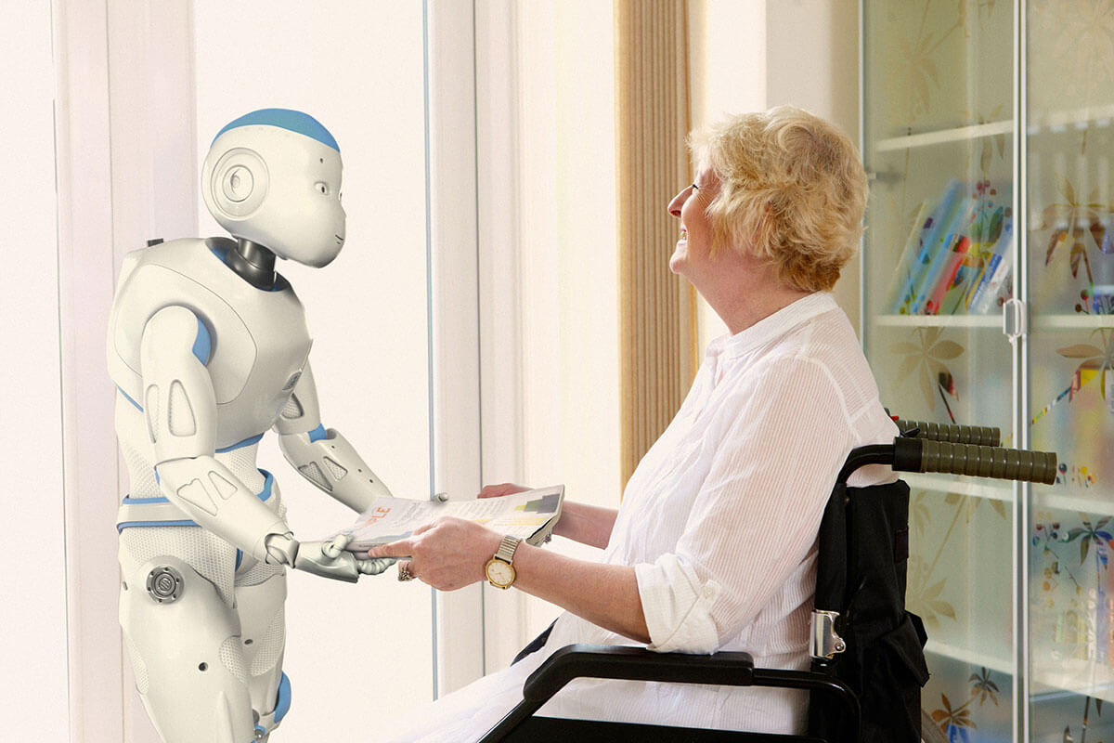
The disrupters are here
Technologies
18

Slide 19

New Competition
1,100 Minute Clinics, 20 M patients, no appointment, 95% satisfaction rating
Majority of consumers would consider using retail clinics and virtual visits for an illness like the flu

Slide 20





New Competition
Apple launches medical clinics for employee healthcare & to test products
Amazon-Berkshire Hathaway-JPMorgan: Starting own healthcare company, attacking “tapeworm on U.S. economy”
GE, Boeing, Lowe’s, Walmart: Negotiate with health systems, tie contracts to quality/outcomes, embrace travel so employees get top-rated care

Slide 21

Patients are Activated
21

Slide 22



People are sharing knowledge with each other
Facebook “...hospital ratings posted on Facebook appear to correlate with hospital readmission rates and overall quality of care.”
Journal of General Internal Medicine, March 2015
Twitter “...is a relevant data source to obtain the patient perspective…”
    83 % specified type of medical error
    52 % expressed frustration
Journal of Patient Safety, January 11, 2016
Yelp “…does a better job than the (HCAHPS) survey in rating the quality of hospital stays…went deeper into the patient experience...include the aspects of care most important to patients and caregivers.”
Health Affairs, April 2016
22

Slide 23

Millennials
More than twice as likely to switch PCPs in the next year than seniors
A third break referrals to see their own specialist
Embrace virtual visits, provider shopping, online reviews, retail clinics
Survey of 2,000 millennials, http://fortune.com/2016/12/16/healthcare-millennials/
23

Slide 24

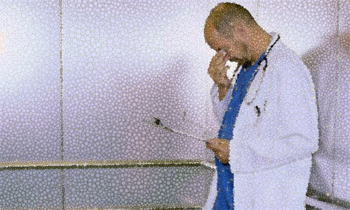
Burnout
Of 17,000 US Physicians:
  Half would not recommend career
  Half will retire or leave
24

Slide 25
Polling Question 2

Slide 26

The hard work of building systems that support best practices – every branch and leaf if nurtured and measured…
26

Slide 27
Safe Care
Patient Engagement
Shared
Decision-making
Joy at Work
Patient Satisfaction
Good Outcomes

Slide 28
Safe Care
Patient Engagement
Shared
Decision-making
Joy at Work
What’s missing?
Patient Satisfaction
Good Outcomes

Slide 29

The roots!

Slide 30
Safe Care
Shared
Decision-making
Patient Engagement
Joy at Work
Good Outcomes
Patient Satisfaction

Slide 31
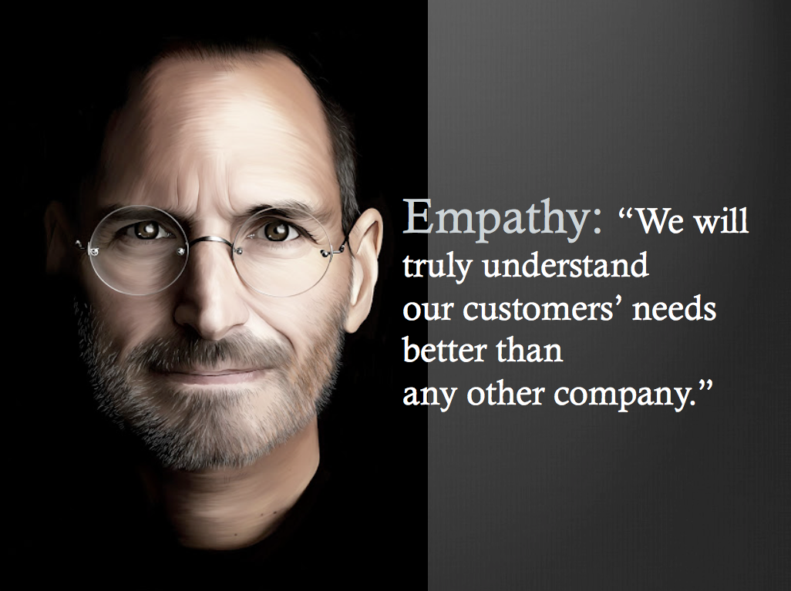

Slide 32
Patients – all of us – are eager to reward visionaries who meet our needs.

Slide 33


Questions & Answers
Randi Kaplan, LMSW
Director, Arthur Emil Caregiver Support Center
Montefiore Medical Center
Pat Mastors
Founder
The Patients' View Institute
Beth Lown, MD
Medical Director
The Schwartz Center for Compassionate Healthcare
Type your questions in the Questions Pane on your screen at any time.

Slide 34
Thank you for participating in today’s session.
Please take a moment to complete the
electronic survey upon exiting today’s program.
Visit theschwartzcenter.org for more details or to register for a future session.
Look for our webinar email invitations and share them with your friends!

