Slide 1

Webinar Series
Using RESPECT To Build Trust
Across Difference and Power with Patients, Supervisees and Teams
Tuesday, March 17, 2015

Slide 2
Audience Reminders
This webinar is funded in part by a donation in memory of Julian and Eunice Cohen.
Submit a question by typing it into the Question and Answer pane at the right of your screen at any time.
Respond to audience polls by clicking on the answer of your choice.
Provide feedback through our electronic survey following the Webinar.
2

Slide 3
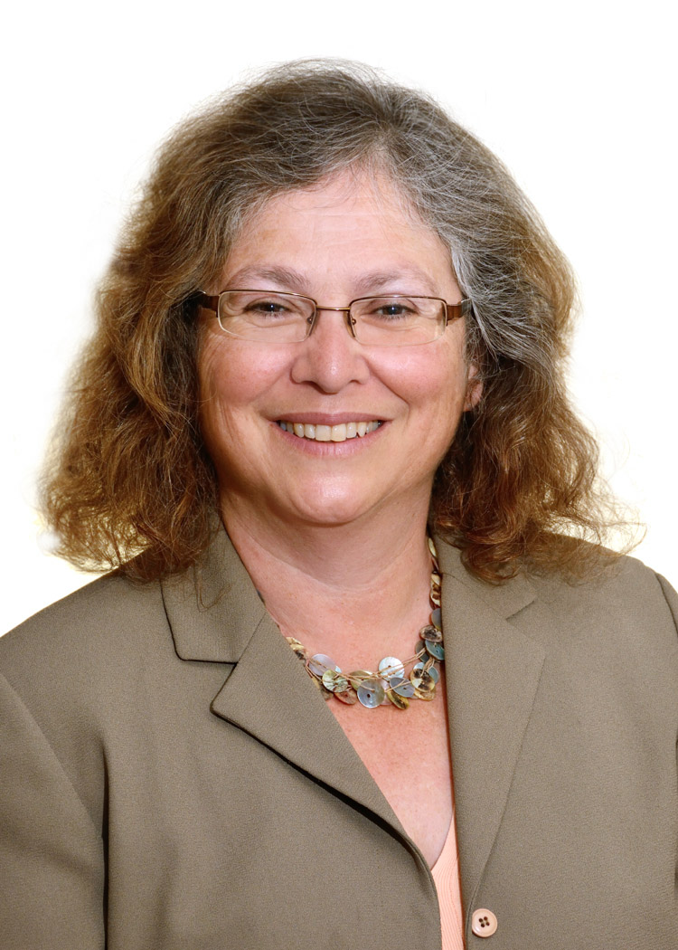
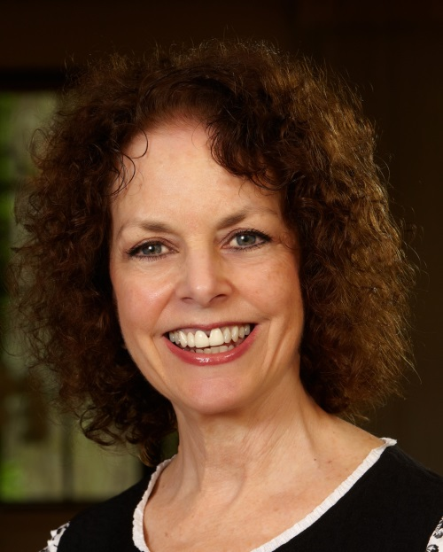
Today’s Speakers
Carol Mostow, LICSW
Assistant Professor of Familly Medicine
Boston University School of Medicine
Beth A. Lown, MD
Medical Director, The Schwartz Center for Compassionate Healthcare, Associate Professor of Medicine, Harvard Medical School
3

Slide 4
Using RESPECT To Build Trust
Across Difference and Power with Patients, Supervisees and Teams
Carol Mostow, LICSW
Assistant Professor of Family Medicine
Boston University and Boston Medical Center
Notes:
Thank you so much Beth and Lynn. It is a wonderful privilege to join all of you today, especially as a member of the extended community that the Schwartz Center has built of caregivers and others committed to compassionate healthcare. It is exciting to know that our conversation today brings together a diverse range of professions, job descriptions and geographic locations throughout the US and beyond, all of whom care about how to do this work and how we can support each other do it even better.
Today I will share with you a tool discovered with the help of colleagues who also exemplify the best of what care is. It was an honor to work with them and an honor to be able to share how we discovered RESPECT and what we have learned over the past 15 years regarding how it can help us with some of the common challenges we face I
n healthcare.

Slide 5
Why RESPECT?
Connect with patients across differences
Partner effectively with supervisees to address challenges
Support inclusive and empowered teams
Carol Mostow LICSW
5
Notes:
In terms of today’s learning objectives, we will become familiar with why and how the RESPECT model was developed and how it can help us connect with patients from backgrounds different than our own. We will also explore how to use the model to engage and partner with our supervisees and trainees in addressing the challenges they face. Finally I will also briefly discuss our most recent work applying RESPECT to teams as a relational guide addressing diversity and hierarchy that helps maximize the team’s capacity to identify, face and adapt to challenges.

Slide 6

A frustrated intern confides in you
Carol Mostow LICSW
6
Notes:
So like much of medicine , the origins of the RESPECT model started with a problem I didn’t know how to solve. In this case, the presenting problem or critical incident, was a particular learner, a burned out and cynical intern. We met in the small group seminar for which I was the instructor for all interns from the Department of Medicine . I certainly knew about burnout because I had already been teaching residents for a number of years, but on that day in 1999, this young man came to our 2nd session and started complaining about the ‘political correctness’ of the intraining exam he had taken the day before.
Perhaps due to the open learning environment or perhaps just due to his lack of concern because of my lack of status, faculty rank or evaluative role, he proceeded to make a series of statements to which I felt unprepared to respond effectively.
He starts out: “These guys, if they hadn’t been up to no good in the first place, wouldn’t have gotten shot.” Without elaboration, I know to whom he alludes. Our setting was a large public safety net hospital serving the poorest neighborhoods of the city. The ‘guys’ to whom he refers were the mostly black and Latino young men who were the city’s most frequent gun shot victims.
He goes on to say, “ When I was their age, I never would have chosen to hang out with those guys” , indicating that it is the fault of the victims for hanging out with the wrong people. Upon inquiry, I learned that he had grown up in a white middle class suburb.
What would you be feeling and thinking at this point if a learner or supervisee shared these thoughts?
To help you understand what was going through my mind, you should know that in my previous career prior to my work training medical residents, I had worked at a community mental health clinic and at the nearby public middle school where kids would tell me how afraid they were to walk to school due to fears about getting shot.. One of my patients was a 13 year old boy who had been referred after he returned from a 2 month hospitalization from severe and massive internal injuries from a gun shot wound acquired from a drive-by shooting from someone unknown to him, while he was lingering on a corner with his friends. Another child confided that he carried a gun which he buried , and then retrieved when coming and then leaving school, so that nobody would accost him.
The intern and I spoke some more and he went on to say, “ I’m sick and tired of these patients changing my scripts” ( he meant to get extra narcotics) . Feeling a bit more confident I say, “ well you don’t have to put up with THAT, that’s illegal”.
He responded : “ Yeah, well I get off late at night and have to walk to my car…”

Slide 7

A teachable moment?
7
Notes:
At some point in all this , the intern added: “ I know not to say this in front of the attendings, but you want us to be honest, right Carol?”
Ok before I elaborate more on the feelings and thoughts evoked for me, just check in with yourself. How would you feel?
Personally, I was appalled, aghast, enraged and self-righteous, wanting to protect the young men he was disparaging, the young men who could have been any of the boys I cared about so deeply from the middle school.
And what is the problem to which you are being asked to respond? Or to use a medical term, how do you diagnose the problem or problems here?
What is the problem for this intern’s patients? What is the problem for the intern? And what is the problem for you, his supervisor or teacher?
Finally, what would you say? I wish this were a smaller group so we could discuss your thoughts .
From my feelings and thoughts at the time and since,
The problem for the intern’s patients are alarmingly clear and worrisome. The victims of violence he encounters, already at huge risk for healthcare disparities, are at even more risk if they encounter this young man as their doctor. Already traumatized, they risk being treated in an overtly racist and biassed manner, being blamed for their injuries, becoming even more alienated and distrusting and less likely to engage and trust future providers and the healthcare system, putting them at even greater risk for poor healthcare outcomes. Equally, the intern clearly had no understanding of the social context in which his patients live, no understanding of poverty, addiction, race or violence and was randomly confounding all of them with no skills with which to approach any of these issues with his patients.
Furthermore, I hear the intern’s own sense of powerlessness, his own long hours and personal deprivation displaced into blame targetting his even more disenfranchised patients. In his story of being afraid to address illegal alteration of his prescriptions because he walks out late at night to his car, it is clear that this brand new doctor feels like he is at war with his patients and that he is losing.
And then what about the fact that he knows that his views are unacceptable and incompatible with the values of his chosen profession of medicine let alone to a touchy feely social worker? What about the fact that he is being truthful with me? Isn’t this what I want? Merely expressing outrage risked silencing this intern so that like his attendings I would have no idea about how unskilled, overwhelmed, and unprepared this intern was to be of help to his patients. I realize that it was my own relatively low status in the hierarchy and that I had so little standing or control over his rewards and sanctions that made him less afriad to tell me the truth. And I realize that he was actually confiding in the right person since it is my responsibility as a teacher as well as my responsibility to the patients he will encounter throughout his career, to help him. He needed to learn what he did not currently already know. That’s what teachers are supposed to be able to help with. I talked to him about the kids in the middle school, I talked to him about the dynamics of addiction, I even suggested that he speak to his patients in recovery to learn about how they behaved when they were using substances. But fundamentally I did not have a readily available approach to provide. I was now an inadequate teacher for the great problem he had presented me, potentially as helpless to help him as he was to help his patients.
What to do? A wise medical educator often says, “never worry alone”. I initially attended medical education conferences to consult with seasoned medical faculty. Their first response was that I lacked enough power to ‘make’ this overtly unprofessional intern comply. However I already knew that he could “act” professional around people with power; my goal was not to silence him or for him to parrot politically correct views in my presence while lacking the skills to understand and help his patients when alone at the bedside on in the office with him.
Instead I wanted to know how to help trainees actually address their challenges, to become aware and open to the ways patients’ experiences might differ from their own, and to gain a skill set to connect more effectively to obtain greater understanding and better outcomes. Indeed , when you look at the great challenges faced by so many of our patients, how could we expect biomedically trained but often socially inexperienced and ethnically sheltered young people in healthcare to bridge often great differences of social background, privilege and racial and cultural experiences between them and their patients? How could we make sure they have the knowledge, skills and attitudes necessary to untangle the relevent factors, especially in the setting of poverty, limited resources and at times overwhelming psychosocial problems? What should we teach them to DO to build trust effectively with patients to promote optimal outcomes? It was my responsibility not to silence the learner but to identify HOW best to engage him and WHAT to teach him.

Slide 8
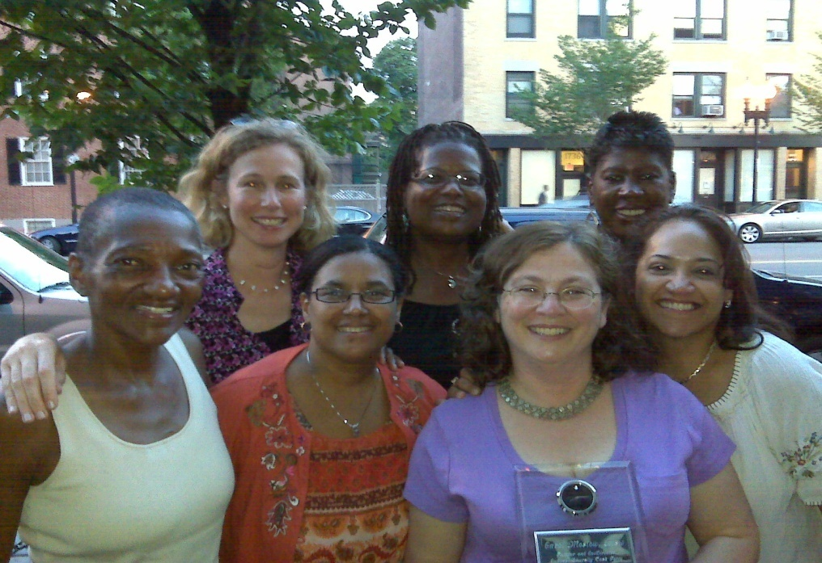
Diversity Curriculum Task Force
WHAT to do and HOW to teach it
Identify communication skills effective with a low income, racially and culturally diverse population
Address disparities in each
doctor-patient encounter
Identify best methods to teach these skills in busy clinical settings
“Never worry alone”
8
Notes:
8
With these kernels of questions but without answers so far, I turned to physician colleagues at my own hospital. What could we learn from postive examples, faculty who feel more effective and rewarded working with these same patients?
Boston Medical Center is now a major academic center serving a large geographic area but historically it grew from a merger of Boston University’s private hospital and the former Boston City Hospital , for centuries the city’s public hospital and haven of care for Boston’s poor, serving the neighboring AA and Latino communicties, other multicultural immigrants and newcomers along with poor white neighborhoods with some of the highest concentrations of poverty in the country. This rich legacy meant that many colleagues had been working for decades to serve the same populations that the intern and others found so overwhelming. Rather than beseiged cynicism, these veteran clinicians find meaning in their work and usually cited their patients as the most sustaining part of what remained challenging work, often with limited resources especially in the early days.
I knew that despite the patients’ challenges if the physicians hadn’t felt they were effective they would have burned out and left. What were these doctors doing with patients that felt so positive? What were these doctors doing with patients that seemed to make both them and their patients feel confident that they were being effective and form such strong trusting partnerships? What was that skill set and what would be the best way to teach it to trainees?
In 2000, some of the colleagues you see above as well as many others formed the BMC Diversity Curriculum Task Force with these goals in mind: To identify what skills we wanted trainees to learn and how best to teach it. What communication skills help clinicians to be effective with a wide range of racially and culturally diverse patients , many of whom face multiple challenges of poverty and other complex social issues in addition to health issues? While healthcare disparities stem from multiple factors including larger systemic factors out of our immediate control, what could we do to optimize each individual encounter with patients at risk?
These groups of colleagues were a marvelous group. In addition to the personal diversity some of which you can see, these physician educators also brought a breadth of professional experience including leaders of the Latino clinic, Haitian services, Interpretor services, experts in substance abuse, in treating refugees and survivors of political torture, and primary care physicians from the widely diverse ethnic neighborhoods in Boston)

Slide 9
Key Drivers of Success
Knowledge
Attitude
Skills
9
Notes:
9
Most educators will recognize that learning typically addresses knowledge, attitude and skills. And especially in an evidence-based culture such as medicine, knowledge about disparities and data about patient experience is important and can also provide powerful motivation regarding the need to improve outcomes.

Slide 10
Awareness Exercise: Difference & Power¹
Personal cultural identity
What about your background do you like/dislike
An experience when you felt different
An experience when you felt privileged or powerless with others
How your background helps and challenges connections with patients
Pinderhughes 1989 Adapted by Swaby-Ellis, Salazar, Pololi, Mostow
10
Notes:
Attitudes also matter . In the story we started with indeed the intern’s ‘bad attitude’ is the first thing that leaps out as well as the cluelessness about the ways his background and options in life differed from those of his patients . The attitude we hope to build in our learners is recognition of the NEED and DESIRE to learn about others, what Campinha-Cote calls the journey to cultural humility, a term I vastly prefer to cultural competence. We need to recognize that we can’t make assumptions about others, or memorize lists and think we know them; rather we need to partner with and learn about who they are and what matters to them personally.
There are a number of exercises one can do regarding cultural awareness. One of my personal favorites continues to be part of our medical school curriculum after 12 years and is an exercise based on Elaine Pinderhughes ground breaking work on Power and Difference. The goal is to promote self reflection regarding one’s own identity and experiences of difference and power. We distribute these questions to participants to reflect on Take a moment to reflect on your personal cultural identity
What about your background do you like/dislike
What is an experience when you felt different
What is an experience when you felt powerful and privileged or felt powerless in regards to others?
The 5th question we have added as a way to reflect non-defensively about the ways one’s background can help one connect with patients in some situations but also pose challenges or blindspots in encounters with others.
. We hope this will be a helpful resource for you so I am including learning objectives and instructions for carefully facilitated groups where participants can share from their reflections in our resource list to be posted the week after the webinar. Those of you particularly interested in teams may want to make a point of looking at it since it is a great way to help us value diversity and flatten hierarchy on teams since we are all expert on our own backgrounds and can learn greatly from each other’s personal experiences. Again, these experiences can be sensitive so making sure you include safety ground rules is important and follow the guidelines. But overall the experiences have been enormously positive with newcomers as well as with people who have known each other for years but never had the occasion to briefly share such important parts of their identity. Of course the more diverse the group the more participants can benefit from the ways people self-identify and hear about the nuances and personal interpretations that shatter assumptions.

Slide 11
Key Drivers of Success
Knowledge
Attitude
Skills
Carol Mostow LICSW
11
Notes:
11
However, the greatest contribution that grew out of our Diversity Curriculum Task Force is in the area of skills which we felt actually may be the most important in order to improve outcomes.
To make a difference in health outcomes, we need to act to reduce risk for poor outcomes. IE WHAT ARE WE GOING TO DO ABOUT IT? It’s not enough just to become more self-aware; Change or improvement in attitude must translate into more effective behavior
Also improving skills can itself improve attitudes; If learners feel ineffective with certain pts, they may develop more negative attitudes , making poor outcomes a self-fulfilling prophecy. So we started surveying the field to see what skills had already been identified as useful

Slide 12
Cross-cultural skills
Explanatory model (Kleinman, Eisenberg, Good 1978)²
LEARN model - negotiating differing explanatory models (Berlin, Fowkes 1983)³
ESFT model (Betancourt, Carillo, Green 1999)⁴
  Explanatory Model
  Social Context
  Fears and Concerns
  Therapeutic Alliance
12
Notes:
Arthur Kleinman, a psychiatrist and medical anthropologist, and his colleagues first identified the Explanatory model as a way to help elicit the patient’s understanding of his or her illness, including such questions as what caused it, what it’s called and what might help. Berlin and Fowkes built on Kleinman’s work with the LEARN model which involves negotiating with the patient regarding the ways the patient’s and physician’s explanatory model may differ in order to form a treatment plan. Betancourt, Carillo and Green incorporated these approaches into their ESFT model while adding Fears and Concerns and the Social Context including especially a variety of stressors, important factors such as literacy, and the way limited access to resources can impact medical care. All these components proved helpful to include in our skill set for communicating to patients with differing cultural and class backgrounds.

Slide 13
RESPECT
R espect
E xplanatory model
S ocial context
  Stressors
  Supports
  Strengths
  Spirituality
P ower
E mpathy
C oncerns
T rust/Therapeutic alliance
13
Notes:
Building on the valuable work done by these leaders in the field, we added relational and affective components that we had begun to feel in our work role playing our encounters with patients, were critical to the process of actually building trust. We realized that in the context of inequity, distrust and stigma, we needed to do more than elicit information about our patients thinking, we needed to demonstrate our trustworthiness and build the relationship.
How did we propose to do that? By SHOWING Respect, SHARING Power, SHOWing Empathy, and Building, rather than assuming Trust.
We also expanded on the social context information to make sure that in addition to identifying the stressors and limitations of our patients’ environments, that we sought out the resources and strengths they brought to the encounter.
So in sum, RESPECT is an action-oriented communication skill set to build trusting relationships across barriers of difference and power.

Slide 14
What is Respect?
Demonstrable attitude
Proactive
Non-verbal and verbal
Affirms other’s value & autonomy
Validates concerns
14
Notes:
We will be discussing the model in more detail but to get started, what is Respect? We used the term before we bothered deriving the definition; and indeed it may well be something that you know it when you see it and feel when it is missing. It may be a feeling but we are interested in how it is demonstrated.
As we practiced our role plays , the person playing the patient remarked that “ it was When you sat down beside me is when I started to feel more open to you.’ It’s a good reminder of the importance of non-verbals , tone of voice , etc .
And what is the message we need to convey? That you and your concerns are important. That you have value and choice .
We began to feel that when power and stigma are problematic, RESPECT can be an important part of the solution.

Slide 15
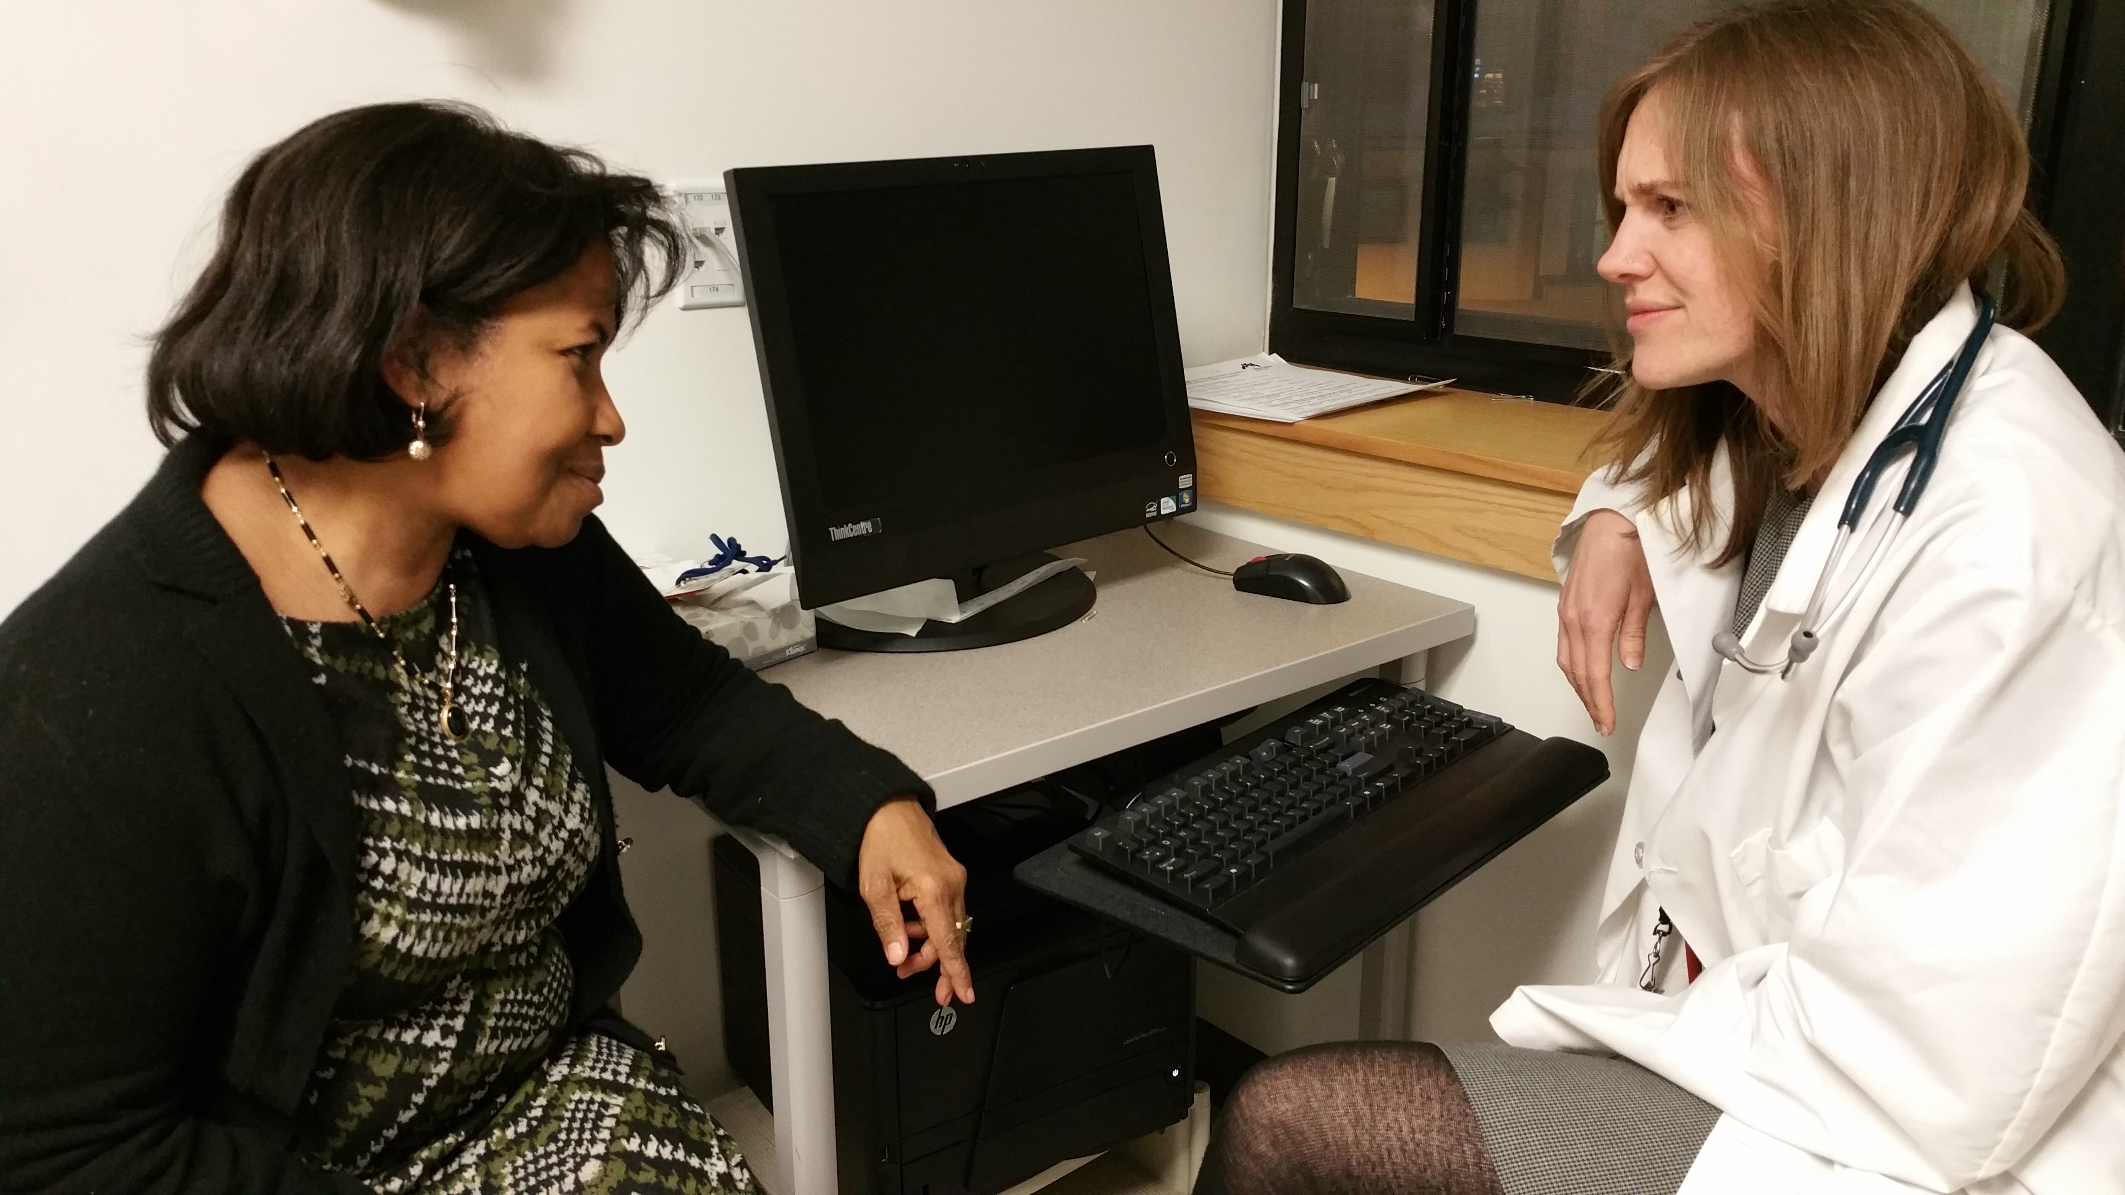
Listening for RESPECT
15
Notes:
One of our first teaching tools was an exercise called Looking for RESPECT ( the handout will also be available in the posted resources). It has turned out to be a useful tool to use to watch the way trust can be built ( or not) over the course of an interaction and what is going on. It can be used for self-reflection, observation or for assessment purposes.. . In this case we’ll do something similar by LISTENING for RESPECT as we practice applying RESPECT to an unhappy encounter between a clinician and a diabetic patient.
Which elements of RESPECT are present?
Are elements of RESPECT missing that might be helpful?
Think of 1-3 statements or behaviors that may have made the encounter more effective
Lynn: Dr Smith sighed as he saw Mrs. Gomez’ name on his schedule. Mrs. Gomez was a 39 year old newly diagnosed diabetic with a strong history of family diabetes. However despite A1Cs of 14, Mrs. Gomez had been irregular with her medications and had failed attempts to change her diet and exercise patterns. Dr. Smith knew what had to happen this time.
Dr. Smith: Nice to see you Mrs. Gomez
Mrs. Gomez: Thank you.
Dr. Smith: Now have you made any of the changes we have discussed about your diet and exercise?
Mrs. Gomez: No. I don’t have fresh vegetables available in my neighborhood and like I’ve been saying, I’ve been too busy with my job and family to have time to exercise. I can afford rice and beans and that’s all I have time to make.
Dr. Smith: But Mrs. Gomez, I’ve told you that something has to change. This high blood sugar is going to kill you. If you can’t make the changes on your own, there’s really no choice. You have to start insulin injections.
Mrs. Gomez: But I’ve told you I don’t want to do that. My mother lost her legs and then she died after starting insulin . I can’t do that.
Dr. Smith: That was the diabetes which did that, not the insulin. There’s no choice, you have to take it.
Mrs. Gomez: I’m the sole provider for my family because I left a husband who called me worthless and always told me what I could and could not do. My friend said you’re a good doctor but nobody tells me that I don’t have a choice.

Slide 16
POLLING QUESTION
16
Notes:
DISCUSS ANSWERS. The difference between feeling concern for the patient and communicating it. Many of us probably think that Dr. Smith felt concern for Mrs. Gomez and in her sense of urgency about the insulin was communicating that concern. However was it expressed in a way that Mrs. Gomez could feel it? In fact how easy can it be for our own desire to help our patients improve their health, to start to feel like scolding and efforts to control them. ( And anybody with spouses, parents or children might recognize a similar dynamic; it can be harder to convey caring effectively than to feel it. Finally, what opportunities were there for the physician to RESPOND to the patient’s emotions , convey empathy and share power to partner more effectively regarding a solution more likely to address her concerns? A note: Compliance is less than 50 % for most interventions and medications. And most of the time, our patients won’t be this open about their inability , hesitation or disagreement to adhere to the plan, resulting in poor care and poor outcomes. IN our scenario Mrs. Gomez is very up front with what her underlying concerns are and her disagreement with the plan but more likely than not, she would be unlikely to be this direct with us.

Slide 17
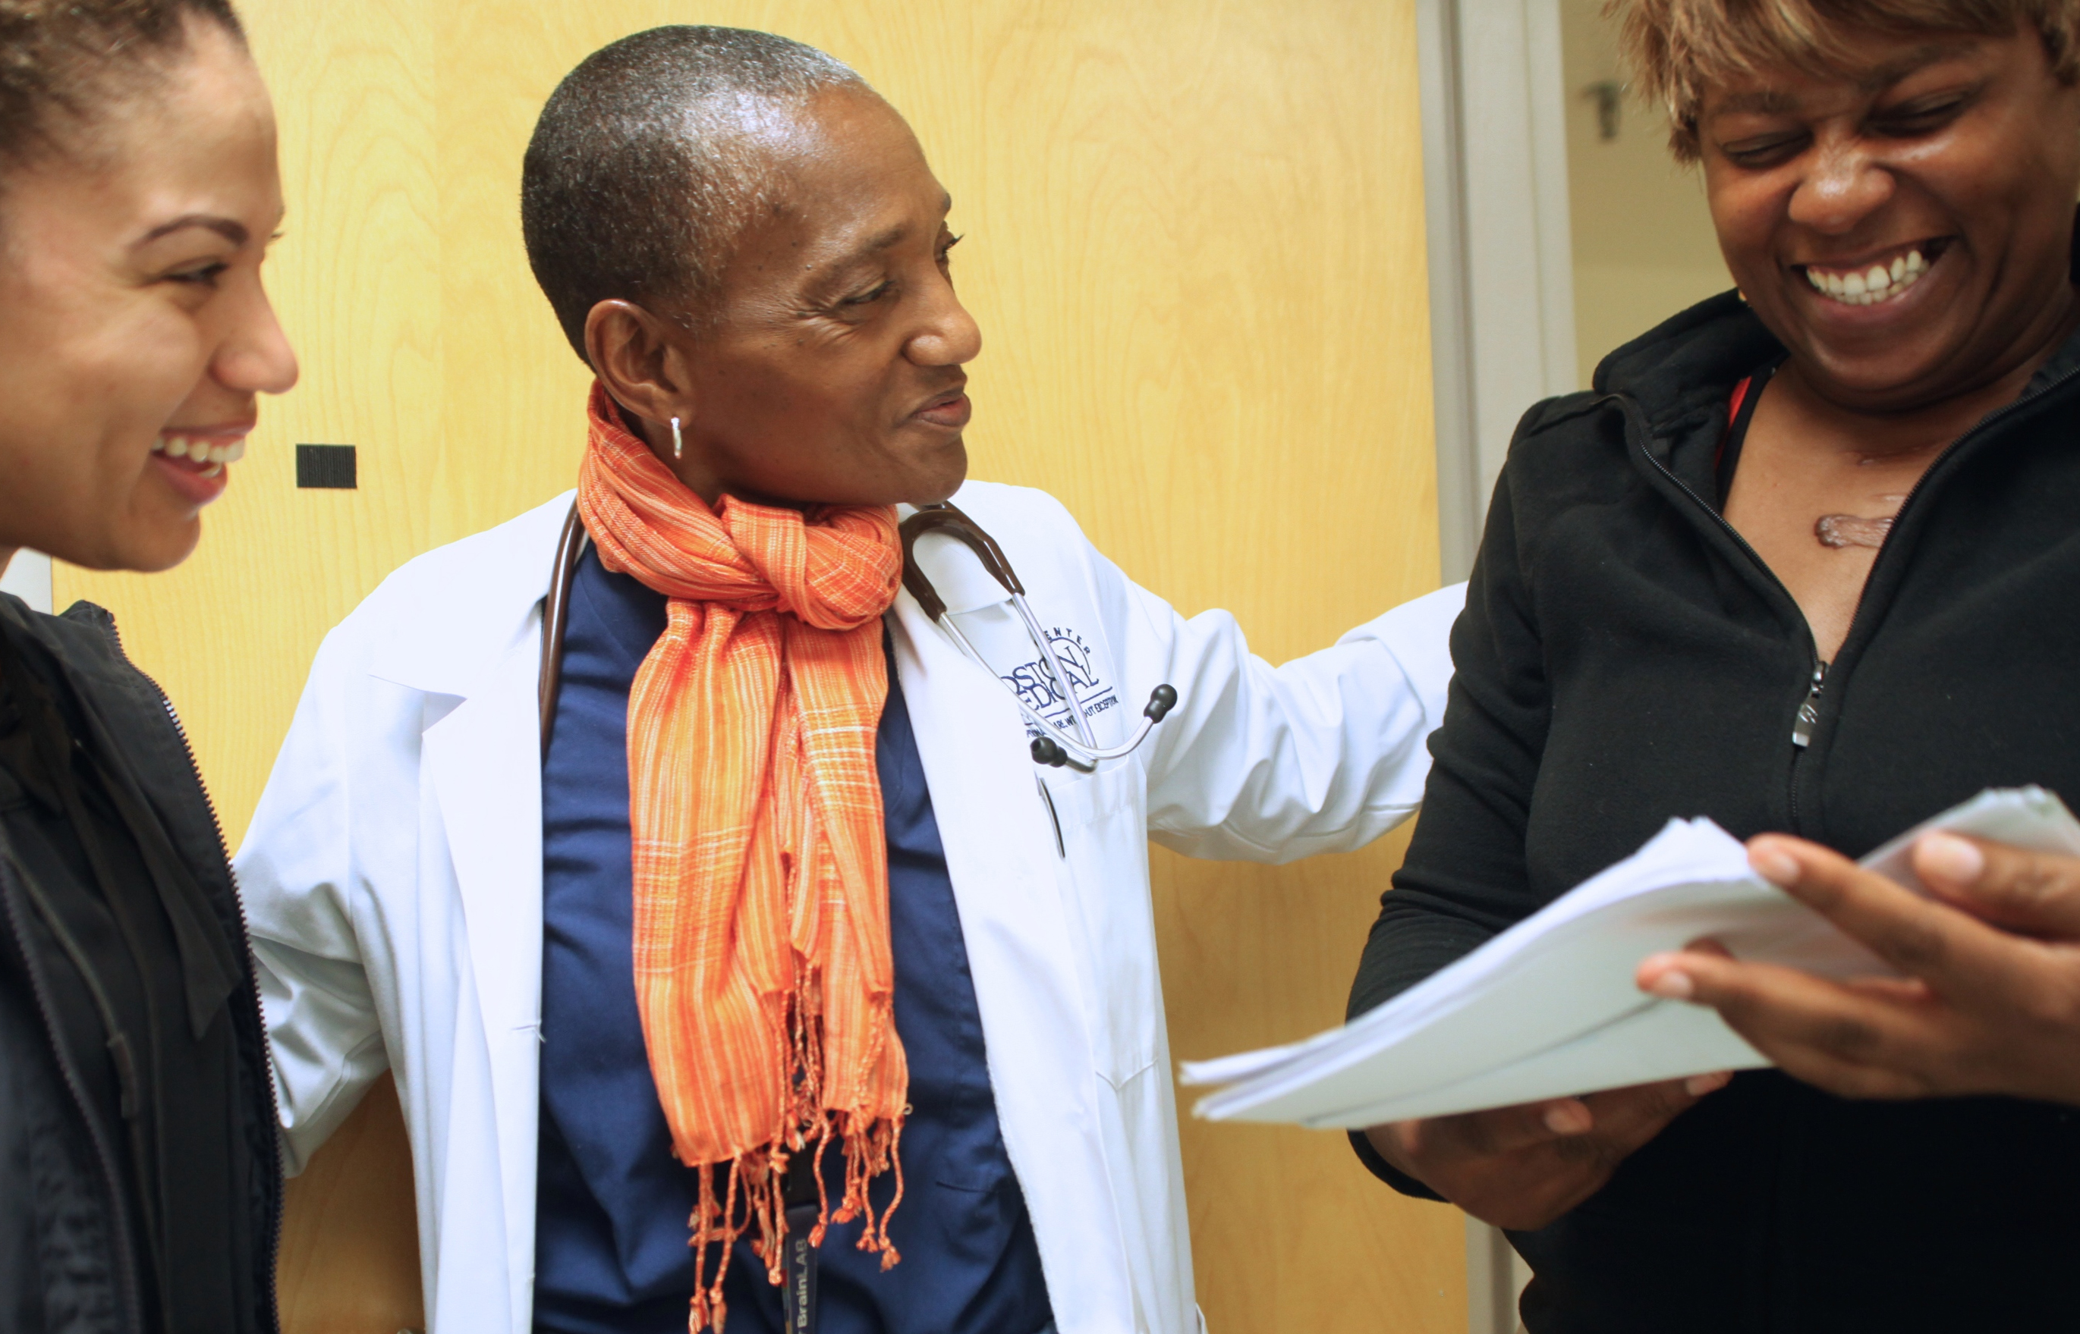
How and why RESPECT?
17
Notes:
17
Before we return to Dr. Smith and Mrs. Gomez, let’s discuss some of the data supportive of the RESPECT model.
RESPECT was developed as an educational tool for teaching but subsequent surveys and studies have confirmed the clinical relevence of these components to patients concerns and experiences.
Many of you may have noticed this year’s SC compassionate caregiver winner Dr. Thea James in the prior photo as well is here. She is one of my wonderful colleagues and one of the coauthors of the RESPECT model; she indeed seeks to provide the same level of respect, empowerment , empathy and compassion to all her patients and seeks to build trust in every encounter. And in fact, ALL patients want and need respect. In fact in a large scale study of CG-CAHPS scores,it turns out that Respect by one’s physician is the single most powerful predictor of patients’ overall rating of their physicians in 27 out of 28 specialties. A recent Consumer Reports study also linked patients’ feeling respected by their physicians with actual fewer safety problems and better workplace safety scores. So again, ALL patient want and need respect.

Slide 18
Disparity data for RESPECT
African American, Hispanic and Asian patients feel less respected by physicians than do white patients.⁵
White physicians dominate speech more with non-white patients. ⁶
White MDs display less warmth, pt-centered behaviors with AA pts ⁶
63% of AA vs. 38% of whites believe their MDs have, or would experiment on them without their consent. ⁷
Experiencing less support, less partnering and less information from their doctor lowered black patients’ trust in their physicians ⁸
18
Notes:
However it turns out that there is supporting evidence that RESPECT may be particularly important for patients from racial and ethinic groups at risk for disparities. Indeed, as you can see many of the components it contains are in fact areas of racial disparities in physician/patient communication.
In terms of Respect African American, Hispanic and Asian patients feel less respected by physicians than do white patients.⁵
IN terms of Power –White physicians dominate speech more with non-white patients.
Empathy is an area of disparities as well–White MDs display less warmth, pt-centered behaviors with AA pts
Trust In data about distrust, Dr. Giselle Corbie-Smith and colleagues established the lasting impact of Tuskegee, fears of experimentation and other negative racial experiences on AA trust in health providers. Let’s notice that more than a 3rd of whites also believe that their doctors had already or might experiment on them without consent which is horrifying enough. But almost twice those numbers of AAs believed the same. Gordon and colleagues found that the fear of mistreatment, while important in itself, was not the only kind of disparity. In fact in an observational study, white physicians indeed did offer less support , partnership and information to their black patients, further lowering their trust.

Slide 19
Show Respect
Affirm patient’s value, dignity, autonomy, concerns verbally and nonverbally
Skills
  Attentive listening, eye contact, body posture.
  Address patient in their preferred terms
  Recognize/affirm patient’s efforts, choices, accomplishments
Example
  “You have so much to take care of with your work and family yet you still made it in today.”
19
Notes:
So did Dr. Smith show Respect to Mrs. Gomez? The physician did start out politely and even said it was nice to see her and did use her proper title of Mrs. Gomez. In the photo we saw she was looking at the patient and not lost in the chart. However Respect is important not only at the beginning but throughout the interview. As we look further atht the definition we can see that Dr. Smith did nothing to convey MRs. Gomez’ dignity, the validity of her concerns and completely disregarded her autonomy. And by the time the photo was taken, her eye contact conveyed displeasure at Mrs. Gomez disagreemrent.
to review more specifically how we do this, proactively demonstrate Respect . Use all your nonverbal as well as verbal behaviors to convey the. patient’s value, dignity, autonomy,and the importance of their concerns. This is important from the very beginning of the interview as well as throughout.
Speaking of the EHR, it can be easy to fall into bad habits of getting distracted by it . It can be important and helpful to remember to actively convey respect through eye contact, words and behavior and establish rapport before ( transparently perhaps) explaining the need to make sure you document their concerns in the chart, which if done right, can be a signal of the importance you place on accurately recording what they are saying. Just remember to look at the patient during sensitive exchanges or other key moments to convey that you are listening, want and value their responses.
In addition to your body posture and terms of address, respect should be woven throughout the interview, as you recognize and affirm the patient’s efforts, choices and accomplishments. For example, given the life that Mrs. Gomez describes as a single working mother, it is impressive and positive that she made it in to see her doctor, to do something for herself.

Slide 20
Elicit the patient's
Explanatory model
What does the patient think caused his/her illness? What does the patient think will help?
Skills
  Kleinman questions ²
Example
  “What do you think has caused your problem?”
  “What do think would help you?”
Rationale
  Patient’s understanding is often different from clinician’s but not shared unless elicited. ⁹
20
Notes:
20
While Dr. Smith did nothing to explore MRs. Gomez’ explanatory model, she actually volunteered some ideas including that insulin had made her mother’s disease worse and led to the amputation. We don’t know what Mrs. Gomez understanding is of diabetes , if she has any symptoms which she herself is concerned about and what she thinks they were caused by. As a way to ally with MRs. Gomez, asking what she knows about her diabetes and what worries her the most about it, would have supplied a potential way to engage her. Even with patients who don’t display overt differences from you, their understanding of what is wrong and what will help can differ greatly from yours. In fact in a study by Lang, it turns out that absent direct inquiry, most patients had a number of ideas about the cause and potential solutions to their problems that were not mentioned , leaving room for great mutual misunderstanding, hidden disagreements and inefficiencies.

Slide 21
Explore Social context
Examine stressors, supports, strengths, spiritual resources ^{10, 11}
Skills - Elicit
  How illness affects the patient’s life
  How the patient’s life affects illness
Examples
  “What or who in your life helps you cope?”
  “What or who makes it harder?”
Rationale
  Personal, family or community resources may help with health burdens
21
Notes:
21
Social context is important for all our patients. While medical students are often trained to gather exhaustive data, by the time most clinicians enter practice, too many social histories consist of smoking and drinking histories and if we’re lucky occupational risks. At minimum, it’s good to have a sense of how the patient’s illness affects his or her life and how his/her life impacts their illness.. Obviously for patients with economic and other stressors, prioritizing treatment and even health can be challenging. Even in situations when care is not limited by resources and access issues, personal stressors can make symptoms worse or make it more difficult to prioritize treatment. Conversely it can be incredibly helpful to elicit the supports, strengths and spiritual resources which can help patients cope and manage their illness and their life. Spirituality of course is more than religious practice although for observant patients and families, religious beliefs ,dietary restrictions and other practices can have a major impact on their approach to care. But using a broader definition of spirituality includes matters of meaning and purpose , which also pertain to how to cope with illness and other life challenges.. What matters most to them can help determine what choices patients make about their illness and their health and even what causes or alleviates their suffering. Exploring the social context can be in fact an incredibly practical way to find out how best to help the patient manage the challenges they face. And it doesn’t have to take a thousand questions to do it. How does your life impact your ability to manage your illness? How has your sickness affected you and your life? “ What? and who ? helps you cope?” “What ? Who makes it harder?”
What did we learn about Mrs. Gomez’s social context?. Again, Dr. Smith didn’t express enough interest in this area to inquire which was another lost opportunity to establish concern and strengthen the relationship. However Mrs. Gomez herself shared the financial stresses, lack of access to healthy food or time, and family and work responsibilities she has to cope with alone having left a marriage which sounds emotionally or potentially even physically abusive. Taking a strength rather than deficit based perspective, Mrs. Gomez shared that she successfully left a man she felt devalued her, and is managing to raise her children on her own and hold down a job. Reflecting on this strength with the respect it deserves would have been another opportunity to partner with Mrs. Gomez as well as to find how how she is coping with all this and if there are any additional sources of support eg from extended family , spiritual beliefs , church or elsewhere that might be able to alleviate some of the burden and give her the breathing room to prioritize her health so that she can continue to be there for her family. In the new patient centered medical home team model, perhaps there would be a colleague who would know of services that could be added if needed to Mrs. Gomez social support network to decrease some of the financial stress, or access affordable healthy food recommended for her diabetes regimen, etc.

Slide 22
Share Power
Share control ^{12, 13}
Skills
  Listen
  Do not dominate or speak too much
  ‘Build’ rather than ‘take’ the history
  Negotiate agenda and treatment plan
  Elicit patient’s preferences and choice
Example
  “What would feel helpful to you?”
22
Notes:
22
The RESPECT model involves sharing power and control. While the clinician is the one generally best acquainted with the disease and treatment options, the patient is equally expert in matters relating to their understanding, the impact on their life, their preferences and in fact will be living with whatever decisions are made. How can you share power with a patient ? First, listen. Do not dominate or speak too much. As Paul Haidet put is so powerfully, “Build” a history rather than “take’ one. Let the patient help you identify what matters to them. Make sure to elicit the patient’s preferences and choice, even if you end up recommending something different. An authentic discussion between you two is better than assuming agreement. This process conveys respect , allows you a chance to address concerns and perhaps increases the likelihood of a mutually constructed solution.
For Dr. Smith and Mrs. Gomez, the inability to share power and a battle over control are clearly where there was a total breakdown in the communication. Dr. Smith, either because she was too burned out, or too anxious about Mrs. Gomez’ A1C, could not get past this to recognize that Mrs. Gomez by necessity is in charge of whether and how she deals with her diabetes. While Dr. Smith’s concern about Mrs. Gomez’ diabetes is warrented, she neglected even to find out why Mrs. Gomez had come to the office and how she hoped that Dr. Smith could help.. By never inquiring about Mrs. Gomez’ agenda, Dr. Smith missed yet another chance to find a way to partner around something Mrs. Gomez might find helpful, to build trust. Even if they ended up disagreeing about the insulin in that visit, there would be more of a chance that the relationship could withstand this difference and that they might be able to find a way to work together over time.
I noticed that a couple of participants had questions about motivational interviewing . Clearly that warrents an entire training itself but I agree it is a very helpful approach that offers a much more effective alternative than do power struggles. In fact with a conscious patient in an outpatient setting, nobody can control or change another person; for change to happen the patient must want to and believe they can. The practitioner can be helpful by creating a respectful and safe place to facilitate that process.

Slide 23
Show Empathy
Demonstrate understanding
Skills
  Respond verbally and nonverbally to patient’s emotions
  Show care, concern and respect
  Put into words the significance of patient’s concerns so patient feels understood, respected, supported
Example
  “No wonder you’re afraid of insulin since you think it made your mom lose her legs and her life.”
  “You take responsibility for your family and feel their needs must come first.”
23
Notes:
23
Regarding Empathy, were there opportunities in our scenario for Dr Smith to express understanding? To show care, concern and respect? To convey that she understands what Mrs. Gomez’ life is like?
Yes, and unfortunately Dr. Smith missed them. What about when she first spoke about how hard it is for her to have time and money to get the food she needs to be healthy? When she expressed the responsibility she feels to take care of her family and to handle being the sole provider? What if Dr. Smith had expressed understanding of how hard that must be and of how responsible and capable she is to handle all of this on her own? What about Mrs. Gomez’ fear about insulin? While Dr. Smith corrected her misunderstanding, she never addressed Mrs. Gomez’ emotion and fear so the impression is of a complete dismissal of Mrs. Gomez’ emotions. Might it have been easier for Dr. Smith to explore options with Mrs. Gomez if she felt like Dr. Smith understood her , cared about her and respected the life she works so hard to maintain? Here are a couple of examples of what Dr. Smith might have said.
No wonder you’re afraid of insulin since you think it made your mom lose her legs and her life.”
“You take responsibility for your family and feel their needs must come first . I really respect how responsible you are. But I wonder if it ever gets hard to have it all riding on your shoulders? “.
So demonstrate Empathy. Remember, that we already know that black patients are at increased risk to experience a lack of warmth from their white doctors. However, it turns out that physicians rarely express empathy to any of their patients for either explicit s or implicit emotions such as when the patient has experienced a loss or is in pain. Why is this? Participants in empathy workshops report a number of factors. Indeed many of you can probably reflect on when or whether you expressed empathy when a patient, colleague, or even friend deserved it and why that might have been.
In clinical settings, it is easy for practitioners to be preoccupied or distracted by problem-solving the solution and perhaps not even register that someone is mentioning an explicit or implicit emotion. ( this I’m sure contributed to Dr. Smith’s problem). Sometimes clinicians have become desensitized to the fact that an experience is really difficult since it pales in comparison to the suffering that other patients have had. Being diagnosed with an STD vs stage 4 cancer for example. But sometimes physicians feel compassion but just don’t know what and how to say something. An example which comes to mind is of a trainee who discussed how distressed he’d been when a patient disclosed that she had been raped. “ I felt really bad”, he said. “ I didn’t know what to say,” he continued “ so I just tried to take really really good care of her”. I reassured him that the authentic concern he felt probably did translate into a more attentive body posture, a gentler tone of voice, and other non-verbal communication of his underlying compassion. But it seemed sad , for him, and for his patient who had made this disclosure, that he felt so ill equipped to express basic empathy.
So first of all remember to notice and respond to patient’s emotions.. Non-verbals are important but putting into words the significance of the patient’s concerns so that they feel understood, respected and supported is also important. So for the trainee who worried about saying the right thing to the rape victim, If he had just given voice to his natural response, that he was so sorry that this had happened to her, I’m sure that would have been powerful. But the rest of his natural empathic response would have helped too, that she didn’t deserve it, how he appreciated her courage sharing something which was clearly so painful to discuss, and that he wanted to do whatever he could to make her comfortable and get her the support she deserved, all of that could have helped her and made him feel more helpful as well . In terms of motivational interviewing, it turns out that an empathic stance is one of the most important components of the method, and more important than fidelity to formal motivational interviewing protocols. It turns out it is easier for most of us to address our challenges when we feel supported and understood.

Slide 24
Explore Concerns
Elicit fears, concerns and needs ¹⁴
Skills
    Ask open-ended questions about concerns and fears
    Active listening
Examples
  “What worries you most?”
  “Any other concerns I should know about?”
24
Notes:
24
Concerns is another important area that Dr. Smith could have addressed more. As we discussed, we did learn about Mrs. Gomez’ fear of insulin because she mentioned it but Dr. Smith never found out if there were other concerns or worries that Mrs. Gomez had about her diabetes or about her health in general. Again, finding out her concerns could have provided another opportunity for partnership. . What worries you most?” “Any other concerns I should know about?”. These are always valuable questions to ask, at the beginning as well as the end of the visit. Skipping these questions can often lead to unmet medical needs and patient dissatisfaction.

Slide 25
Build Trust
Patient feels and believes clinicians act in his/her best interest. This must be built, not assumed
Skills
  Invite hesitation or disagreement.
  Integrate patient’s concerns and priorities into treatment plans and decisions
  Find common ground with alternative shared goals if patient unready or disagrees
Example
  “Let's make sure we answer all your questions so you feel comfortable making a decision."
25
Notes:
25
After all these missed opportunities, it is not surprising that trust was not built between Mrs. Gomez and Dr. Smith. In the scenario we presented, Mrs. Gomez was willing to be very overt and verbal about her disagreement with Dr. Smith. But according to the data we reviewed, distrust in healthcare is way too common. And given the power dynamic, patients too often don’t feel able to share their discomfort about what they understand, want or feel able to do. Well intentioned clinicians who feel confident in their diagnoses and treatment plans can get tunnel vision and never even bother to explore how the patient feels about these matters. ARen’t we better off finding out before the patient leaves what they think and actively invite our patients to express their hesitation and disagreement so we can address the issues together?
In my work with residents I often ask patients for their consent to videotape interviews. I always make a point of thanking patients who decline for their honesty by saying that the whole point is for them to feel comfortable with their provider and to feel able to say what they actually think and feel , so I’m glad they feel able to do that.

Slide 26
Build Therapeutic alliance
Patient and clinician reach shared understanding about goals and options. Interactional education builds partnership to implement plans.
Skills
  ASK, TELL, ASK (American Academy on Communication in Healthcare)
  Elicit what patient understands, wants, can, will do
Examples
“What do you think…?”
“How do you feel…?”
“What would you like to do…?”
“What might get in the way?”
26
Notes:
In addition to building relational trust, there are some important techniques regarding interactional education for establishing a shared understanding and mutually constructed treatment plan. Rather than Dr. Smith’s wishful thinking approach that she could just order the patient to follow the assigned treatment plan, The Ask, Tell, Ask model of patient education by the American Academy on Communication in Healthcare is much more useful. By first asking the patient, , this approach allows you to target education efforts to the understanding and concerns expressed by the patient. Ask what the patient understands, wants, can and will do. What do they think and feel about the diagnosis, the plan? What do they feel able to do? What might get in the way? Anticipate the problems and brainstorm strategies that the patient thinks would be helpful and feasible.

Slide 27
Reach common understanding
Have you reached common ground?
If preferences diverge, find other shared goals
Address obstacles
Find alternatives
Elicit the evidence
27
Notes:
Finally, if you have successfully elicited that the patient indeed has views different than yours regarding the problem , the solution or the priorities, see if you can find common ground or other shared goals. In other words, don’t assume that you are on the same page and agree about the plan. Given compliance rates of less than 50% it is your responsibility to elicit the evidence of what the patient actually wants and feels able to do after he or she leaves your office, even if it’s not yet what you wish they would do. As most primary care providers know, the value of a longer term relationship is that if the patient trusts you, they can work with you with issues over time, when a new problem arises or when they feel ready to try a different approach

Slide 28
Helping those we supervise to RESPECT the patient
Educators and managers need to be self- aware about power too
Why assume that others see things the way I do?
28
Notes:
So we have discussed what the RESPECT model is , why it matters for all patients as well as especially for patients at risk for disparities, and discussed how to apply it in clinical encounters with patients to build trust. And while we could easily see how using RESPECT would have improved Dr. Smith’s interaction with Mrs. Gomez, in real life, how likely would we be to know that things had gone so poorly? In real life, we wouldn’t have been listening in on their interaction and would instead depend on what Dr. Smith told us, unless it got to the point of the patient filing a complaint.
So how do we go about getting our supervisees to treat their patients with RESPECT? It turns out that educators and managers need to be self-aware about power too. For one thing, how do we make sure we are approachable enough so that supervisees will tell us that things aren’t going well and ask for help? Secondly, if we realize that our supervisees are floundering with their patients, how do we manage ourselves? I mentioned in the opening anecdote about the intern, that I was appalled and filled with righteous anger triggered by my desire to protect his patients from his bias and incompetence. However, I’ve come to realize that my assumption that my learner should see his patients and the world the way I do, despite our differences in life experiences, was my own blind spot and arrogance. Clearly our supervisees need to be taught the skills to be effective with all their patients and to learn to bridge differences of culture, class and privilege to build trust and be able to help. But to do that, we in turn need to build partnerships with our supervisees

Slide 29
Supervising and precepting for RESPECT
Respect, empathize, empower supervisees
Counteract documented decline in empathy¹⁵
Align learning climate, relationships, modeling, incentives, goals
Harness the power of positive reinforcement
Employee engagement and morale impacts patient satisfaction and organizational outcomes
29
Notes:
29
So we have come to our 2nd major goal with the Diversity Curriculum - What do we need to do to help our supervisees engage their patients more effectively? How do we teach this?
Lectures , guided observations , reflection and sharing exercises worked well at the medical student level but for clinicians we needed to integrate the learning into the clinical setting and into the supervision relationship. If we didn’t hear about clinicians’ real challenges, we wouldn’t be able to help our supervisees learn how to do things any better. Adult learning and Motivational Inteviewing both tell us that changing behavior involves wanting and believing one can; passive obedience in a single situation may not translate into future behavior change. We needed to go where the challenge was. So our group realized that we needed to apply the same RESPECT skills with our learners.
In other words, we need to use respect , empathy and empowerment to build trust with them. Why is this important?
. For one thing, there continues to be a documented decline in empathy among the clinical years in medical school as well as over the course of residency. Our trainees and their current and future patients, deserve support, empathy and the skills needed to face their challenges, restore efficacy and morale. As one intern in February once said to me, How do you expect us to be empathic to patients when nobody’s empathic towards us?
This is true for staff as well as for trainees since we are all vulnerable to burnout in a career that brings us so close for so long to suffering, overwhelming social problems, illness, death , and other problems that are not easily resolved including even systems frustrations.
As Skinner discovered, positive reinforcement is actually an extremely effective way to shape behavior. How do we find ways to support the best of what people bring to healthcare, and make them comfortable to share their challenges so that we can support each other to strategize solutions. This appreciative approach also harnesses the power of what is known in the social work supervision as “parallel process”, establishing the kind of open trust with the supervisee that you want them to have with the patient.
The ‘hidden’ or implicit curriculum, and organizational culture also are expressed in terms of who is rewarded and penalized and for what behaviors.
Think about if the role modelling, incentives and rewards in your setting match what we claim we value? Empathic rather than punitive stances align the learning climate, relationships, modeling , incentives and goals. In one long ago example after I praised the breakthrough that a resident had with his patients, he responded, “None of the other faculty care how I talk with patients or that my patient told me that for the first time in 10 years he finally understood his diabetes after I explained it to him; they just want to know if I’ve read the latest articles”. If we want our supervisees to treat patients with empathy and respect, we need to make sure that behavior is noticed and rewarded and that we aren’t inadvertently conveying that the way we treat patients isn’t that important because other things matter more.
Finally, it turns out that employee engagement and morale in turn impacts patient satisfaction and organizational outcomes. It shouldn’t be a surprise that none of us can go on empty for long. By supporting and empowering our supervisees in facing their challenges , they have something left to give to patients and become more effective in addressing their needs as well as the shared mission.

Slide 30
How can we supervise Dr. Smith with RESPECT?
Dr. Smith: “She won’t even consider insulin, but she hasn’t made any other changes I told her to. I’m not sure what the point is of even discussing her with you since she doesn’t seem to be willing to do anything to help herself.”
30
Notes:
30
Ok, so getting back to that original scenario with Dr. Smith and Mrs. Gomez that went so badly, as the supervisor we would first hear about any problems if and when Dr. Smith mentions it to us. Let’s think how supervising Dr. Smith with RESPECT might help.
Beth as Dr. Smith “ She won’t even consider insulin but she hasn’t made any other changes I told her to. I’m presenting her tho not sure what’s even the point since she doesn’t seem willing to do anything to help herself.”

Slide 31
Respect your supervisee
Approach the supervisee with Respect
Build supervisee confidence, trust with supervisor.
Reduce defensiveness
Example:
“I know how hard you have been working to address Mrs. Gomez’ diabetes.”
31
Notes:
31
So here is Dr. Smith who almost didn’t think it was even worth mentioning her visit with Mrs. Gomez since “she isn’t willing to do anything to help herself.”
Is there anything here to respect?
Well, yes, First of all we’re glad Dr. Smith IS telling us about the visit with Mrs. Gomez since the 2 of them clearly need our help! Secondly Dr. Smith did have Mrs. Gomez come back because she was really hoping the A1C results would be better because she WAS working hard to try and address the diabetes.Thirdly, part of why Dr. Smith is so fed up is that she DOES care about Mrs. Gomez’ diabetes being so out of control. This is also a good thing. Even her overcontrolling style is an expression of how important Dr. Smith considers Mrs. Gomez’s health to be. While the results were inept, the motivation was a good one and we need to support the fact that Dr. Smith cares about Mrs. Gomez’ health ( until of course she is at risk for giving up , cynically, and not investing in patients she decided don’t care about their health).

Slide 32
Elicit supervisee’s Explanatory model
Convey interest while supporting the supervisee’s interest in patient’s perspective.
Learn what supervisee knows about patient as the starting point
Examples
  What do you think is going on with the patient?”
  “What does the patient think is causing her symptoms?”
32
Notes:
32
Rather than launching into telling Dr Smith what to do, ( which by the way would be an exact replica of what Dr. Smith did with Mrs. Gomez) , seek her explanatory model. What does she think is going on? This gives Dr. Smith the opportunity to share her perspective about Mrs. Gomez and conveys interest in her. Then you can move to what does Dr Smith know about the patient’s explanatory model? By even inquiring about what Dr. Smith knows about the patient’s explanation for her problems, the supervisor is indicating that this is a worthy area of inquiry which Dr. Smith may think of asking about more frequently in the future.

Slide 33
Supervisee’s Social Context
Ask about supervisee’s well-being
Explore stressors, supports, strengths, sources of meaning
Build supervisor-supervisee relationship
Model interaction with patients
Examples
  “How are things going for you these days?”
  “What’s been difficult?
  “What’s helping?”
  “What keeps you going?”
33
Notes:
33
Eliciting the supervisee’s social context is important for all the reasons we’ve mentioned regarding burnout. Along with a decline in empathy, there is a decline in well-being as well. One faculty member using this approach was surprised to learn that the resident who appeared so disinterested and disengaged in her clinic was actually clinically depressed; not only did this change the faculty member’s perspective about the resident, she was successfully treated and became much more invested and effective with her patients. In addition to the stressors, what are the supports, strengths and sources of meaning for the supervisee?. Getting to know your supervisee, not only builds your relationship and models the desired kind of interaction with patients, but also can help you find ways to build on the supervisees strengths , priorities and supports to face their challenges.
Check to see how things have been going, what’s been hard, what helps and what keeps them going. You can find out if there’s something particularly frustrating about Mrs. Gomez or if Dr. Smith has been feeling surprised or disillusioned at how hard it is for patients to follow recommended guidelines. Either way, you become more able to diagnose what the learning need is what kind of support Dr. Smith needs.

Slide 34
EmPower supervisee
Find ways to share power
Support supervisee’s self-efficacy
Resist temptation to take over when the learner is uncertain
These approaches help supervisor
  Assess supervisee’s clinical judgment
  Build supervisee’s ability to formulate and own solutions
34
Notes:
34
Empower your supervisee, just like you hope they will do with their patient. Dr. Smith is clearly feeling very ineffective with Mrs. Gomez which can lead to burnout and discouragement as well as angry cynicism. Remembering our motivational interviewing we remember that self-efficacy is important for behavior change. What can we do to reengage Dr. Smith rather than just telling him what to do?

Slide 35
POLLING QUESTION
35
Notes:
This time we want you to to be the supervisor and vote on what would be most empowering response to give to Dr. Smith?
1.“You’re the doctor; just go tell the patient she needs to take insulin or the diabetes will cause her even more problems and shorten her life.”
2. “You can’t make the patient do anything; it’s up to her what she chooses to do.”
3.“You have a patient with a sky high A1C; what are you going to do about it?”
“4. How might you find out why this patient has a hard time taking her medicines daily?”
Discuss _ yes #1 empowers Dr. Smith but only to go back and repeat the kind of threats that didn’t work the firs ttime around
#2 is true, only the patient can make the decision to change but this reenforces Dr. Smith’s sense of powerlessness. Does that mean she should just give up on the patient?
#3 challenges Dr. Smith to formulate a plan to address the high A1c that she was already alarmed about without giving any tools /skills to try something different
#4 could stimulate Dr. Smith to think about how to learn about a topic she hadn’t previously explored.

Slide 36
Show Empathy to supervisee
Acknowledge and validate frustrations and emotions
Safety scores improve when staff feel support at work for stressors, adverse events
Examples
  “It can be frustrating when patients disregard medical knowledge and jeopardize their health.”
  “Sometimes it’s hard for us to remember that right now other things might feel more important to the patient.”
36
Notes:
36
Show Empathy to your supervisee. Acknowledge and validate frustrations and emotions and convey understanding of their experiences.
Sometimes we all need to let off steam and detox before we can approach with renewed energy, new perspective and reengage.
“It can be frustrating when patients disregard medical knowledge and jeopardize their health.”
“Sometimes it’s hard for us to remember that right now other things might feel more important to the patient.” The “ we” language can help the resident realize they’re not alone, that you’ve been there, that it can be frustrating when patients’ choices differ from what we recommend or that they could be more worried about things that feel more pressing to them than about the disease that has you concerned.
Remember that you can express empathic understanding of the supervisee while subtly encouraging increased understanding of the patient as happens in the 2nd statement. Just like a good Schwartz Center rounds, there’s enough empathy for everybody to get some! And empathizing with staff doesn’t mean we need to blame patients, just like empathizing with patients doesn’t mean we need to ignore how frustrating and challenging it can be for caregivers.
The good news is that empathic support at work can restore/ recharge. As Dr. Lown has written about , the Schwartz Center Rounds create that kind of environment and have that kind of renewing impact.. I was also recently very impressed to learn about the improvement in safety scores at health centers that established peer support service systems to address unexpected and adverse medical events. Once the systems were in place , workers sought support for a variety of stressors from their workplace as well as other personal problems. And it turns out that outcomes for workers who received support for adverse events were better than for those who never suffered adverse events. In other words, if you feel like you were helped when you were down, you have better outcomes than if you never had that experience at all. ( results from U Missouri, conference sponsored by Medically Induced Trauma Support Services ) s

Slide 37
Address supervisee’s Concerns and challenges
Help strategize possible solutions, share relevant data
Replace anxiety with information
Examples
  “ I know that eliciting the patient’s concerns worries you. Eliciting them doesn’t mean you can or should tackle them all in one visit.”
  “Let’s discuss how to identify the patient’s and your top priorities, create a plan for today and bring her back for follow-up.”
37
Notes:
37
In addition to supporting your supervisees problem-solving, actively encourage them to bring you their concerns and challenges so that you can support them in their efforts to think through these situations. So for example, what prevents Dr. Smith from feeling comfortable exploring more of Mrs. Gomez’ perspective?
eg a common fear that inhibits clinicians from seeking what concerns the patient is fear that it will prolong visit and take more time than they have; they worry about time management. When you find out what concerns your supervisee has , you can help them with strategies and clarify your priorities. In other words, you DON’t intend them to sit there for an hour chatting with Mrs. Gomez, instead, perhaps a few high yield areas, and building enough of a partnership to be able to see her back. Or even that you will understand that it may take a while if ever for Dr. Smith and Mrs. Gomez to reach agreement about insulin so that you will understand if this goal takes longer while they build a relationships built on Mrs. Gomez goals and priorities to begin with to reach more trust and mutual understanding.
An example of parallel process in action comes from a resident clinic I once taught at where residents worried so much about the questions they would be asked by their preceptors that they would shut down the patients concerns and instead pepper them with closed ended questions). The supervisor was totally unaware of the impact his interrogation of his residents was having on the way those residents interacted with their patients. . The supervisor valued patient-centered communication but had inadvertently been undermining his own message by constantly pressuring them to answer his own questions. Opening the communication with the supervisee allows all these priorities to be made explicit.

Slide 38
Foster Trust and open communication
Be approachable and receptive
Encourage supervisees to share both positive and negative experiences
Help them articulate challenges
Example
  “I admire your openness to share that your patient was so frustrated she wanted to change providers. How can I help you?”
38
Notes:
38
Trust again is the key. Invite supervisees to share what goes well as well as what the challenges are . AS in this case, it is critical that Dr. Smith did decide to bring up the case of Mrs. Gomez. The patient was clearly at risk for dropping out of care and for poor outcomes. And the staff person was clearly at risk for cynical discouragement from investing in her patients. Thank her for the courage to share what are very common challenges in care, very worthy of attention. You can even identify this as an area worth sharing with others, make it an academic exercise to discuss what helps patients persist with treatment, etc. This is the challenge of healthcare, making it work for the specific patient you are seeing.

Slide 39
Building teams with RESPECT
Respect – Welcome members, appreciate contributions, strengths and diversity
Explanatory model – Explore differences, build understanding and shared mental models
Social context – Explore what impacts participation, what makes work meaningful
Power – Share, flatten hierarchy, empower members
Empathy – Express caring despite differences
Concerns – Identify and address worries and dissent
Team trust – Shared vision, support, adaptive creativity
39
Notes:
Finally, I am delighted to share the latest application of the RESPECT model to teams that coauthors Julie Crosson, Marla Rowe Gorosh. Maysel Kemp White, and I have been developing. I will run through it briefly but a fuller explication including demonstration videos is in progress for a module to appear as part of the DocCom online communication curriulum collection produced by the American Academy of Communication in Healthcare. The model’s attention to relationship building across differences and hierachy turns out to be very helpful to developing strong and effective team relationships. These are the kind of team relationships that support the team’s adaptive capacity and safety culture including the ability to freely identify concerns and collaborate on solutions.
An atmosphere of Respect is helpful throughout but should be established from the very beginning in the way new members are welcomed, their contributions appreciated and the strengths and diversity of the members, valued. This can help establish an inclusive environment where all feel welcome . As new members join at different points in the life of the team, this step will continue to be important. As the initial safety has been established, differences become more apparent and important. Identifying diverse explanatory models and perspectives becomes important to clarify differences, build mutual understanding and shared mental models. The team becomes more adept at recognizing and working through differences. Diversity becomes a source of strength since members can supply perspectives that might have been missing , and more accurately account for the fuller picture. The ancient story of the blindfolded men each of whom holds a different part of the elephant and imagines the whole based on his limited perspective and knowledge captures the way that the team’s collective wisdom is multiplied and exponentially increased when diverse perspectives are shared and reconciled. Diverse identities in terms of professional discipline, job title and personality style as well as race, culture, class , sexuality as well as personality style all add to the resources and experience available to the group. This can be a great time to do the cultural sharing exercise we discussed earlier, to allow people to bring themselves more fully to their work. Our social context including stressors, strengths, supports and sources of meaning and purpose all can impact our team participation. ( OMIT To give a small example from our recent inundation of snow in Boston where I live, I was constructing this slide during this extended seige from the weather which involved continually interrupting my work to periodically tend to the leaks from the ceilings, the closets and the frozen dishwasher throughout the inside of the house, and to making sure my husband wasn’t falling off the roof where he was hammering away at frozen ice). . My husband’s willingness to deal with the outside portion of the house, my perseverence with the inside leaks and my own excitement and purpose regarding the team model of RESPECT , kept me working however since otherwise I wouldn’t have bothered. At one point, as I returned to the line about social context a 3rd time, the irony and accuracy of it made me laugh rather than groan.) Again, the attention to Power in the RESPECT model makes it particularly helpful as a way to help flatten the hierarchy. As those familiar with the valuable work from airline safety industry as well as the applications to the TEAm STEPPs model know, hierarchy and intimidation are known to be antithetical to a safety culture. To help those who may frequently assemble in very short-lived teams, a common vocabulary for Stopping the Line or expressing Concern about a possible safety issue are shorthanded protocols to help overcome the barriers to direct communication across hierarchy. RESPECT supports these efforts while also addressing some of the underlying relationship dynamics. Leaders are encouraged to share power, flatten hierarchy and seek to empower members. Leading from the side also becomes possible since members are encouraged to contribute what and when they can to further the mission and the value of leveraging the diversity makes each participant able to add their unique perspective. Empathy is critical to help support the team members individually as well as as a group. Again the findings of the impact of peer support programs seem relevent. Getting support when you need it not only improves your wellbeing beyond where it would be if you didn’t get it when needed, it’s even better than if you never needed it at all. And it strengthens safety culture scores. Being able to discuss and get support when you’re down and out makes you feel that people have your back in all ways. Again, empathy doesn’t need to mean agreement, but it does mean you are in it together. You can hash out differences without jeopardizing the team, perhaps because you do care about each other. By now the team has established an inclusive mutually respectful and supportive culture that values each member and its diversity, and invites participation and contributions from across the hierarchy; in this setting , members feel free raising concerns and leaders are eager to get input prior to implementation to address worries and potential dissent. Everybody knows the outcome will be stronger if all are on board. The final result of this approach? : Team Trust consisting of a shared vision, mutual support and the adaptive creativity that comes when everybody can contribute their strengths . Hopefully most of you have experienced this kind of ideal team flow stage marked by the free exchange of ideas, eager collaboration and shared willingness to step up , and fill in for each other as needed. The team itself becomes a way of sustaining and renewing its members as well as of performing it’s mission and tasks.

Slide 40
ACKNOWLEDGEMENTS:
Material for this webinar is based on the following:
Mostow C, Crosson J, Gordon S, Chapman S, Gonzalez P, Hardt E, James T, David M. Treating and Precepting with RESPECT: A Relational Model Addressing Race,Culture and Ethnicity in Medical Training. J Gen Int Med. May 2010; 25(Suppl 2):146–54. DOI: 10.1007/s11606-010-1274-4
The RESPECT model for teams was developed by Crosson J, Gorosh MR, Mostow C to appear in module by Mostow C, Gorosh Rowe M, Crosson J, White MK. A Relational Approach to High Performance Teams: Addressing Diversity and Teamwork with RESPECT forthcoming in DocCom, American Academy on Communication in Healthcare’s online curriculum resource in healthcare. (See www.aachonline.org for information or to subscribe to DocCom)
The development of the original RESPECT model was supported in part by grants from the Schwartz Center for Compassionate Healthcare and by
Blue Cross Blue Shield Foundation of Massachusetts
40
Notes:
40
For those eager for full references and to learn more about applications of the RESPECT model, please see the 2010 article about treating and precepting with RESPECT. To learn more about the team model, please
see the second resource listed here. The initial RESPECT model for treams developed by Dr. Crosson, Dr. Gowe Gorosh and me will be appearing in the module in progress is entitled A Relational Approach to High Performance Teams: Addressing Diversity and Teamwork with RESPECT. It will be forthcoming in DocCom the online curriculum resource in healthcare by the American Academy on Communication in Healthcare. See www.aachonline.org for information or to subscribe to DocCom . There will be lots more detail , demonstration videos and additional materials.
But also I want to highlight this slide to honor and acknowledge members of the wonderful teams on which I’ve worked on these projects. I acknowledge all the coauthors listed as well as all the contributors to the RESPECT model

Slide 41
Diversity Curriculum Task Force contributors to original RESPECT model include:
O. Aladessamni MD,MPH
C. Brackett MD,MPH
S. Chapman MD
S. Crosby MD PhD
J. Crosson MD
M. David MD MPH,MBA
L. Delgado MD
P. Gonzalez MD
S. Gordon MD
E. Hardt MD
T. James MD
D. Lee MD PhD
C. Mostow LICSW
S. Wahi MD
Step by step, the longest march can be won, can be won. Many stones to form an arch, singly none, singly none.
41
Notes:
I need to express this final word of gratitude and acknowledgement to these and the others who joined our initial explorations. By engaging around what mattered most to each of us, we were able to combine our diverse perspectives and strengths, unleash our creativity, find truths that none of us would have identified on our own, and bring out the best in each other. Before we even considered applying the model to teams, this collaboration was among the most meaningful that a number of us had experienced. From the initial despair I felt when encountering an overwhelmed and misguided intern, grew a great partnership with colleagues who helped me find solutions that had eluded me. The work we do in healthcare is hard; we all need to build teams and relationships that help us sustain ourselves, each other, and our patients, that help us do our best and then learn how to do it even better with and for each patient and each challenge. We hope that RESPECT will be helpful to you in these efforts. Thank you.

Slide 42
REFERENCES
Pinderhughes E. Understanding Race, Ethnicity and Power. New York: Free Press; 1989
Kleinman,A, Eisenberg L,Good B. Culture, illness and care. Soc. Sci. & Med 1978:88(2):251-8 .
Berlin EA, Fowkes WC Jr. A teaching framework for cross-cultural health care. Application in family practice. West J Med. 1983 ;139(6):934-8.
Betancourt JR, Carrillo JE, Green AR. Hypertension in multicultural and minority populations: linking communication to compliance. Curr Hypertens Rep. 1999;1(6):482-8.
Collins KS et al. Findings from Commonwealth Fund 2001 Health Care Quality Survey.At: http://www.commonwealthfund.org/publications/surveys/2001/2001-health-care-quality-survey.
Johnson RL, Roter D, Powe NR et al .Patient race/ethnicity and quality of patient-physician communication during medical visits. Am J Public Health 2004:94(12):2084-90
Corbie-Smith G, Thomas SB, St. George DMM. Distrust, race and research. Arch Intern Med. 2002:162(21):2458-63.
Gordon HS, Street RL Jr, Sharf FM, et al. Racial differences in trust and lung cancer patients’ perceptions of physician communication. J Cln Oncol. 2006:24(6):904-9.
Lang.F, Floyd MR, Beine KL, et al. Sequenced questioning to elicit the patient’s perspective on illness. Fam Med. 2002:34(5):325-30.
Green AR. Betancourt JR, Carillo JE.Integrating social factors into cross-cultural medical education. Acad Med 2002;77(3):193-7.
Mostow, Crosson, Gordon,et al. Treating and Precepting with RESPECT: A Relational Model Addressing Race, Ethnicity and Culture in Medical Training. J Gen Int Med 2010.25(Suppl 2):146-54
Haidet P, Paterniti DA. “Building” a history rather than “taking’ one: a perspective on information sharing in the medical interview. Arch Intern Med 2003;163(10):1134-40.
Cooper L,Roter DL.Patient-provider communication: the effect of race and ethnicity on process and outcomes of healthcare.Unequal Treatment. Smedley BC, Stith AY,Nelson AR,eds.IOM 2002:552-93.
Dyche and Swiderski. The effect of physician solicitation approaches on ability to identify patient concerns. J Gen Intern Med. 2005 Mar;20(3):267-70.
Bellini LM,Shea JA. Mood change and empathy decline persist during 3 years of internal medicine training. Acad Med. 2005:80(2):164-7.
42

Slide 43
Questions & Answers
Carol Mostow, LICSW
Assistant Professor of Familly Medicine
Boston University School of Medicine
Beth A. Lown, MD
Medical Director, The Schwartz Center for Compassionate Healthcare, Associate Professor of Medicine, Harvard Medical School
To submit a question, type it into the question’s pane at the right of your screen at any time.
43

Slide 44
Upcoming Schwartz Center Webinars
Effective and Compassionate Communication for Shared Decision-Making
May 12
Family Meetings: Improving Patient-Family-Clinician Communication
October 19
Visit www.theschwartzcenter.org for more details or to register for a future session, and look for our Webinar email invitations.
44

Slide 45
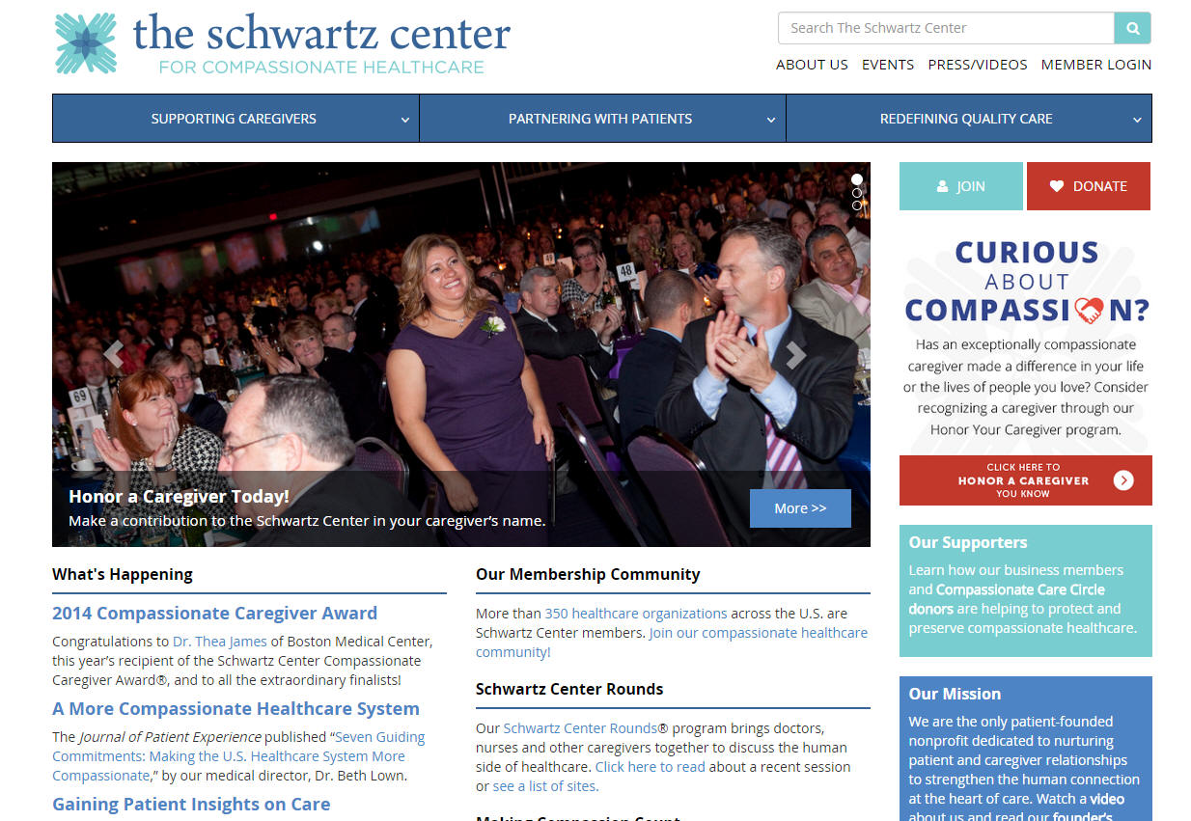

Slide 46

Thank you for participating in today’s session.
Please take a moment to complete the electronic
survey upon exiting today’s program.
46

