Slide 1
Note To Presenters:
This PowerPoint is designed to be an adaptable resource. Presenters may use the full deck or select slides based on audience, time, and local priorities. The accompanying implementation guide provides suggestions for how to best use these materials.
This slide deck is intended to be iterative. Please share feedback on how this slide deck could be improved by emailing community@theschwartzcenter.org.
Last Updated: July 2026
Hide this instructional slide before presenting.

Slide 2


The Schwartz Rounds® Program
An Evidence-Based Strategy To Strengthen Staff Well-being, Connection, and Cultures of Compassionate Care

Slide 3
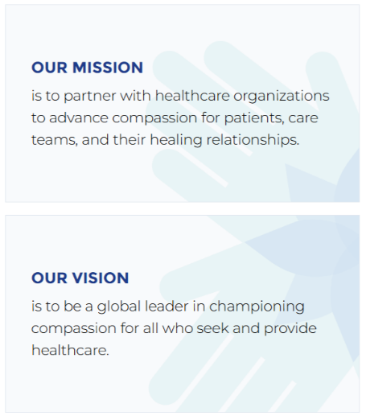
About the
Schwartz Center
Our programs increase compassion in healthcare and create more meaningful connections between patients and healthcare professionals.
We work with more than 700 healthcare partners in the U.S., the U.K., Ireland, Canada, Australia, and New Zealand to advance compassion for patients, care teams, and their healing relationships.
Healthcare organizations face unprecedented challenges: staffing shortages, widespread provider burnout, mounting financial pressures, and deepening health disparities. We deliver evidence-based solutions that restore purpose to healthcare work, reduce burnout, and ensure that compassion remains at the heart of healing.

Slide 4



Our Work
Patients and healthcare workers alike believe that compassion is essential to successful medical treatment, how well patients recover from illness, and even whether a patient lives or dies. With the difficulties facing healthcare, compassion matters now more than ever.​​
We cultivate compassion in healthcare for patients, families, teams and organizations by:​​​
Increasing the reach and impact of the Schwartz Rounds program
Offering educational, networking, and recognition opportunities
Helping healthcare organizations and their leaders to advance a culture of compassion

Slide 5
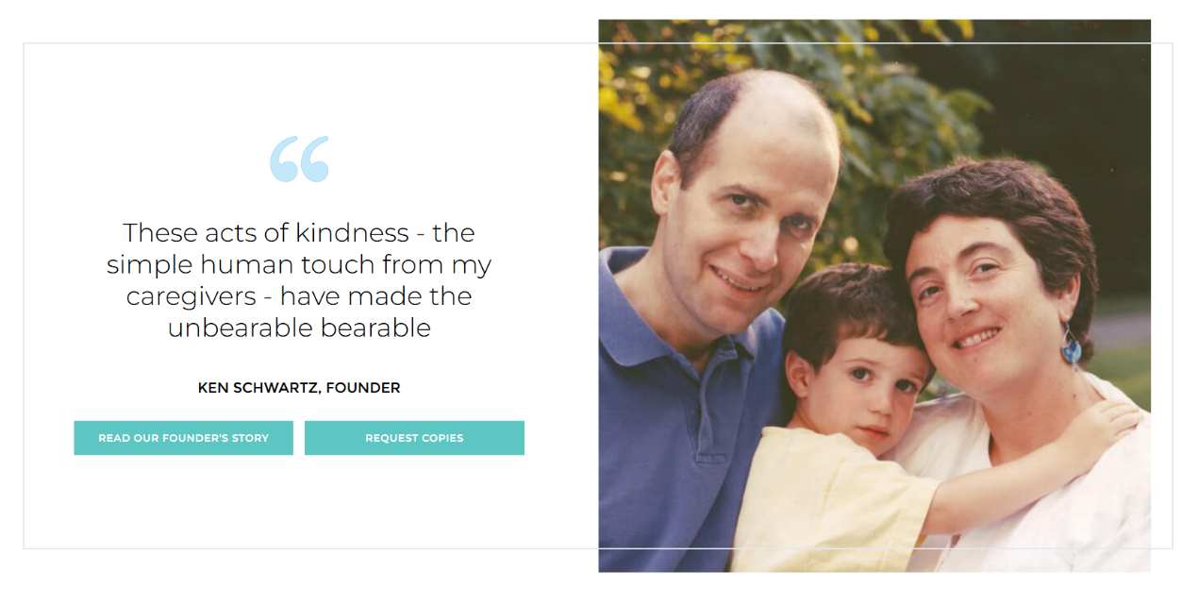

Slide 6
The Strategic Imperative

Slide 7

Workforce Instability is
Eroding Health System
Performance
Burnout and turnover are not HR issues. They are financial, safety, and performance risks.
Burnout is widespread and persistent
~50% of physicians reported burnout in 2024
45% of nurses experience burnout at least several times per week
Turnover is financially and operationally costly
18.4% national RN turnover
$60K+ average cost to replace one bedside RN
Vacancies strain care delivery
10%+ vacancy rate at over one-third of hospitals nationally
Physician attrition has major financial impact
$500,000–$1M+ cost per physician departure
System-level impact
Staff distress, moral injury, and disconnection can erode teamwork, compassion, and commitment to the work.
See Schwartz Center Research Summary for references.

Slide 8

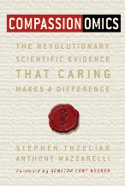
Compassion Makes Healthcare Better…
“Compassion is a necessity, not a luxury, in healthcare.”
Beth Lown, MD, Schwartz Center CMO Emeritus
As published in Compassionomics
For Patients:
  Reduced pain and disability
  Fewer symptoms in cancer patients
  Less PTSD in patients with trauma
  Improved adherence
  Improved chronic disease outcomes
  Positive patient experiences
For Providers:
  Positive emotions
  Sense of reward and fulfillment
  Sense of affiliation
  Deeper connection
  Improved professional quality of life
The Art & Science of Compassion!
Selected evidence summarized from compassion science, patient experience, and clinician well-being literature.

Slide 9
Connect the Schwartz Rounds Program to Local Strategic Priorities
Presenter:
Customize this slide with 2-3 local priorities such as: workforce retention, staff well-being, patient experience, safety culture, teamwork and communication, and organizational culture.

Slide 10
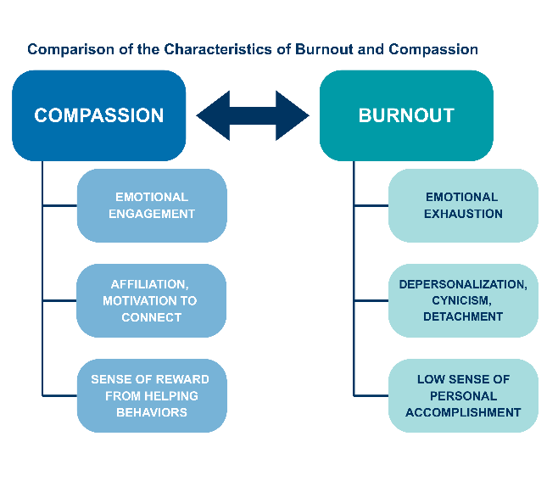
The Connections Between Compassion,
Distress, Moral Injury, and Burnout
Compassion-related behaviors of nurses and physicians are inversely correlated with emotional exhaustion and depersonalization, and with a lack of perceived organizational support
The less support providers perceive, the more burnout they experience, and the less capacity they have to offer compassion to patients and families
The Schwartz Rounds program is not designed to place responsibility on individual workers. It creates organizational space to acknowledge and respond to the emotional, social, and moral dimensions of healthcare work.
Lown; 2019 Foundation of the ACHE

Slide 11

Linkages between
Compassion → Burnout → Patient Safety
High staff burnout rates are associated with:
Higher turnover and less continuity of care
Increased risk of patient safety incidents
Increase in self-reported medical errors
Increase in malpractice suits
Reduced patient satisfaction
Flawed diagnostic processes
Greater isolation and disconnection among staff
Notes:
Aiken LH, Lasater KB, Sloane DM, Pogue CA, Fitzpatrick Rosenbaum KE, Muir KJ, McHugh MD; US Clinician Wellbeing Study Consortium. Physician and Nurse Well-Being and Preferred Interventions to Address Burnout in Hospital Practice: Factors Associated With Turnover, Outcomes, and Patient Safety. JAMA Health Forum. 2023 Jul 7;4(7):e231809.
Aiken LH, Sermeus W, McKee M, Lasater KB, Sloane D, Pogue CA, Kohnen D, Dello S, Maier CBB, Drennan J, McHugh MD; Magnet4Europe Consortium. Physician and nurse well-being, patient safety and recommendations for interventions: cross-sectional survey in hospitals in six European countries. BMJ Open. 2024 Feb 12;14(2):e079931.
Owoc J, Mańczak M, Jabłońska M, Tombarkiewicz M, Olszewski R. Association Between Physician Burnout and Self-reported Errors: Meta-analysis. J Patient Saf. 2022 Jan 1;18(1):e180-e188.
Balch (malpractice) http://refhub.elsevier.com/S0002-9610(21)00759-5/sref24
Al-Ghunaim TA, Johnson J, Biyani CS, Alshahrani KM, Dunning A, O'Connor DB. Surgeon burnout, impact on patient safety and professionalism: A systematic review and meta-analysis. Am J Surg. 2022 Jul;224(1 Pt A):228-238.
Tawfik DS, Scheid A, Profit J, Shanafelt T, Trockel M, Adair KC, Sexton JB, Ioannidis JPA. Evidence Relating Health Care Provider Burnout and Quality of Care: A Systematic Review and Meta-analysis. Ann Intern Med. 2019 Oct 15;171(8):555-567.
Sullivan EE, Khazen M, Arabadjis SD, Mirica M, Ramos JM, Olson APJ, Linzer M, Schiff GD. Exploring relationships between physician stress, burnout, and diagnostic elements in clinician notes. Diagnosis (Berl). 2023 Mar 7;10(3):309-312.

Slide 12
The Evidence-Based Solution

Slide 13

What is the Schwartz Rounds® Program?
Creates a dedicated space that is:
Intentionally structured, confidential, and reflective on the challenges and the joys that come with the day-to-day work of healthcare
Led by Schwartz Center-trained local facilitators
Centered on a theme or case
Open to clinical and non-clinical healthcare workers, staff, and team members
Meant to build meaningful connections through dialogue

Slide 14

What This Looks Like in Practice…
Sample Schwartz Rounds Topics:
A Patient I Will Never Forget
The Power of Small Gestures
Bearing Witness to a Loved One’s Grief
Finding Joy and Awe in Our Work
Navigating Uncertainty
The Weight We Carry After the Shift Ends
When the Personal and the Professional Overlap
Holding Hope When Outcomes Don’t Change

Slide 15
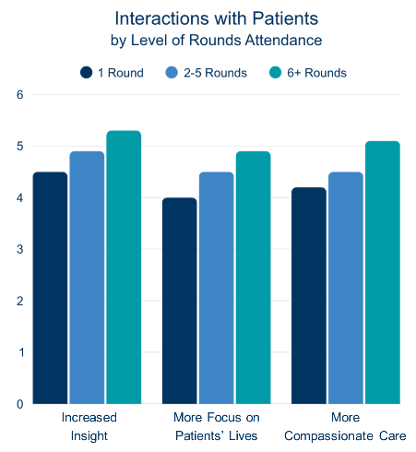
Schwartz Rounds Sessions Help Staff Provide More Compassionate Patient Care
Caregiver-reported improvements:
  90% reported more insight into non-clinical aspects of patient care
  88% feel more effective in responding to patients’ socioemotional needs
  82% focus more on the effects of illness on patients and families
  82% provide more compassionate care
Similar impacts on teamwork and stress
Dose-response effect: More Schwartz Rounds sessions attended, greater reported impact.
Lown BA, Manning CF. Acad Med. 2010;85(6):1073-81.
Notes:
This shows a dose-response curve. More session attended, more impact.

Slide 16
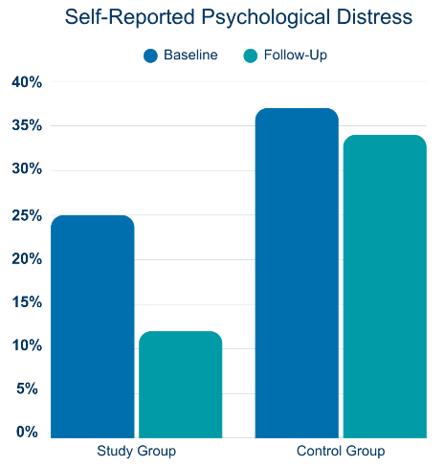
Schwartz Rounds Sessions Significantly Reduce
Psychological Distress
In a longitudinal comparison study, regular Schwartz Rounds attendees showed a 50% reduction in self-reported psychological distress vs. 10% decrease in a comparison group
Likelihood of distress severe enough to require a clinical mental health intervention was reduced by ~20% in Schwartz Rounds attendees compared with non-attendees
Related outcomes include reduced isolation, stress, and moral distress.
Dawson, Jeremy, McCarthy, Imelda et al. BMC Health Services Research. 2021; 21:392

Slide 17





The Impact of the Schwartz Rounds
Individual Attendees
Care Team
  50% reduction in severe
psychological distress
  Renewed passion and commitment
  Reduced mental health stigma
  Decreased isolation and stress
  Reduced moral distress
  Improved understanding of
others' roles/perspectives
  Increased teamwork and
communication
  Leadership engagement and
flattening of hierarchy
  Sense of shared purpose
Patient Care
Organizations
  Increased compassion and empathy
  Improved insight into patient
needs and concerns
  Increased sensitivity to illness
impacts
  Better patient satisfaction
  Changes in policies and practices
  Positive/supportive work and
learning environment
  Bridging and de-siloing of depts.
  Visible leadership support
  Ripple effects on culture

Slide 18
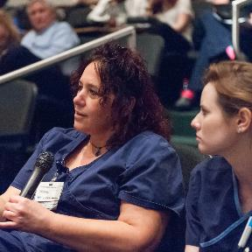
The Impact of the Schwartz Rounds
Individual Attendees
  50% reduction in severe psychological distress
  Renewed passion and commitment
  Reduced mental health stigma
  Decreased isolation and stress
  Reduced moral distress

Slide 19

The Impact of the Schwartz Rounds
Care Team
  Improved understanding of others' roles/perspectives
  Increased teamwork and communication
  Leadership engagement and flattening of hierarchy
  Sense of shared purpose

Slide 20

The Impact of the Schwartz Rounds
Patient Care
  Increased compassion and empathy
  Improved insight into patient needs and concerns
  Increased sensitivity to illness impacts
  Better patient satisfaction

Slide 21

The Impact of the Schwartz Rounds
Organizations
  Changes in policies and practices
  Positive/supportive work and learning environment
  Bridging and de-siloing of departments
  Visible leadership support
  Ripple effects on culture

Slide 22
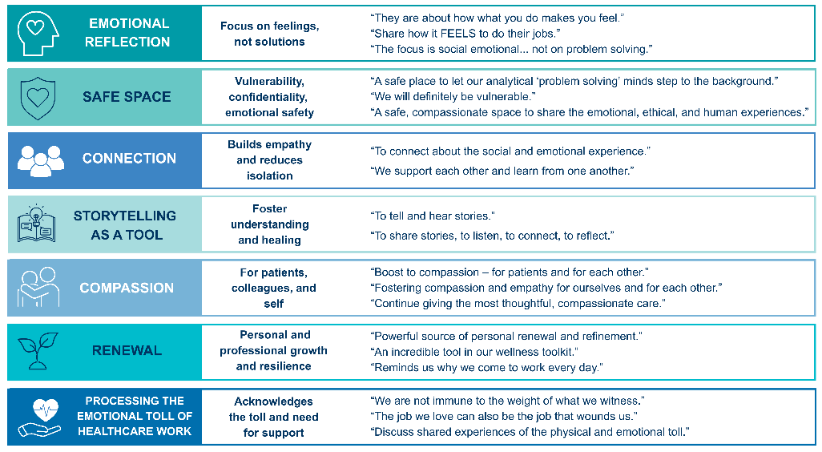
What Participants Experience in Schwartz Rounds Sessions
As shared by Schwartz Rounds Leaders

Slide 23
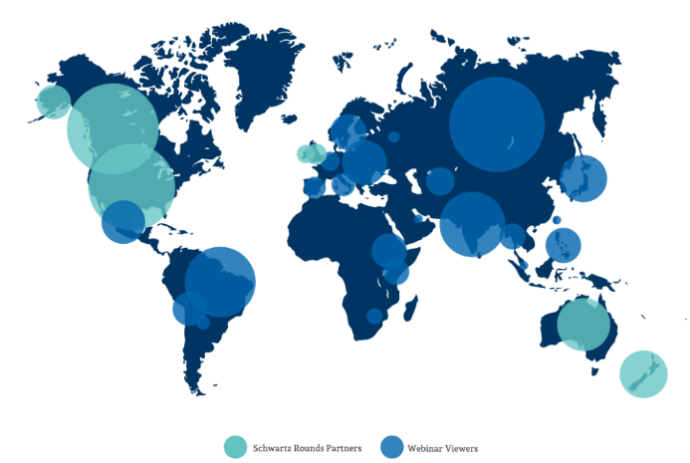
Global Impact
700+
sites across the U.S., the U.K., Ireland, Canada, Australia, and New Zealand run our Schwartz Rounds program.
8,900+
caregivers, representing 34 countries, viewed our Schwartz Compassion in Action webinars and online resources.

Slide 24
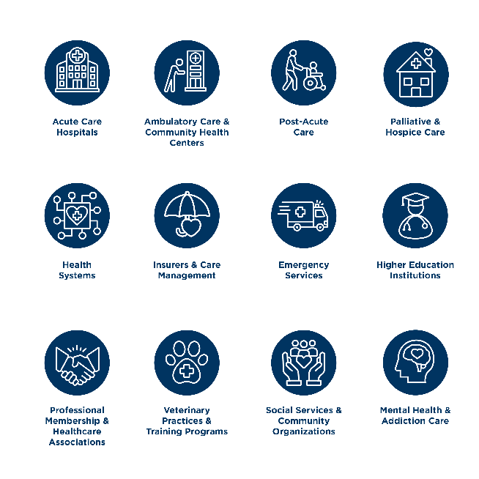
Healthcare Organizations
We Support
The value and impact of a Schwartz Rounds program can be experienced in a variety of organization types.

Slide 25
The Case for Adoption NOW

Slide 26
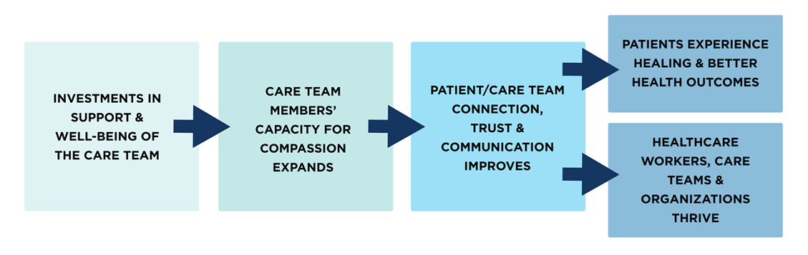
How Will the Schwartz Rounds Program
Benefit Our Organization?

Slide 27
The Business Case: Reduced Costs and Stronger Performance
DECREASED COSTS
Reduced Burnout (estimated to cost US $4.6 billion/yr)
  Reduced turnover and vacancy → Reduced coverage and replacement costs
    Average cost of replacing a staff nurse ~60,000.
    Average cost of replacing a physician $500,000 – $1,000,000
  Reduced mental/physical health costs and sick-time
Reduced Utilization of Diagnostic Tests, End-of-Life ICU Utilization, Readmissions
Reduced Adverse Events/Medical Errors (estimated to cost U.S. $20 billion/yr)
  Fewer malpractice claims, lower premiums
INCREASED REVENUE
Increased Patient Revenue Growth from improved loyalty and reputational benefits
Improved Caregiver Productivity
Improved Provider Retention
See Schwartz Center Research Summary for references.
Notes:
Li CJ, Shah YB, Harness ED, Goldberg ZN, Nash DB. Physician Burnout and Medical Errors: Exploring the Relationship, Cost, and Solutions. Am J Med Qual. 2023 Jul-Aug 01;38(4):196-202.
https://www.ama-assn.org/press-center/press-releases/surge-medical-liability-premiums-increases-reaches-fourth-year
Burnout, Professionalism, and the Quality of US Health Care | Health Policy | JAMA Health Forum | JAMA Network
https://www.beckershospitalreview.com/workforce/the-cost-of-nurse-turnover-in-24-numbers-2023.html
https://www.beckershospitalreview.com/finance/the-cost-of-physician-turnover.html
https://www.fitchratings.com/research/us-public-finance/operating-margins-reset-potential-pain-point-for-us-nfp-hospitals-29-01-2024?ite=1055569&ito=2639&itq=830bbef9-6a48-4bdc-a0f0-058bbe8ad808&itx%5Bidio%5D=139430645.

Slide 28
The Case for Compassion:
A Strong Return on Investment
Utilization of unnecessary resources and services (EOL care, diagnostic tests, readmissions)
Medical errors
Malpractice claims
Healthcare worker burnout
Lost provider revenue
Staff turnover and associated costs
Vacancies, overtime, traveler costs
Better patient physical and mental health
Patient satisfaction and loyalty
Healthcare worker physical and mental health
Teamwork and communication
Organizational culture and employee engagement
Operating revenues and margins
Notes:
Li CJ, Shah YB, Harness ED, Goldberg ZN, Nash DB. Physician Burnout and Medical Errors: Exploring the Relationship, Cost, and Solutions. Am J Med Qual. 2023 Jul-Aug 01;38(4):196-202.
https://www.ama-assn.org/press-center/press-releases/surge-medical-liability-premiums-increases-reaches-fourth-year
Burnout, Professionalism, and the Quality of US Health Care | Health Policy | JAMA Health Forum | JAMA Network
https://www.beckershospitalreview.com/workforce/the-cost-of-nurse-turnover-in-24-numbers-2023.html
https://www.beckershospitalreview.com/finance/the-cost-of-physician-turnover.html
https://www.fitchratings.com/research/us-public-finance/operating-margins-reset-potential-pain-point-for-us-nfp-hospitals-29-01-2024?ite=1055569&ito=2639&itq=830bbef9-6a48-4bdc-a0f0-058bbe8ad808&itx%5Bidio%5D=139430645.

Slide 29
The Schwartz Rounds Program
An Investment in Our Future
Our Providers
Stronger teamwork
Enhanced communication
Deeper emotional connection
Reduced burnout
Restored sense of commitment and purpose
Improved mental and physical health
Our Patients
Better patient physical and mental health
Improved patient satisfaction scores
Greater patient loyalty
Decreased medical errors and malpractice claims
Our Organization
Stronger employee engagement
Strengthened workplace culture and recruitment
Decreased utilization of unnecessary services
Reduced staff turnover
Improved margin

Slide 30


Success Stories
When I arrived at Calvary and spoke with staff about their needs, they expressed a need for emotional support. Being able to connect with an organization like the Schwartz Center that has experience in this area—rather than trying to figure it out ourselves—is incredibly helpful. When staff see leadership actively supporting them, it elevates the entire culture and strengthens what they’re doing. This improved culture then helps with recruitment, and better recruitment ultimately reduces burnout.
Michael J. Fosina, MPH, FACHE
President, Calvary Hospital
Bronx, New York

Slide 31
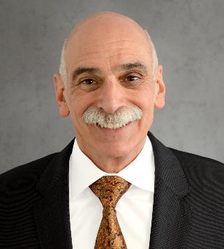

Success Stories
In a safety net hospital, while we don’t have extensive financial assets, we have our workforce—they are our greatest asset… I’m a strong believer in Schwartz Rounds. I attend every session, and we typically get about 200 participants. I look forward to them because I think they’re incredibly important.
Bruce Flanz, MBA
President and CEO
MediSys Health Network
Jamaica & Flushing Hospital Medical Centers
Queens, New York

Slide 32
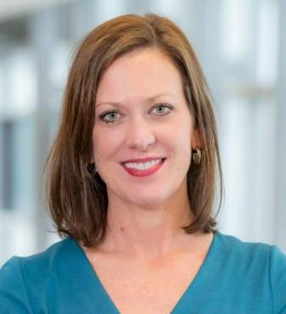

Success Stories
When you attend Schwartz Rounds and witness what people go through as they share their experiences, you see the profound learning that occurs alongside the immediate emotional release and healing that happens in that moment. It’s very powerful, and I think it’s an amazing program.
Shelly Anderson, MPM
Hospital President
Memorial Sloan Kettering Cancer Center
New York, New York

Slide 33


Success Stories
At CVS Health, we’re making personalized, trusted care accessible in local communities. We recognize that our practitioners must be supported by the same compassion they provide to our patients. Integrating the Schwartz Rounds program into our MinuteClinic provider support programs and investing as a Schwartz Center donor are two important examples of how to ensure our frontline teams have the resilience and emotional tools they need to lead with heart, even in the most fast-paced healthcare environments.
Angela Patterson, DNP, FNP-BC, NEA-BC, FAANP
Enterprise Chief Nurse Officer, VP and Chief Nurse Practitioner Officer, Retail Health
CVS Health
Woonsocket, RI

Slide 34
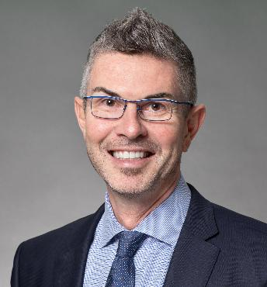

Success Stories
Our commitment to ‘show up for everyone like they’re the only one’ begins with how we show up for our own people. By integrating Schwartz Rounds into our health and medical management division, we ensure our frontline teams have the emotional resilience to lead with compassion in every member interaction.
Ashley Yeats, MD, FACEP, FCFPC(EM), CHIE
Vice President, Medical Operations
Blue Cross Blue Shield of Massachusetts
Boston, MA

Slide 35
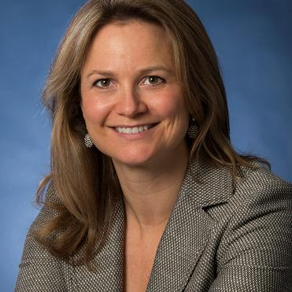

Success Stories
Our Schwartz Rounds sessions are a powerful demonstration of the impact that intentional, reflective spaces can have on healthcare teams. The feedback has been overwhelmingly positive, with many noting a renewed sense of connection, perspective, and purpose. Experiences like this underscore how meaningful it is to create opportunities for staff to process the emotional realities of their work together.
Carol-Anne Moulton, MD
Associate Professor, General Surgery
University of Toronto
Toronto, Ontario, Canada

Slide 36
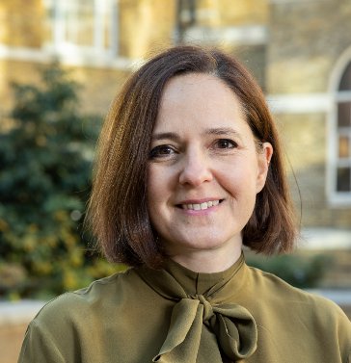

Success Stories
The Schwartz Rounds programme was introduced to UK medical schools more than a decade ago as a way to improve engagement and provide a space to process emotions. Students consistently report that the program strengthens empathy for patients, peers, and colleagues. Today, Schwartz Rounds sessions are embedded in healthcare curricula across the UK, helping to shape a more compassionate future workforce.
Faye Gishen MBBS, BSc, FRCP, EdD, PFHEA, FAcadMEd
Director, UCL Medical School
London, United Kingdom

Slide 37


Success Stories
Oxleas leads Schwartz Rounds sessions targeted towards mental, physical and learning disability professionals across hospital, community, learning and prison settings. What is striking is that a focus on the emotional processes always reminds us how much is in common between our teams. Sharing experiences together helps individuals and also the positive working relationships between parts of our organisation.
Neil Springham, PhD
Chief Therapies Officer and Executive Lead for Patient Experience
Oxleas NHS Foundation Trust
London, United Kingdom

Slide 38
Adoption Pathway
Getting started is simpler than many leaders expect, and the Schwartz Center for Compassionate Healthcare provides support throughout the journey.

Slide 39
Sustaining Your Schwartz Rounds Journey:
Ongoing Support from the Schwartz Center!
Observations with debriefs
Live training workshops
Community of Practice sessions
Community Schwartz Rounds
Sustaining Quality &
Expanding Impact Through Continuous Support
Consultation with
Program Advisor
Webinars and virtual trainings
Cohort
Initial Training Process
Host & Debrief First Schwartz
Rounds Session
Planning
& Prep
Succession planning support

Slide 40
Your Schwartz Rounds Team
Leadership Team
Key implementers of the Schwartz Rounds Program
Planning Committee
Vital program champions with peers and within departments
Who?
Who?
Facilitators (3)
Clinical Leader (1)
Program Coordinator / Administrator (1)
8-12 members (including the Leadership Team)
Represent a cross-section of the organization
Meet regularly to plan sessions; select topics and storytellers; conduct outreach
Model participation and offer logistical support
What?
What?
Completes the initial cohort training process
Lead and plan program
Interface with organizational leadership and the Schwartz Center
See Roles and Responsibilities document for additional information about each of these roles.

Slide 41

Typical Launch Pathways:
The First 4 - 6 Months
Cohort
Initial Training
Process
Host and Debrief First Schwartz
Rounds Session
Set the
Foundation
Planning
and Prep
Leadership commitment and champion identification
Initial planning committee formation
License agreement signed
~ 2 months
Two 60-minute live
meetings
2-4 hours of online training
2-hour live experiential training for facilitators
~ 2-4 months
Planning Committee meetings
Program Advisor/Mentor support and guidance
~ 1 week
Feedback collection and refinement
Program Advisor/Mentor debrief

Slide 42
Minimal Investment, Maximum Impact
Schwartz Rounds Program Training Fee
  5 implementation training seats for the Schwartz Rounds Leadership Team
  Asynchronous online training (depending on role)
  Virtual onboarding support led by Schwartz Center program experts
Annual Program Fee
  Ongoing program support meetings with program experts following initial training
  Schwartz Rounds session observations and debriefs provided by program experts
  Complimentary registrations for virtual workshops and trainings for the Schwartz Rounds Leadership Team
  Connection to broader Schwartz Center community, including monthly Community of Practice sessions
  Opportunity to explore complementary offers, including Stress First Aid.

Slide 43

Invest in Compassion Today
Supporting staff strengthens teams.
Stronger teams improve communication, patient care, and the capacity for compassion.
Better patient and staff experiences strengthen organizational culture.
The Schwartz Rounds program empowers organizations to build compassionate, connected systems of care.

Slide 44


Placeholder
Thank You / Questions?
Thank you!
Questions?

Slide 45
Appendix

Slide 46


Strategic
Transformational
COMPASSION IS...
Essential

Slide 47
References
An extensive bibliography including references to data and information shared in this presentation can be found at the following two resources:
Schwartz Rounds Research Summary
Schwartz Center Case for Compassion

Slide 48
Additional References
American Medical Association. 2024 AMA Joy in Medicine™ Health System Recognition Program Overview. American Medical Association; 2024.
National Academy of Medicine. National Plan for Health Workforce Well-Being. National Academy of Medicine; 2022.
NSI Nursing Solutions, Inc. 2024 National Health Care Retention & RN Staffing Report. NSI Nursing Solutions; 2024.
Association of American Medical Colleges. The Complexities of Physician Supply and Demand: Projections From 2021 to 2036. Association of American Medical Colleges; 2024.
Aiken LH, Lasater KB, Sloane DM, et al. Physician and nurse well-being and preferred interventions to address burnout in hospital practice: factors associated with turnover, outcomes, and patient safety. JAMA Health Forum. 2023;4(7):e231809.
Aiken LH, Sermeus W, McKee M, et al. Physician and nurse well-being, patient safety and recommendations for interventions: cross-sectional survey in hospitals in six European countries. BMJ Open. 2024;14(2):e079931.
Han S, Shanafelt TD, Sinsky CA, et al. Estimating the attributable cost of physician burnout in the United States. Ann Intern Med. 2019;170(11):784-790.
Owoc J, Mańczak M, Jabłońska M, Tombarkiewicz M, Olszewski R. Association between physician burnout and self-reported errors: meta-analysis. J Patient Saf. 2022;18(1):e180-e188.
Al-Ghunaim TA, Johnson J, Biyani CS, Alshahrani KM, Dunning A, O’Connor DB. Surgeon burnout, impact on patient safety and professionalism: a systematic review and meta-analysis. Am J Surg. 2022;224(1 Pt A):228-238.
Tawfik DS, Scheid A, Profit J, et al. Evidence relating health care provider burnout and quality of care: a systematic review and meta-analysis. Ann Intern Med. 2019;171(8):555-567.
Sullivan EE, Khazen M, Arabadjis SD, et al. Exploring relationships between physician stress, burnout, and diagnostic elements in clinician notes. Diagnosis (Berl). 2023;10(3):309-312.

Slide 49
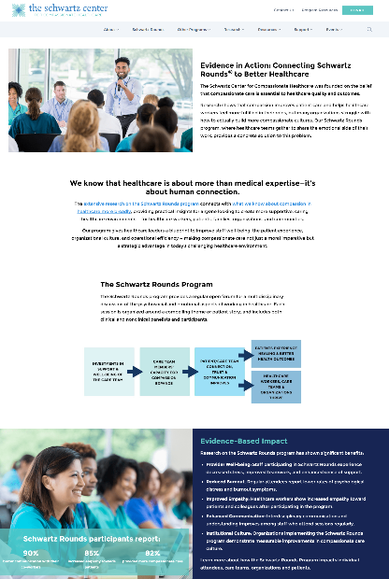
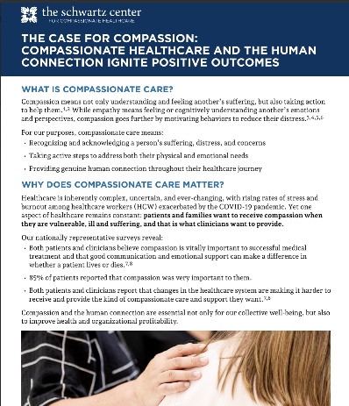
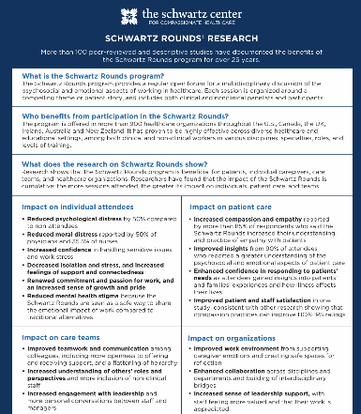
Appendix: Research Summaries and Supporting Evidence
https://www.theschwartzcenter.org/research/evidence-in-action/

