Slide 1
Ways to Fund Your
Schwartz Center
Programs

Slide 2
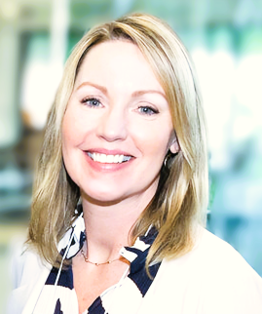
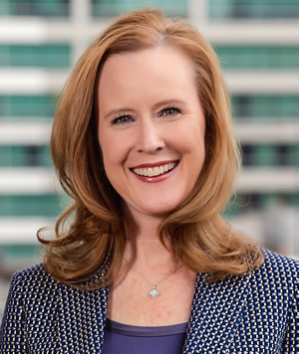
Our Speakers
Jessica Moran-MacAleese
Director of Individual Giving
The Schwartz Center for
Compassionate Healthcare
Laura McWhorter
President
Texas Health Resources Foundation

Slide 3
Topics
Seeing the opportunity, not the burden
Building a relationship with fundraising, marketing and public affairs colleagues
Thinking about possible donors
Acknowledging donors
Discussing costs and making your case
Case Study: Texas Health Resources Foundation

Slide 4


Seeing the opportunity, not the burden

Slide 5
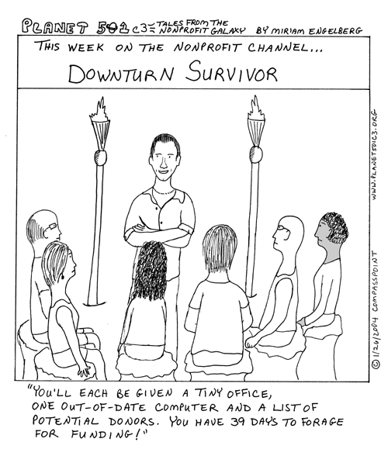
You have an opportunity for your fundraising team
Schwartz Center programming is an opportunity for your colleagues
Fundraisers need special projects to raise funds
They need a “hook”
Schwartz Center programs are a very compelling hook

Slide 6

Opportunities and ideas translate to donations
Your idea around Schwartz Center programs can raise more money for your organization
You can offer an invaluable tool for the fundraising professionals at your institution
They should be thrilled to hear from you!

Slide 7

Building a relationship with your fundraisers
Identify the right fundraiser
  Start with the Director of Development or Major Gifts Officer
Educate the fundraising team on Schwartz Center programs and what inspires you to implement them
Engage your fundraising teams by inviting them to observe a Schwartz Rounds® session. For opportunities to observe, please contact info@theschwartzcenter.org.

Slide 8

What is the Schwartz Rounds program?
The Schwartz Rounds program provides a regular open forum for a multidisciplinary discussion of the psychosocial and emotional aspects of working in healthcare. Each session is organized around a compelling theme or patient story and includes both clinical and nonclinical panelists and participants.
Organization-Wide or Unit-based
Case- or theme-based multidisciplinary panel followed by trauma-informed facilitated discussion
Fosters social support, perspective-taking, community-building; NOT didactic, problem-solving, medically focused
Confidential & Safe

Slide 9
Use data to convey the impact of the Schwartz Rounds program
Research shows that the Schwartz Rounds program is beneficial for patients, individual caregivers, care teams, and healthcare organizations. Studies show:
85% of respondents said the Schwartz Rounds program increased their understanding and practice of empathy with patients
90% of attendees reported a greater understanding of the psychosocial and emotional aspects of patient care
50% reduction in psychological distress
Read more: theschwartzcenter.org/schwartz-rounds-research

Slide 10
Think about grateful patients or clinicians
Mrs. Smith once made me promise that if there was anything she could do to help that I should ask her.
One of the hospital c-suite executives shows up to Schwartz Rounds sessions every month. Many times I see tears in her eyes. Maybe she could help us think about possible donors.
Dr. Rosen was always passionate about patient-centered care—I heard his family is looking for a way to memorialize or honor his involvement at the hospital.

Slide 11
Think about institutional donors
Many of us buy our lunches at the deli across the street; maybe they would consider donating pasta salad and sandwiches for the lunches.
Companies interested in quality and safety initiatives are often interested when they learn about the Schwartz Rounds programs.
Our food service might be interested in making a donation of the food for each session…

Slide 12
Thank donors
Remember, the Schwartz Center is a highly-regarded brand in healthcare with a broad reach and 30 years of experience
Creative ways to thank or memorialize a donor:
    Wording at the bottom of promotional materials – “The Schwartz Rounds program is made possible by a generous donation from…”
    Tent card on the tables at each session
    Announcement/slide at the beginning of each session
    Add the Schwartz Center logo and sponsor logos to your email signature
Notes:
Now, let’s shift our focus from how and from whom we raise funds, to what happens at the end of that process — thanking the donors who choose to give.
It’s important to know that the Schwartz Center is a highly-regarded brand in healthcare
Donors like knowing they’re affiliated with your local institution, but also an internationally recognized organization like the Schwartz Center. Our broad membership reach and 30 years of experience will be a compelling reason for donors to support the program.
There are many ways to creatively thank donors who support the program at your hospital
Use the Schwartz Center brand on all materials saying “The Schwartz Rounds program is made possible by a generous donation from…”
Set tent cards on the food and materials table.
Make announcements at the beginning of Schwartz Rounds sessions. Remember, some donors like to remain anonymous, but others love your institution and are motivated to give by public recognition, particularly businesses looking to increase visibility.
At one of our Schwartz Rounds sites, a staff member added a simple graphic to her email signature — thanking the hospital foundation for support and promoting awareness of the Schwartz Rounds program. It’s a great example of how a small gesture can make a meaningful impact.
Remember, recognition is free, offer it abundantly! This can be done whether your Schwartz Rounds sessions are live, hybrid or virtual.

Slide 13
Determine the costs of Schwartz Center programs
Think about all related costs:
  Program fees
  Food for the attendees
  Room fees
  A/V expenses
  Staff time for Program Coordinator, Clinical Leader, or Facilitator

Slide 14
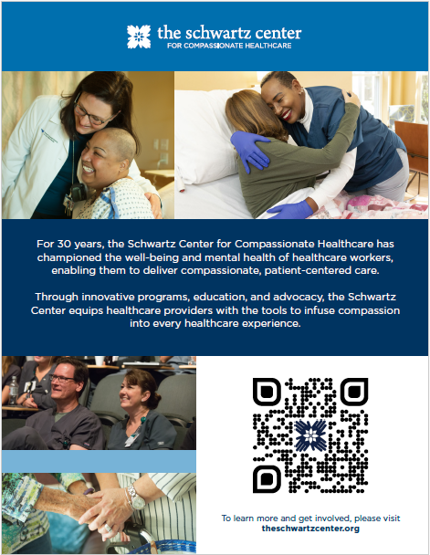
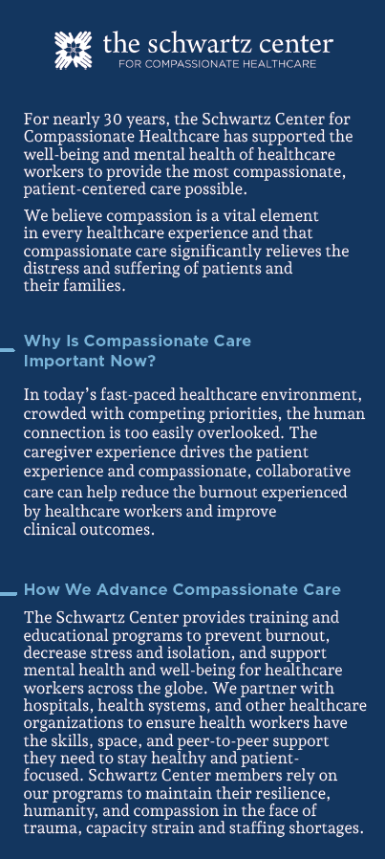
Make your case - use Schwartz Center materials
Schwartz Center literature and materials, such as flyers, rack cards and videos, are a great way to introduce the Schwartz Center to your patients and visitors.

Slide 15
Case study: Laura McWhorter
TEXAS HEALTH RESOURCES
FOUNDATION

Slide 16
Key Ingredients to the THR Story
The Foundation’s Donor-centric Fundraising to Align Donor Interest & Passion
Executive Hospital Sponsor
Support & Buy-in from CEO
Steering Committee & Individual Hospital Planning Committees

Slide 17
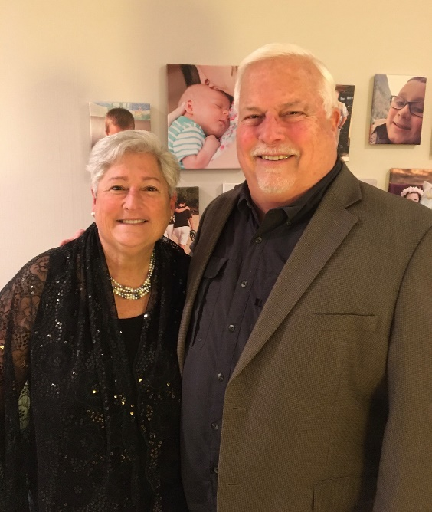
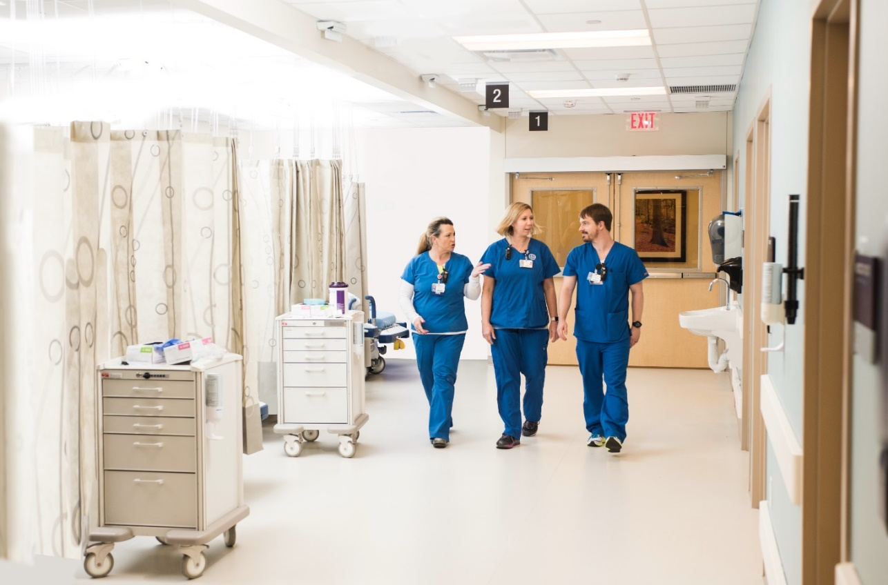



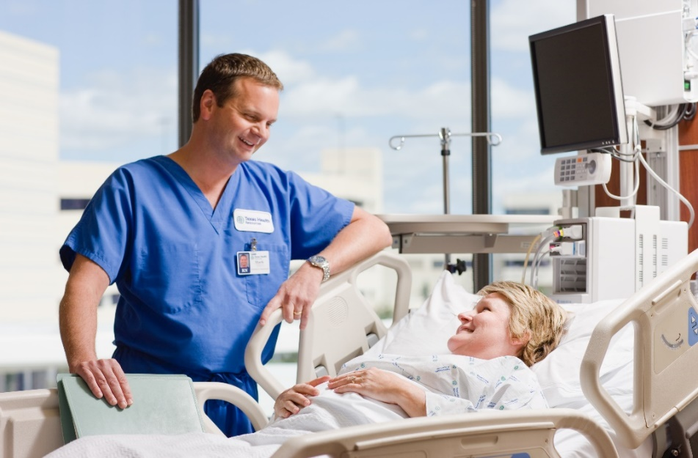


Donor-centric Approach
“The Schwartz Rounds touched our hearts so much…
It was a chance for us to really move the needle for hospital staff across Texas Health, especially after the experience of 2020 that brought extra tears and heartbreak for our caregivers.”
- Lynne & Alan Moffatt

Slide 18



Sustainability through Annual Fund
The Foundation does not specifically hold a fund for the Schwartz Rounds program nor specifically fundraise for the program…
North Texas
Giving Day
Texas Health Together Employee Giving Campaign
Annual Fund Appeal for 365 Fund

Slide 19
A Win-Win for THR Staff, Foundation, and Donors
System-wide access to the Schwartz Rounds program for THR staff
A major gift officer successfully secured a gift that married donor interest with THR priorities
Further connected Foundation and philanthropy with the health system’s strategic priorities
Our donors are thrilled with the success of the program and expansion since their original gift
  The Moffatts are still attending Schwartz Rounds sessions at their home hospital location

Slide 20
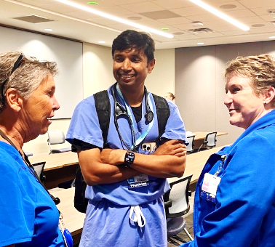
Supporting Compassionate Healthcare at THR
“Participating in Schwartz Rounds fosters a sense of community and support among everyone, encouraging open discussions about challenging experiences.
This environment promotes empathy, compassion and improved teamwork, ultimately leading to more supportive and cohesive work culture.”
Dhruvangkumar Modi, M.D., M.P.H.
THDN, Pulmonary & Critical Care
Chair, System Physician Leadership Council

Slide 21
Thank you
For further information please feel free to contact
the Schwartz Center Development Team at development@theschwartzcenter.org

