Slide 1
Stress First Aid
Briefing
Developed in collaboration with
Patricia Watson, PhD
National Center for PTSD
Notes:
Stress First Aid – 30-Minute Briefing
Instructor Guide
Based on Resources from the National Center for PTSD & adapted for Schwartz Center Members
Acknowledgements from Patricia Watson, PhD and the National Center for PTSD
This manual, intended for those in high-stress jobs such as fire/rescue, healthcare, law enforcement, rail, and pretrial/probation settings, is derived from the Stress First Aid for Firefighters and Emergency Medical Services Personnel Student Manual, developed by the National Fallen Firefighters Foundation. The principle authors of The Stress First Aid for Firefighters and Emergency Medical Services Personnel Student Manual are Patricia Watson, Ph.D., of the National Center for PTSD, Vickie Taylor of Prince William (VA)Community Services/NFFF Behavioral Health Specialist, Richard Gist, Ph.D., of the Kansas City (MO) Fire Department, Erika Elvander of the Defense Centers of Excellence for Psychological Health and Traumatic Brain Injury, Captain Frank Leto of the FDNY Counseling Unit, Captain Bob Martin of the Chicago Fire Department, Captain Jim Tanner of Prince William (VA) Fire and Rescue, District Chief Don Vaught of the Eugene (OR) Fire & EMS Department, William Nash, MD, Captain, MC, USN (Retired), Richard J. Westphal, Ph.D., PMHCNS-BC, Captain, NC, USN (Retired), and Brett Litz, Ph.D., of the Mental Health Core of the Massachusetts Veterans Epidemiological Research and Information Center at the VA Boston Healthcare System. The Stress First Aid for Firefighters and Emergency Medical Services Personnel Student Manual represents a civilian adaptation of the Combat and Operational Stress First Aid (COSFA) Field Operations Manual, developed by the Bureau of Medicine and Surgery, Department of the Navy, in cooperation with the Combat and Operational Stress Control, Manpower & Reserve Affairs, Headquarters Marine Corps, the Navy Operational Stress Control, Chief of Naval Personnel, Total Force N1, and the National Center for PTSD, Department of Veterans Affairs. The principal authorsof the COSFA Field Operations Guide included William Nash, Richard Westphal, Patricia Watson and Brett Litz. We are grateful to the military units and bureau listed above for allowing the adaptation of their work to help our nation’s first responders.
Acknowledgements from the Schwartz Center for Compassionate Healthcare
The Schwartz Center for Compassionate Healthcare would like to express gratitude for our collaboration with Patricia Watson, PhD and for the work of the National Center for PTSD. Dr. Watson was instrumental in bringing the core concepts of Stress First Aid to our programming. Schwartz Center courses on Stress First Aid were developed with guidance and support from Dr. Watson.

Slide 2
Briefing Objectives
This presentation will support stakeholders to:
Identify sources of stress and stress injury for healthcare workers
Articulate the purpose of Stress First Aid
Describe the Stress Continuum
Identify resources for further training and implementation
Notes:
Introduction and Objectives
Welcome to Stress First Aid Training. Stress First Aid (SFA) is a set of supportive actions designed to promote self-care and coworker support. The overarching aim of SFA is to identify and mitigate the negative impacts of stress at work before they can impair workers’ health and wellbeing. The consequences of these impacts must not be underestimated because of their toll on the personal wellbeing of workforce, and on health care quality, patient safety, productivity, and workforce retention. From a public health perspective, SFA is useful for both primary and secondary prevention as a pre-clinical intervention to ward off clinically significant mental and behavioral health issues and stress disorders .

Slide 3

What is the Stress First Aid Model?
The Stress First Aid (SFA) model is a self-care and peer support model developed for those in high-risk occupations to assess and respond to stress reactions.
The aims of SFA are to preserve well-being, prevent further harm, and promote recovery.
It includes seven actions that will help you to identify and address early signs of stress reactions in yourself and others in an ongoing way (not just after “critical incidents”).
Notes:
What is Stress First Aid?
SFA is an evidence-informed framework to promote recovery from stress reactions, both in oneself and in coworkers. It was based on research support for five elements that seem to be related to recovery from different types of ongoing adversity. The potential strategies identified within each element were derived from focus groups with those judged to be good leaders, coworkers, and mentors within each culture that requested and adopted a uniquely tailored version of the model. High risk occupations that have implemented SFA include the military, fire and rescue, law enforcement, railway workers, and pretrial/probation workers.

Slide 4
Characteristics of Stress First Aid
Flexibility and “tiny steps” are emphasized
Timing and context are important
Mentoring and problem solving are highlighted
SFA is not meant to address all issues
Bridging to higher care is recommended when indicated
Notes:
Characteristics of Stress First Aid
The timing and context are important – what you can achieve with any interaction depends on how much time you have, where you are, how open a person is to hearing what you have to say, and how long after the incident the conversation takes place.
SFA emphasizes flexibility and “tiny steps.” Flexibility in the advice offered helps people receive it in ways they can use. Breaking down issues into small achievable goals and tiny manageable actions helps restore confidence and competence among those who are stressed. SFA should always fit your personality and style, and should look different for each person who implements it and within each context it’s implemented in.
Mentoring and problem solving are highlighted – your role is to provide support and possible assistance to help someone get back on their feet and manage the tasks that might seem overwhelming to them when they’re under a lot of stress.
SFA is not meant to address all issues – it is a first aid model. It's not meant to deal with lifelong problems, personality issues, serious mental health issues, or complex problems that would require more intensive interventions.
Bridging to higher care is recommended when indicated – always think in terms of referring a person on to EAP or local mental health providers if they are having difficulty adjusting and experiencing strong stress reactions. Effective treatments are available and being a bridge to that care may be your most helpful SFA action.

Slide 5
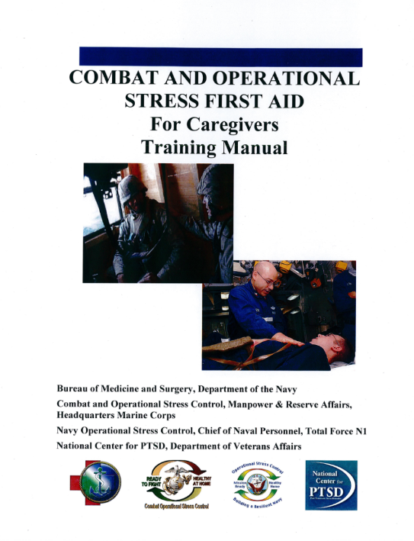
Stress First Aid Iterations
First created for the Marines Corps and Navy, Stress First Aid has since been adapted for:
Railway workers
Wildland
Law Enforcement
Probation
Hospitals
Notes:
Stress First Aid Model Iterations
Stress First Aid and Curbside Manner were adapted from the Stress and Combat Operational Stress First Aid model for Marines Corps and Navy personnel. The Schwartz Center for Compassionate Healthcare is working with the National Center for PTSD to adapt a model of Stress First Aid for healthcare workers.

Slide 6
Why Implement Stress First Aid?
To support the mental and physical health and wellbeing of the workforce
To reduce risk of:
  Stress injuries among healthcare workers affecting sense of purpose, team and unit cohesion
  Stress injuries impacting patient care experiences, quality, and safety
  Chronic stress and related chronic health conditions among healthcare workers
  Absenteeism and presenteeism due to disaffected, burned out, disengaged workforce
Notes:
Why Implement Stress First Aid
In addition to creating positive, caring and compassionate cultures, SFA fosters longevity on the job. In potentially stressful work environments, the value of reducing the impact of stress translates into a stronger workforce, less turnover, more productivity, and less likelihood of employees leaving the job prematurely.
SFA can help reduce the stigma of reaching out for help by changing organizational culture. When SFA is included in orientation and training from the start of one's career, acknowledgement of stress and stress reactions becomes a matter of fact. SFA creates a common language with which to discuss stress and stress reactions in an efficient way and is a common sense approach that reduces stigma.
SFA addresses stress reactions before they create larger problems that can derail health, relationships, or a career.

Slide 7
Potential Sources of Distress in Healthcare
Burnout
Emotional exhaustion, cynicism, lack of self-efficacy
Empathic Distress
Feeling overwhelmed by the pain and suffering of others
Moral Distress
Behaviors or witnessing behaviors that violate moral values
Grief & Loss
Loss of cherished people, things, aspects of self, activities
Physical Illness
Physical fatigue, loss of function, fear of infection and infecting others
Abandonment
Lack of adequate supplies, resources, perceived leadership indifference
Notes:
Potential Sources of Distress in Healthcare
Burnout: Emotional exhaustion, cynicism, lack of self-efficacy
Empathic Distress: Feeling overwhelmed by the pain and suffering of others
Moral Distress: Behaviors or witnessing behaviors that violate moral values
Grief & Loss: Loss of cherished people, things, aspects of self, activities
Physical Illness: Physical fatigue, loss of function, fear of infection and infecting others
Abandonment: Lack of adequate supplies, resources, perceived leadership indifference

Slide 8
The Stress Continuum Model
READY
Description:
Optimal functioning
Adaptive growth
Causes:
Health & wellbeing
Positive social environment
Resources
Features:
At one’s best
Well-trained and prepared
In control
Physically, mentally and spiritually fit
Mission-focused
Motivated
Calm and steady
Having fun
Behaving ethically
REACTIVE
Description:
Mild transient distress/impairment
Low risk, resolves
Causes:
Any personal or professional stressor
Features:
Irritability
Feeling anxious or down
Loss of motivation
Loss of focus
Difficulty sleeping
Muscle tension or other physical changes and somatic symptoms
Not having fun
INJURED
Description:
More severe, distress or impairment
Leaves a scar
Higher risk
Causes:
Traumatic injury
Grief injury
Moral injury
Fatigue injury
Loss of control
Features:
Panic, rage, intense anxiety or depression
No longer feeling like normal self
Excessive guilt, shame or blame
Substance use
Misconduct
ILL
Description:
Clinical mental disorder
Unhealed stress injury
Persistent impairment
Causes:
PTSD
Depression
Anxiety
Features:
Symptoms persist and worsen over time
Severe distress
Social and occupational impairment
Notes:
The Stress Continuum Model
The Stress Continuum Model was developed as a visual tool for assessing an individual’s stress experiences, zones of stress, and stress responses. It forms the foundation for Stress First Aid. It also indicates that four possible types of stress “injury,” might move a person from the Yellow Zone to the Orange or Red Zones. These causes of stress include significant trauma, grief or loss, inner conflict from moral injury, and long-term chronic stress, or “wear and tear.”
Stress responses lie along a spectrum of severity and type – from transient and mild to chronic and debilitating. The continuum has four zones: Red (Green), Reacting (Yellow), Injured (Orange), and Ill (Red). It is important to note that 100% of people will react when faced with significantly stressful experiences. However, the way in which they respond will depend on many factors, including how prepared they are for the stressor and how they interpret it. A person’s reaction can fluctuate relatively rapidly from Green to Yellow to Orange to Red and back again.
This model acknowledges that within this range of reactions to stress, a person can go from being in optimal functioning, feeling good, mentally and physically fit, mission focused, calm, and motivated into what’s called a Yellow Zone where they’re having more stress reactions, but the stress reactions are mild and/or transient, and always go away. In the Yellow Zone a person can feel more irritable, anxious, or down, have a loss of motivation, loss of focus, have trouble sleeping, or have muscle tension or other physical changes, but these are transient reactions.
Once a person gets into the Orange Zone it’s usually caused by an accumulations of different types of stressors or a pretty severe stressor. In the Orange Zone you start to see more severe and persistent distress or impairment, the person doesn’t feel like themselves, or they have a loss of control of their stress reactions. They might feel strong panic, depression, rage, guilt, or blame. In this zone it starts to feel like the stress “leaves a scar,” and the person is at high-risk for having trouble functioning and/or strong or persistent distress.
The Red Zone is usually reserved for diagnoses like PTSD, depression, anxiety, or substance-use disorder. What signifies a person being “Red Zone” is that their symptoms are persistent or worsen over time. The person experiences severe distress, and may have significant difficulty functioning at work or in their home life.
The SFA Model was designed to help people move from the Red and Orange Zones back to the Yellow or Green Zones as soon as possible.
The ethos in many high stress work cultures has been that after a difficult event, one should be able to “tough it out.” This is still the case in many settings, where the stigma associated with reacting to stress or stress injury behaviors is very real and people will try to conceal stress reactions from supervisors to avoid medical or psychological intervention.
However it is usually not possible to keep these behaviors hidden for long from family members, coworkers, and friends. When a coworker recognizes that someone is in trouble it is important to break the code of silence. Getting this individual connected with the next level of help as soon as possible may help prevent their reaction from progressing into the Red Zone. And once an individual has moved into the Red Zone, the goal is to help get them into treatment as soon as possible.

Slide 9
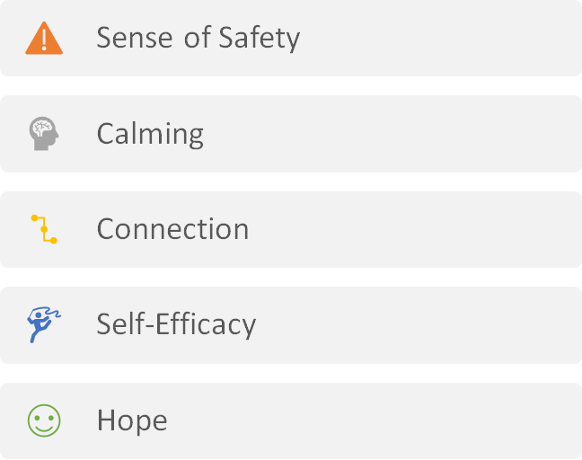
Key Factors that Promote Recovery from Adversity and Stress
Hobfoll E, et al. Five Essential Elements of Immediate and Mid Term
Mass Trauma Intervention: Empirical Evidence. Psychiatry. 2007;70(4):283-315.
Notes:
Key Factors that Promote Recovery from Adversity and Stress
Systematic reviews by mental health experts and traumatologists indicate that five essential factors promote recovery from adversity and stress. These include a sense of safety, calming, connection with others, self-efficacy and hope.

Slide 10

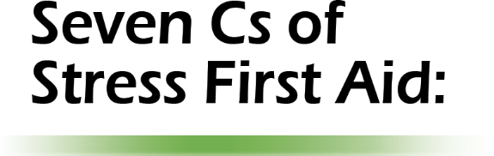


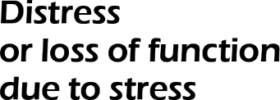
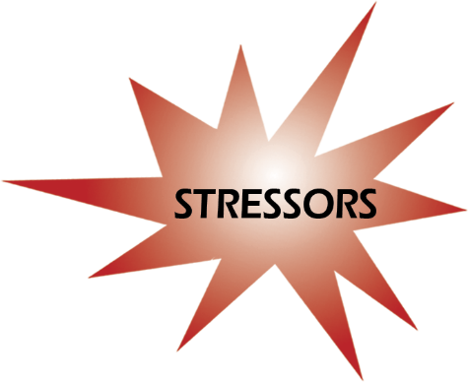









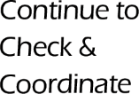



Stress First Aid Model
Notes:
The Stress First Aid Model
The Stress First Aid Model maps onto the five essential elements in the prior slide. The goal of SFA is to move people towards wellness.
Ask the audience how many are CPR certified, and how many have actually performed CPR to save a life. Then ask how many in the last 30 days have interacted with someone who was having a strong stress reaction or possible stress injury? Note that, if the organization should invest time and energy for responding to a relatively rare experience, they should probably spend at some time learning how to respond to an everyday, common, and arguably, just as lethal an experience.
The SFA model always starts with some stressor, which can occur at work or in the person’s personal life. However, a stressor alone is not usually sufficient to consider Stress First Aid. It has to be accompanied by evidence of either distress or loss of function due to that stressor.
Note that, because of this condition, SFA is similar to CPR in it’s first two core actions, Check and Coordinate.
In CPR training, you are instructed to first recognize that something might be wrong. Next you are instructed to say, “Are you ok?” If the person responds appropriately, you don't do CPR.
Similarly, with Check, you observe over time to determine if a peer may be in trouble. Check involves observing, paying attention, and checking in on peers on a regular basis, so that you know both their baseline functioning and behavior. In this way, you'll be prepared to notice any changes in behavior or functioning.
Then, if you do notice changes, you will find a way to ask, “Are you ok?”
In CPR training, if a person is not OK, you do a quick Airway, Breathing, and Circulation check and then yell, “Call EMS” to get help. Similarly, with Coordinate, you may have to see if someone else can assist, if needed.
Coordinate involves always being aware of additional resources that you may need to refer to if your SFA actions aren’t sufficient to make a difference in alleviating stress reactions.
In addition to these two continuous actions, the five key factors on the previous slide have been adapted for the SFA model. The core actions of Stress First Aid are based on these five key factors, but each factor now starts with the letter “C” in order to make it easier to remember:
Safety is now Cover. If there is a physical safety risk or the person’s own perception of risk is endangering their well-being, you act to make sure the person is safe or feels safer (cover).
Calm stays the same. In addition to checking and addressing sense of safety, you also assess if they are calm, and act to reduce distress if they are not. We know that people with post-stress elevated HR, respiration, and BP show greater risk for long term health and mental health problems. This is where calming reduces the risk for further stress reactions.
Connect stays the same. We may also assist by facilitating connectedness. In fact this may be all that is needed to reduce stress.
Self-Efficacy is now Competence. This involves helping a person build or regain their competence for coping and functioning. In some situations, it may involve helping a person gain new skills or refresh previous training.
Hope is now Confidence. Actions to build a stress-affected person’s confidence may be needed. They may have lost confidence in self, peers, or leaders. Or they may have lost hope and faith in a positive future.
Note that in some people, stress reactions can be delayed so those implementing SFA should be ready to respond in the future if stress injury behaviors emerge over time.

Slide 11
Essential SFA Skills
Recognize
Recognize when a coworker has a stress injury
Act
If you see something, say something
To the distressed person
To a trusted support of the distressed person
Know
Know at least 2 trusted resources you would offer to a coworker in distress
Notes:
Essential SFA Skills
There are three essential SFA skills
Recognize: Pay attention to signs of stress reactions in yourself and others. Recognize if stress reactions are in the Orange or Red Zone on the Stress Continuum
Act: If you see something, say something
To the distressed person (always try to communicate with the distressed person first)
To a trusted Support (If communicating with the distressed person is not within your role then coordinate with a trusted other)
Know: Know at least 2 trusted resources you would offer to a person in distress. This is where you need to know your organization and community resources.
Remember that SFA is both a coworker support and a self-care model. It can and should be used to both support coworkers and increase your own self-awareness and improve your early recalibration in response to stressors in your life.

Slide 12
How Can You Use SFA?
 | Cover | Calm | Connect | Competence | Confidence
Grief |  | X | X
Anxiety | X | X
Guilt/Shame | X | X | X | X
Isolation |  |  | X | X
Sleep Problems |  | X |  | X | X
Severe Inability to Function |  |  |  |  | X
Check:
What is your colleague describing?
What are you observing?
Coordinate:
What approach would best serve needs?
Notes:
How Can You Use SFA?
This slide shows the actual flow of Stress First Aid. It is not a linear process as might be implied in prior slides. SFA actions are chosen based on need, and one or more actions can be used for each stress reaction.
One always starts with CHECK - either through your own observations or after being informed about a high risk event, signs of distress, or changes in functioning in a coworker. Then you begin by approaching the person to make contact first, and to gather information that helps you make a decision about what to do based on the information you gathered.
Your actions should be based on the person’s stress reactions. This chart is not meant to be a prescription, but rather, to offer some examples.
For example, for the stress reaction of grief you could use a number of SFA core actions including Calm and Connect.
For each of the stress reactions, there could be any number of SFA actions that would be appropriate, depending on the context, so you have the opportunity to tailor your response to the needs of the person and the context.
SFA is not one-size-fits-all. More than one core action can fit different stress reactions, so the decision of how to act will depend first on what type of stress reaction a person is experiencing, but also on a number of other factors, including:
How much time do you have to spend with this person?
What is the nature of your relationship?
Which action would bring the greatest benefit?
Which action would be most acceptable to the person?
Which action would foster the most recovery?
Depending on the symptoms and circumstances, you may also be utilizing more than one SFA action concurrently. It is important to keep an open, flexible stance towards Stress First Aid and use it as a framework for remembering the factors that should be considered when someone is exhibiting moderate to severe stress reactions.

Slide 13
Check Actions
Observe
Look
Keep Track
Stressors
Explore
One-to-one interactions
Decide
Dangerousness
Listen
Distress
Changes in functioning
Response to SFA Actions
Collateral information
Stress Zone
Needs
Notes:
Check
The action of Check is different in that it is not triggered by certain situations, but rather should be an ongoing process. This is because people may be unaware of their stress zones and needs, or may not recognize the ways that stress has impacted their lives. Even if the person affected by stress recognizes distress or changes in functioning, the stigma that surrounds such problems can be a powerful barrier to seeking help.
Both the stress zones of individuals and the resources available to help can change drastically over time. A continuous process of assessment is often the only way to match needs with appropriate levels of help each step of the way.
It is also important to remember that the after-effects of stress injuries can be delayed by weeks, months or even years. Those who have been seriously affected by stress at any one point in time will need to be periodically followed up with and reassessed.
The first and most important procedure of Check is to observe: to look, listen, see and hear what is going on with the stressed individual, noting how he or she is being affected and by what. This is not meant to be an intrusive process, but one of awareness and caring.
While looking and listening, it is important to keep track of the key indicators of the Stress Zones that we will learn about shortly. Special attention should be paid to stressor events (both at work and on the home front) and the internal distress and changes in functioning that these events (or their accumulation over time) may provoke. If SFA actions have already been used, we need to keep track of whether or not they have been effective.
Observing from a distance is not usually enough to really get to know others. By explore, we mean talking one-on-one to the person we’re checking and, when appropriate, asking about how he or she is feeling and functioning. We can also gather information from other sources that might be helpful, including from peers and family members.
The final component of Check is to decide on helpful SFA actions based on this information. We must also decide in every case whether anyone is in danger, and make decisions about Stress Zones and the need for further care.
Check often begins with awareness that an individual has been exposed to specific stressors. These stressors may be discrete events, personal or family life difficulties, or challenges to one’s value systems. Sometimes these stressors may also be an accumulation of small and seemingly insignificant challenges that can add up over time, and have a sizable impact on an individual's stress level.
However, exposure to stressors is not enough to warrant SFA or other direct aid. Most people who experience even intense stressors don’t need help. What triggers the sequence of Checks that initiate SFA are not the events themselves but indications that someone who has been exposed to these events is operating in the Orange Zone.
Then, ask yourself “What are the individual's physical, mental, social, and spiritual needs?” Depending on the answer, it may be appropriate to use Connect, Confidence and Competence, and to identify what resources to mobilize on this person’s behalf, and who else needs to know.

Slide 14
Coordinate Actions
Collaborate
To promote recovery
Inform
Supervisor(s)
Refer
Recommend resources
To ensure safety
To get more information
Coworkers
Family
Consultation
Direct hand-off
Notes:
Coordinate
The next core action of SFA is Coordinate, which should come naturally to you. Within SFA, providers consult and collaborate with others, and inform those who need to know. The key components of the Coordinate action are:
To collaborate with everyone who has a stake in the well-being and future of the stressed individual.
To get assistance from others at any step in the process in which help is needed to assess and care for individuals with stress problems.
To inform supervisors, managers and chairs or chiefs to the extent they need to know.
To refer individuals in need to others who can help either in a direct hand-off or through a more gradual consultation process.

Slide 15
Cover Actions
Stand By
Ready to assist
Make Safe
Authoritative presence
Make Others Safe
Protect
Encourage Perception of Safety
Caring presence
Watch and listen
Hold attention
Warn
Protect
Assist or refer
Warn
Listen and communicate
Reduce chaos
Reduce danger
Notes:
Cover
To provide Cover means to ensure ongoing safety, usually performed more for others more than yourself. The components of Cover involve:
Standing by a coworker and remaining available and ready to assist as needed, watching and listening for ways you might intervene if needed, or holding the person’s attention if they are overwhelmed or panicky.
Making the person safe in any way you can, including by being an authoritative presence, by warning the person, by protecting the person physically or psychologically, or by assisting the person.
When necessary, Cover may also involve making others safe from an individual if he/she is not functioning well because of stress reactions. This may entail protecting them physically or warning them about possible dangers that might result because of the stressed individual’s actions.
Encouraging a perception of safety occurs in the long term for affected individuals by offering a caring presence, listening to feedback, communicating transparently about what's known and unknown during an emerging event, about organizational safety, leadership commitment to psychological safety, striving to maintain the highest care quality standards and resources, and by attending to worker fatigue and burnout.

Slide 16
Calm Actions
Quiet
Stop physical exertion
Reduce hyper-alertness
Slow down heart rate
Relax
Compose
Draw attention outwards
Distract
Re-focus
Foster Rest
Recuperate
Sleep
Time out
Soothe
Listen empathically
Reduce emotional intensity
Notes:
Calm
This slide shows the major components of the next SFA action, Calm. You may notice there is some overlap between the concepts that make up Cover and Calm. Procedures that promote one of these two actions often also help with the other.
The major difference is that while the goal of Cover is safety, Calm’s goal is to reduce the intensity of physiological, emotional and behavioral activation.
The first and most basic procedure of Calm is simply to stop, quiet, and cease physical exertion if possible. Some examples of this are to sit down or lie down, put down any items and relax, with the goal of slowing heart rate.
Regaining composure will help to restore cognitive function. The word “compose” means to help to pull back together that which is scattered or fragmented into a more orderly and coherent state. In the Calm function of SFA, we help people compose by drawing their attention away from their frightening and chaotic inner thoughts and feelings, and refocusing them in a calming way.
The next component of Calm is simply to rest—including sleep--for as long as is necessary to return to baseline levels of arousal and physical and emotional function. Pay particular attention to the sleep of a stress-injured person. Sometimes a good night’s rest is the only thing that will restore a stress-injured person to baseline mental and emotional functioning, so make sure they actually get to sleep.
The final component of Calm is soothing, which means to reduce the intensity of destructive emotions like fear and anger, by providing a calm physical presence and listening empathically.

Slide 17
Connect Actions
Be With
Maintain presence
Promote Connection
Find trusted others
Reduce Isolation
Improve understanding
Keep eye contact
Listen
Empathize
Accept
Initiate support huddles and group activities
Encourage contact with others
Correct misperceptions
Restore trust
Invite and include
Notes:
Connect
This slide shows the three components of the next SFA core action, Connect. As with all SFA actions, these components are designed to be adapted to fit your setting, your personality and the needs at that time of the individual experiencing a stress reaction.
The first component is to simply be with the stress-injured person. This means being present, making eye contact, listening and/or mentoring and empathizing.
The next component is to comfort. This implies accepting the person and his or her reactions, providing encouragement if that is what is needed, or soothing in a way that fits your style and is acceptable to the individual.
The final component is to reduce the stress-injured person’s sense of isolation, which can often occur when Orange Zone reactions make the individual want to isolate, or when he or she feels shame about what is happening. Assisting in such a case may involve helping to improve the person's understanding of the situation and of stress reactions. Often, the SFA provider must help the person to see that stress reactions are frequent, understandable and acceptable.
This component also involves correcting misperceptions that will reduce the stressed person's alienation and isolation. This includes clearing up those held by the stress-injured person about his or her own stress reactions, as well as those held by others. Doing so will effectively restore the individual's trust in him or herself, and restore trust in others. In its simplest form, you can help reduce isolation by simply inviting and including the stress-injured person into department or team activities.
Research has shown that many people who are experiencing significant stress respond well to being included in an activity, having casual friendly encounters or receiving help and information in strictly practical way rather than directly discussing emotional problems or reactions. This is particularly true among those whose coping style involves suppression of emotions. Emotional support brings adverse events to their attention again. Individuals suffering from post-traumatic stress may prefer to keep away from this type of emotional support, especially in work contexts.
These Connect strategies are designed to help the stress-injured individual feel that he or she is not alone, that there are caring others around and ways to stay connected to others. As was previously mentioned, social connectedness is one of the strongest protective factors against stress injury, and is linked to emotional well-being and recovery following traumatic stress and loss.

Slide 18
Competence Actions
Occupational Skills
Improve occupational skills to reduce risk of stress reactions among staff in settings new to them:
Well-Being Skills
Re-establish or learn new skills to deal with stress-reactions:
- Calming
- Problem-solving
- Health and fitness
Social Skills
Re-establish or learn social skills to deal with stress-reactions:
- Requesting support
- Conflict resolution
- Seeking mentoring
- Assertiveness and advocacy
- Train
- Retrain
- Reassign
- Mentor back to duty
- Managing trauma and loss reminders
Notes:
Competence
The Competence action focuses on enhancing and restoring individual capacities to function and perform in all important life roles, including occupational, personal, and social domains. The term “Competence” is really shorthand for “help restore previous capabilities” or “cultivate sense of personal competence.” In some cases, this may involve retraining or augmenting previous skills.
The need for Competence is usually signaled by the awareness that inexperience can cause stress, or that there is evidence of Orange or Red Zone stress reactions that might require re-establishment or learning of new skills to deal with stress reactions. This SFA action focuses on building or fostering skills that will either prevent or reduce stress reactions.
We know from the research literature that increasing Competence:
Improves functioning and individual as well as group morale.
Reestablishes the confidence of others in the stressed individual.
Helps to overcome injury to mind, body and spirit.
Builds resilience.
The first component is to augment occupational skills that either have contributed to stress reactions, or that may have been damaged by stress injury. This may require mentoring, respite, and retraining for the stressed individual to feel capable again and to once again gain self-esteem from his or her work. SFA can be employed for stress-related injuries that impair abilities on the job. To grow out of stress-induced decrements in functioning may require enhancing existing capabilities or developing new ones, much in the same way that physical therapy is used in physical rehabilitation,
The next component is to foster the development well-being skills that can help the stressed individual establish calming, problem-solving, health and fitness, and management of trauma and loss reminders, to restore and improve abilities to cope with life’s challenges.
The last component of Competence is to improve social skills to deal with stress reactions. These skills are often damaged by stress or may become necessary when a person is dealing with stress reactions.

Slide 19
Confidence Actions
Trust in:
Self-forgiveness
Belief in self
Meaning
Sense-making
Peers
Equipment
Leaders
Mission
Forgiveness of others
Imagining the future
Accurate self-concept
Self-respect
Purpose
Faith
Self-Worth
Hope
Trust
Notes:
Confidence
The final SFA action is Confidence, originally derived from the literature on “hope.” There is a lot of overlap between Competence and Confidence, because when individuals feel more competent to handle what is in front of them, they usually feel more Confident and hopeful.
What distinguishes Competence from Confidence is that Competence actions often involve training or mentoring in skills building, whereas Confidence actions are aimed at affecting or altering inner states or thoughts that an individual with stress injury may be having.
Confidence actions are intended to:
Promote realistic hope and build self-esteem that may have been damaged or lost as a result of stress.
Promote confidence in core values and beliefs.
Bolster pride and commitment.
This slide shows the four components of Confidence:
The first Confidence component is rebuilding trust, which can include trust in peers, equipment, leaders, oneself or mission.
The second component is rebuilding hope, which is often the result of forgiving self or others, or being able to imagine the future in a positive way.
The third component is aimed at rebuilding self-worth, which includes belief in self; an accurate and mostly positive self-image; self-respect or a thinking process that taps a sense of agency or will; and the awareness of the steps necessary to achieve one’s life goals.
The fourth component is aimed at rebuilding or facilitating meaning-making, which includes the process of making sense of life; having a sense of purpose or faith; holding a spiritual perspective related to the human condition; or a belief in something larger than oneself and/or a higher power who will intervene on the person’s behalf.
All of these functions lead to a sense of confidence – in the self, in others, in life or in spiritual sources of solace

Slide 20
Key Point Emphasis
Tone is collaborative, experimental, non-judgmental
Timing and context are important
SFA is not meant to address all ranges of issues
Flexibility and “tiny steps” are emphasized
Mentoring and problem solving are highlighted
Bridge to higher care when indicated
Notes:
Key Point Emphasis
Some key points to emphasize about implementing SFA include:
The tone of any interaction is collaborative, experimental, non-judgmental. It should always fit your personality and style, and should look different for each person who implements it and within each context it’s implemented in.
The timing and context are important – what you can achieve with any interaction depends on how much time you have, where you are, how open a person is to hearing what you have to say, and how long after the incident the conversation takes place.
SFA is not meant to address all ranges of issues – it is a first aid model, and not meant to deal with lifelong problems, personality issues, serious mental health issues, or complex problems that would require more intensive interventions.
Flexibility and “tiny steps” are emphasized – giving a person a sense of accomplishment by breaking down issues into small, manageable actions. Being flexible on the advice you give makes it more likely the stressed person will experience a sense of connection and accomplishment.
Mentoring and problem solving are highlighted – your role is to provide support and possible assistance helping someone get back on their feet and manage the tasks that might seem overwhelming to them when they’re under a lot of stress.
Bridge to higher care when indicated – always think in terms of referring a person on to EAP or local mental health providers if they are having difficulty adjusting and experiencing strong stress reactions. Effective treatments are available and being a bridge to that care may be your most helpful SFA action.

Slide 21

Next Steps
Form a Support Team
Join a Train the Trainer Cohort
  Create an Implementation Plan
  Train Staff
  Access Ongoing Support
Notes:
OPTIONAL GROUP DISCUSSION
Facilitate a discussion with the participants. The goal is to have participants identify what adaptations of the SFA model need to be made to make it a better fit locally, potential obstacles to using SFA, and next steps.
Ask:
What adaptations need to be made to SFA to make it a better fit with local culture?
What are potential obstacles to rolling out SFA?
What policy recommendations would you make to better support and preserve law enforcement personnel from the effects of stress injuries?
What are next steps in the 6 months ahead?

